Slide 1
Alternatives to the Medical Model
Key Study: Szasz (2011)
The Myth of Mental Illness: 50 Years Later
Prep questions: 24 marks
Explain 2 key points in Szasz’s argument [2+2]
Explain 2 reasons Szasz gives that the medical model is unacceptable. [2+2]
Outline how patients with a mental illness would be treated under the medical model. [3]
Outline how patients with a mental illness would be treated by Szasz. [3]
Referring the research by Gottesman and the theories of Szasz, explain the reductionism / holism debate. [10]

Slide 2
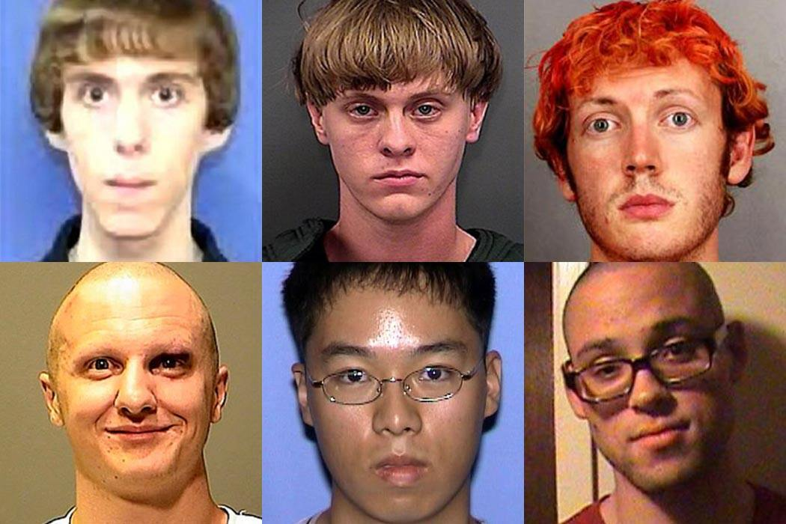
If neuro-scientists discovered that
If neuroscientists discovered that mass murderers had different brain chemistries from other people,
would you accept this as evidence that they suffered from a mental illness/brain disorder ?

Slide 3

If neuro-scientists discovered that
People who claim that they are Jesus had different brain chemistries from other people,
would you accept this as evidence that they suffered from a mental illness/brain disorder ?

Slide 4
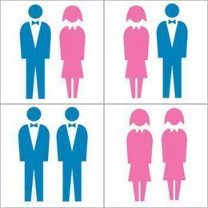
If neuro-scientists discovered that
homosexuals had different brain chemistries from heterosexuals,
would you accept this as evidence that they suffered from a mental illness/brain disorder ?

Slide 5

If neuro-scientists discovered that
nuns had different brain chemistries from everyone else
would you accept this as evidence that they suffered from a mental illness/brain disorder ?

Slide 6

If neuro-scientists discovered that
married men had different brain chemistries from bachelors
would you accept this as evidence that they suffered from a mental illness/brain disorder ?

Slide 7
If neuro-scientists discovered that
If neuroscientists discovered that mass murderers had different brain chemistries from other people,
MOST WOULD ACCEPT THIS PROVES THEY HAVE MENTAL ILLNESS / BRAIN DISORDER

Slide 8
If neuro-scientists discovered that
People who claim that they are Jesus had different brain chemistries from other people,
MOST WOULD ACCEPT THIS PROVES THEY HAVE MENTAL ILLNESS / BRAIN DISORDER

Slide 9
If neuro-scientists discovered that
homosexuals had different brain chemistries from heterosexuals,
FAR FEWER WOULD ACCEPT THIS PROVES THEY HAVE MENTAL ILLNESS / BRAIN DISORDER

Slide 10
If neuro-scientists discovered that
nuns had different brain chemistries from everyone else
VERY FEW WOULD ACCEPT THIS PROVES THEY HAVE MENTAL ILLNESS / BRAIN DISORDER

Slide 11
If neuro-scientists discovered that
married men had different brain chemistries from bachelors
NO-ONE WOULD ACCEPT THIS PROVES THEY HAVE MENTAL ILLNESS / BRAIN DISORDER

Slide 12
So ….
People, including psychiatrists, are willing to attribute behaviour to mental illness/brain disorder to the extent that they disapprove of that behaviour, and are unwilling to do so to the extent they approve of, or tolerate, that behaviour

Slide 13
Key research: Szasz (2011)
The myth of mental illness:
50 years later
https://www.youtube.com/watch?list=PL79E9D68C92C00DAC&index=10&v=zQegsqYhuZE&feature=share&app=desktop
https://www.youtube.com/watch?v=Qj7GmeSAxXo&feature=youtu.be

Slide 14
Mental illness as a myth
Thomas Szasz wrote an essay in 1960 that detailed the myth of mental illness.
In it he claimed that treating mental illness as a medical condition was wrong, and that people with mental ‘illness’ were just people behaving differently.
The need to treat these illnesses was simply to make society feel more comfortable rather than actually help the patients themselves.
In this study Szasz reviews his comments in 2010.
Notes:
[CE] Bullet points appear on a click

Slide 15
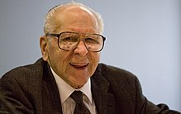
Mental health 1960s
Health care for mental health consisted of mental hospitals and private professionals
Mental patients are treated no better than prisoners. Patients have few rights – e.g. held against their will
Mental illness is not the same as physical illness
Mental illness doesn’t exist, so it is foolish to look for causes or cures
Notes:
[CE] Bullet points appear on a click

Slide 16
Mental health 2010
All mental health care is provided by the NHS and the aim is to prevent danger to patients and others
A false belief that is seen in research is that mental illness can be diagnosed accurately and treated successfully
Mental illness is seen as being a disorder of the brain, despite there being no scientific evidence that it is caused ONLY by the brain
Mental disorders are labels given to undesirable behaviours
Doctors don’t see people as inherently bad, but if they perform negative behaviours, it is a result of their mental illness
Consent for treating mental illness does not happen
Medical treatments should not be used to treat mental illness. People need to be helped to overcome obstacles and treated with respect.
Notes:
[CE] Bullet points appear on a click

Slide 17
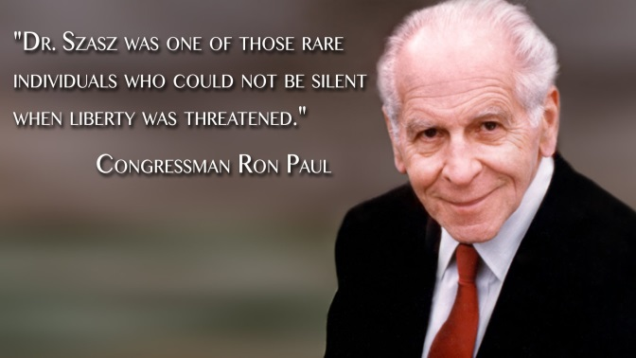
The key points in Szasz’s argument
Mental illness is a myth, not a disease that can be scientifically proven.
Medical model is now the only way of dealing with people who behave differently.
Government decides what illnesses exist, control all regulation and funding.
Mental hospitals are more like prisons to control peoples’ behaviour.
Notes:
[CE] Bullet points appear on a click

Slide 18
The key points in Szasz’s argument
Economic issues – big business in pharmaceuticals and treatments to treat mentally ill.
Mentally ill people are actively trying to cope in the world using whatever coping mechanisms they can. They are not passive players to biological forces.
People are being deprived of the freedom to behave in the way they choose on the grounds of having a disease. This also has implications for ‘insanity’ as a defence.
We need to try to understand the reasons for a person’s actions by respecting, understanding and helping them, not diagnosing under a loose fitting definition.
Notes:
[CE] Bullet points appear on a click

Slide 19
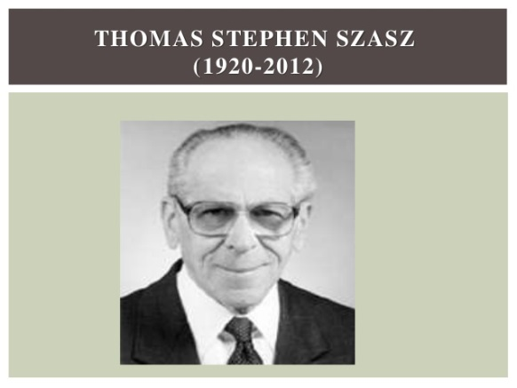
Reasons Szasz gives that the medical model is unacceptable
The causes of mental illness: there is no identifiable cause like an infection, or nutritional deficiency. It is a way of coping. It is a mistake to keep looking for biological causes.
Notes:
[CE] Bullet points appear on a click

Slide 20

Reasons Szasz gives that the medical model is unacceptable
No alternative legal approach – government has become involved. Mental illness is not based on scientific research
Notes:
[CE] Bullet points appear on a click

Slide 21
Reasons Szasz gives that the medical model is unacceptable
It denies people freedom and responsibility to choose how to behave. They are coerced and forced into diagnosis and treatment. This is unethical.
Notes:
[CE] Bullet points appear on a click

Slide 22
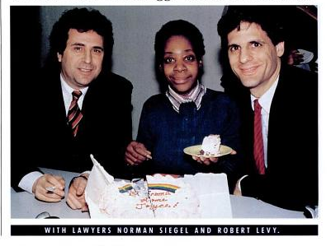

JOYCE BROWN
Remember???
Joyce Brown was living on the streets of New York in 1987 in a wealthy neighbourhood, above a heating duct near a bank and a restaurant. She smelled and frequently abused passers-by. She burned any money she was given. She sometimes soiled herself.

Slide 23
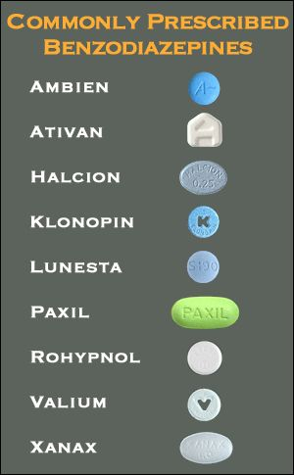
Reasons Szasz gives that the medical model is unacceptable
Medical model is dehumanising, ignores suffering of person. Labels are constructed due to medicalisation of disturbed behaviour.
Alternative ways – understanding the patient, help them help themselves. Medical treatments do not work, only supress symptoms.
Notes:
[CE] Bullet points appear on a click

Slide 24
Alternatives to the Medical Model
The Behaviourist Explanation of Mental Illness

Slide 25
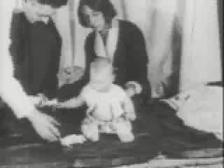
PSYCHOLOGICAL EXPLANATIONS OF PHOBIAS
Behavioural Model: Starter Activity

Slide 26
Behavioural explanations of PHOBIAS
1 – Classical Conditioning
The Theory – Watson (1920) claimed that most emotional responses including fear of objects are learnt by C.C.
The Evidence – He demonstrated a “rat phobia” in little Albert by pairing a loud bang (UCS) with a white rat (CS) the fear response was generalised to similar stimuli – ??
Evaluation – ETHICS! & Low ecological validity, i.e. evidence does not show that all “real life” phobias happen this way. DiNardo (1988) found over half of “dog phobic's” could recall being bitten (but what about the rest?), However half of those who reported been bitten did not go onto develop a phobia of dogs, so maybe biological factors also play a role!?

Slide 27
Behavioural explanations of PHOBIAS
2 – The Two Process Theory
Mowrer (1947) the original learnt fear is maintained by operant conditioning. The relief felt by avoiding the phobic object is reinforced by “avoidance learning” (negative reinforcement).
The Evidence – DiNardo’s findings that more than half of those people bitten did not develop a phobia of dogs (maybe because some were not further reinforced?).
Evaluation – Could explain specific phobias but does not work so well with Agoraphobia & Social Phobia.
Also difficult to explain cases when there is no history of contact with the phobic object. (eg: DiNardo’s participants who had not been bitten).

Slide 28
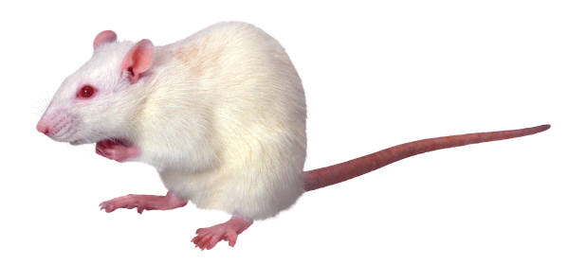
Behavioural explanations of PHOBIAS
3 – Social Learning Theory
Bandura (1986) showed that modelling and observational learning provides a better explanation for many behaviours.
Mineka (1984) found that monkeys could develop snake phobias just by watching another monkeys fear.
Could explain children learning to fear some objects from their parents or role models but in most cases of phobias there is little evidence of this.
Despite this emphasis on behaviour to understand phobias in humans we need to what is going on their minds.

Slide 29
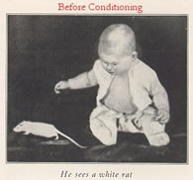
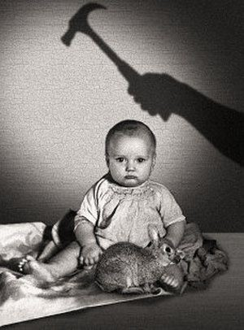
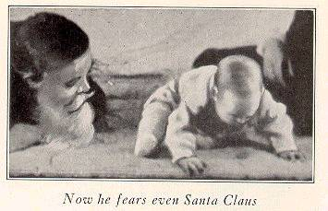
Complete the Activity Phobias & Conditioning.

Slide 30
Alternatives to the Medical Model
The Cognitive Explanation of Mental Illness

Slide 31
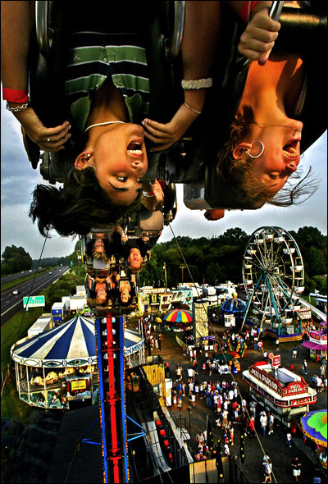
Other Psychological Explanations of Phobic Disorders - Starter
Cognitive
Psychodynamic
RECAP: What are the main assumptions of the above to approaches?
  How would each explain a fear of roller coasters?

Slide 32
Cognitive explanations of PHOBIAS
Cognitive Bias (Beck 1985)
The Emotions we feel are the result of our interpretations of our experiences according to our existing SCHEMAS.
Phobic's are likely to
over exaggerate the negative consequences
under estimate their ability to cope.
show “Catastrophic Misinterpretation”
It’s poisonous !
I can’t escape !
I’m going to die !

Slide 33
Causes: Cognitive Factors
phobics are more likely than nonphobics to believe that frightening events will occur in the future
phobics pay selective attention to threat cues
  research using Stroop task
  must name colour of ink word in which word is printed
  phobics take longer to name ink for threat-related words

Slide 34
Sample Stroop Task #1
blue
green
red

Slide 35
Sample Stroop Task #2
leisure
daughter
fatal
lamp

Slide 36
Sample Stroop Task #3
confident
inferior
drive
phone

Slide 37
Causes: Cognitive Factors (continued)
phobics are more likely to misinterpret ambiguous or neutral situations as threatening

Slide 38
Sample Statements
“They discussed the minister’s convictions.”
“The doctor examined little Emma’s growth.”

Slide 39

Cognitive explanations of PHOBIAS
Evaluation
Better at explaining how phobias are maintained than how and why they appeared in the first place.
Can be applied to Social Phobia and Agoraphobia because of the emphasis on negative thinking about expectations.
They will all laugh at me!
Treatments based on this approach (eg: cognitive restructuring) have proved to be very effective.
Combined with the two process theory this provides best explanation yet but still weak on why some people develop phobias when others in similar situations do not.

Slide 40
Alternatives to the Medical Model
The Psychodynamic Explanation of Mental Illness

Slide 41
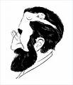
Psychodynamic explanations of PHOBIAS
Freud explained phobias using his idea of Ego Defence mechanisms.
Anxiety provoking thoughts or desires coming from the ID are REPRESSED into the unconscious where the anxiety is DISPLACED onto another neutral object which becomes the subject of the phobia.
In the case of Little Hans the ID’s desire was to kill his father (Oedipus Complex) and the fear of castration was displaced onto horses - the link was big “widdlers”! (see handout for further detail)
Hans phobia was only resolved when he had overcome his Oedipus complex.

Slide 42
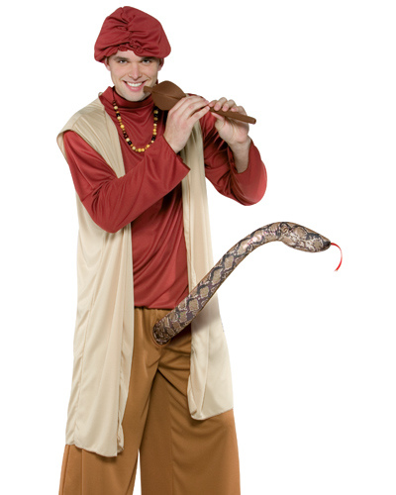
Psychodynamic explanations of PHOBIAS evaluation
Freudian interpretations of snake or spider phobias suggest displacement from an unconscious fear of sexual gentitalia.
However most people with these phobias seem to have a normal sex life.
Using Little Hans as evidence for this theory has many flaws-
not least that other approaches can offer alternative, simpler explanations for Hans phobia. (eg: Behaviourist)
The best evidence comes from therapeutic case studies were the interpretation of the symptoms makes sense in the wider picture of the individual’s problems and their avoidance of conflicts in their lives.

Slide 43
Activity: Phobias – the Psychodynamic View
Complete the above activity regarding Phobias and Symbolism.
Use the handout Psychological Explanations of Phobic Disorders to help you answer the questions at the bottom of the sheet.

Slide 44
Activity & Homework
Use handouts and textbooks to complete a poster presentation entitled Biological & Psychological explanations of Phobias.
Make sure that it is fully evidenced and evaluate using I. D. A’s and Methodology etc.
HOMEWORK: Use the handout 4. “Learning table of explanations of one anxiety disorder (phobias)” to complete the essay : Compare and contrast biological and psychological explanations of one anxiety disorder (25 marks).

Slide 45
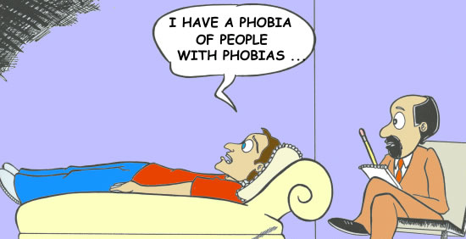
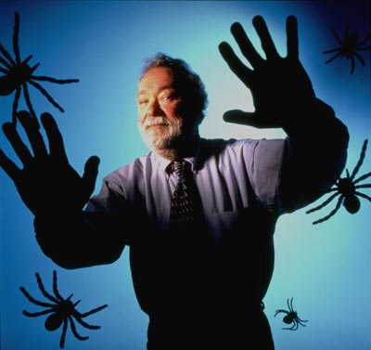
Treating Phobic Disorders
STARTER: Recap Activity
Treatments Crossword

Slide 46
Alternatives to the Medical Model
1 non-biological treatment of 1 specific disorder

Slide 47
Behavioural therapies
The therapies below are based on Classical conditioning principles - learning by association.
Systematic desensitisation- The individual is exposed gradually in a safe environment to their feared stimulus- this is completed whilst the individual is taught relaxation techniques and the fear is then eventually eradicated.

Slide 48
What is a phobia?
An exaggerated fear of an object or situation
According to the learning approach it is a learned response to a stimulus

Slide 49
Remember Little Albert?
UCS
Noise
Fear
UCR
Noise
Fear
UCS
+
NS
UCR
Rat
Rat
CS
Fear
CR

Slide 50




An example in everyday life...
How Ivan became phobic of walking in the forest

Slide 51
Work it out...
UCS
UCR
UCS
+
NS
UCR
CS
CR

Slide 52

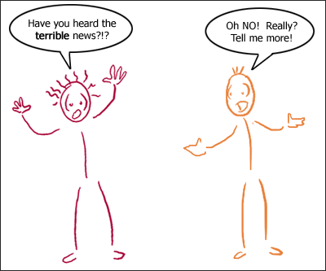
Systematic desensitisation
This therapy aims to extinguish an undesirable behaviour: by replacing it with a more desirable one: .
fear
This called reciprocal inhibition
relaxation
We cannot feel fear and relaxed at the same time

Slide 53
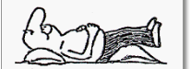




How does it work?
The client learns relaxation techniques
(Relaxation Training)
It is a step by step approach
The client works out a hierarchy of fear from the least frightening to the most frightening (Functional Analysis)
The client works through the hierarchy being bought gradually into contact with the phobic stimulus whilst using relaxation techniques (Graduated Exposure)
Picture of dog
Stroke
Dog
Fur
Dog, but behind screen
Pet Dog

Slide 54
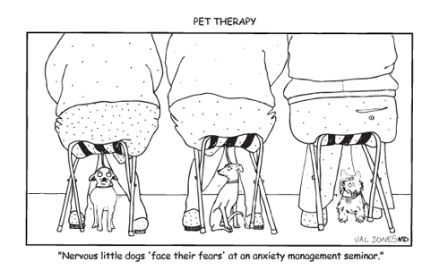
Flooding
An alternative approach to treatment is to use flooding
Intense exposure to the phobic stimulus with no graduated exposure and no opportunity to escape.
The idea is that an anxiety response can only be sustained for a finite amount of time.
After a while the anxiety will subside and the person will relax and learn a new association between the phobic stimulus and the relaxed state.

Slide 55
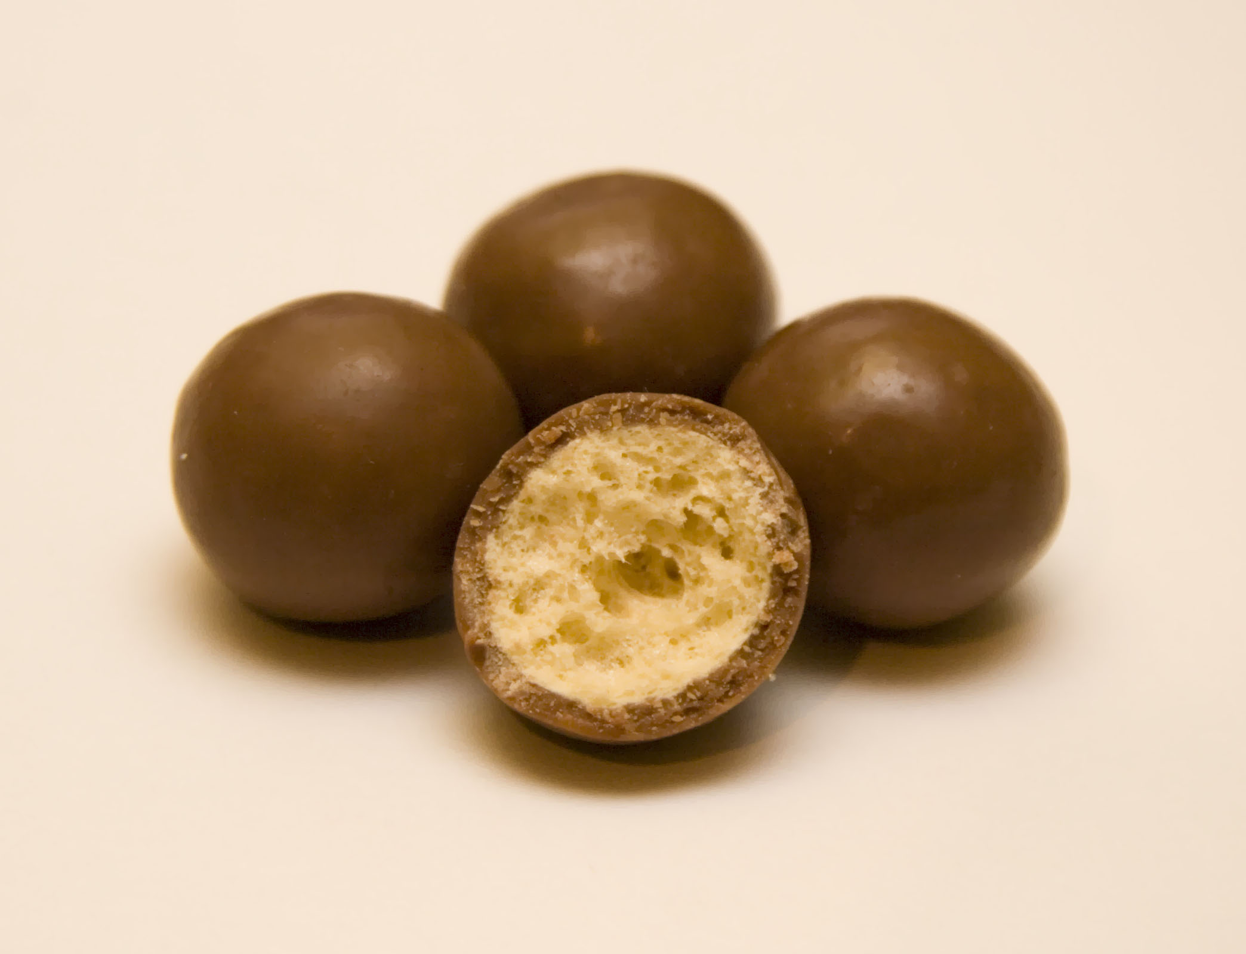
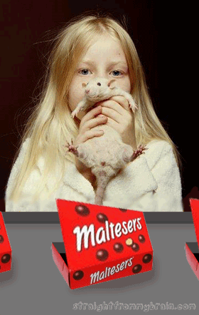
Systematic Desensitisation -V-(Implosion therapy) Activity
I hope that this doesn’t result in you developing a phobia for Maltesers!
With a partner discuss a phobia or fear that either or both of you have.
Construct a hierarchy of fear provoking stimuli.
Close your eyes and work through your hierarchy using the ‘Mindfulness meditation’ relaxation technique.
What are the problems with this implosion technique compared to systematic desensitisation?

Slide 56
Evaluation
SD is effective in reducing the phobic behaviour but it is not always the same than a cure.
Some phobias initially improve but worsen again after a few months
SD & Flooding work better for some phobias than others. Social phobias and agoraphobia do not seem to show as much improvement. Could it be that there are other causes for phobias than classical conditioning?

Slide 57
Appropriateness & Effectiveness
Effective?
SD- Good success rate for those suffering anxiety.
Research shows high level of effectiveness >75% in most trials. (McGrath 1990) – but improvement may be only slight (Craske & Barlow 1993)
Relapse: 50% relapse within 6 months! (Craske & Barlow 1993)
Ohman suggested that Phobias with an evolutionary root (animals, the dark, heights) respond less well to behavioural therapies.
Appropriate?
Quick, less effort required.
High drop out rate.
Ethics-Can inducing stress actually relieve stress?
Avoidance – is a simpler way of dealing with the fear.
All behavioural techniques have roots in behaviourism i.e. learning not always successful as humans and animals react differently, majority of early evidence based upon research carried out using animals.
Relaxation – may not be necessary SD works without that stage. (exposure may be more important)

Slide 58
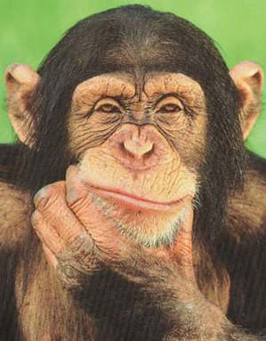

And more evaluation....
It takes variable number of sessions the average is 6-8 but more for stronger phobias
The client has some control over the therapy and that in itself could be helpful in giving a greater feeling of self confidence
Can you think of any other evaluation that deals with the issues debates and approaches?
Write down as many ideas as you can.

Slide 59
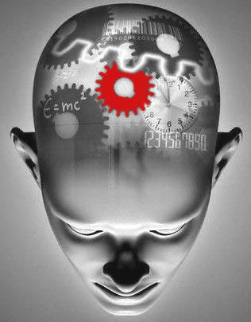
Cognitive Therapies
Starter: Cognitive Errors
A cognitive error is an error in thinking
Read the handout “Cognitive Errors” then identify the following statements ..... Which type of cognitive errors are they?
  “If only I had been there I could have stopped her, she wouldn’t have died”
  “I do the lottery every week I never win, I never win anything..... “
  “Angelina, has everything going for her, beautiful, slim, rich, it’s no wonder I don’t have a job or a boyfriend!”
  “How did you do in your GCSE’s? I hear you got 8 A stars” “ Yes but I only got a C in Maths, which is rubbish”
  “I never fly on planes, I just know that the first time I do, it will crash.... It would be just my luck”

Slide 60
Cognitive Therapies
Cognitive Behaviour Therapy (Aaron Beck)
REBT (Rational Emotive Behaviour Therapy) Albert Ellis
  Rational Humorous Songs included!

Slide 61
Cognitive behavioural therapy
CBT was developed from two earlier types of psychotherapy:
Cognitive therapy, designed to change people's thoughts, beliefs, attitudes and expectations.
Behavioural therapy (also called behaviourism, designed to change how people acted.)
This therapy looks at cognitive errors with the client – but does not directly challenge them. Rather the client is given homework which leads to them challenging their own irrational beliefs – and proving them wrong! Thus changing their beliefs.

Slide 62
CBT usually involves...
Assessment – this may include filling out various questionnaires to help you describe your particular problem.
Person education – the therapist provides written materials (such as brochures or books) to help you learn more about your problem. A good understanding of your problem will help you to dismiss unfounded fears, which will help to ease your anxiety.
Goal setting – the therapist helps you to draw up a list of goals e.g. Less shyness in social settings. You and the therapist brainstorm practical strategies to help fulfil these goals.
Practise of strategies – you practise your new strategies with the therapist. E.g. role-play difficult social situations.
Homework – you will be expected to actively participate in your own therapy for example, the therapist may ask you to keep a diary. You are encouraged to use the practical strategies during your daily life and report the results to the therapist.

