Slide 2
Are you left- or right-brained?
Often one hemisphere is dominant in an individual. Think about the kinds of activities you do – do they match the left or right hemisphere?
Look at the image.
If the dancer is spinning clockwise then you might be right-hemisphere dominant.
If the dancer is spinning anti-clockwise then you might be left-hemisphere dominant.
Look closely – does she change direction? What do you think this means?

Slide 3
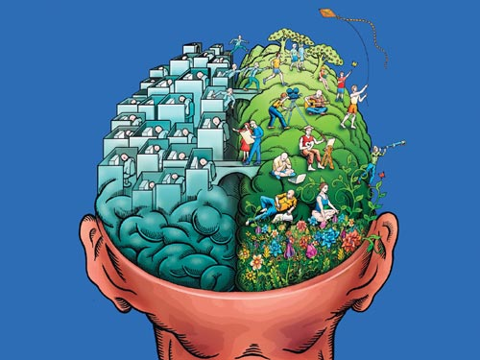
Some background
Our brain is divided into two halves or ………..
Each half is associated with different abilities.
Right hemisphere
Corpus Callosum
Left hemisphere

Slide 4
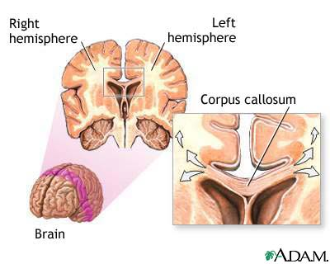
The brain and the Corpus Callosum

Slide 5
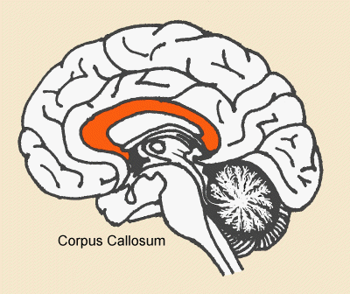
The Corpus Callosum
The Corpus Callosum is responsible for communicating messages from the left to the right hemisphere and vice versa.
The CC is made up of a think bundle of nerve fibres called commissural fibres. These are attached to both the R and L hemisphere.
https://www.youtube.com/watch?v=VHgClWAPbBY

Slide 6
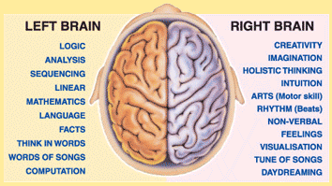
Lateralisation of function
The two hemispheres have different functions from each other.

Slide 7
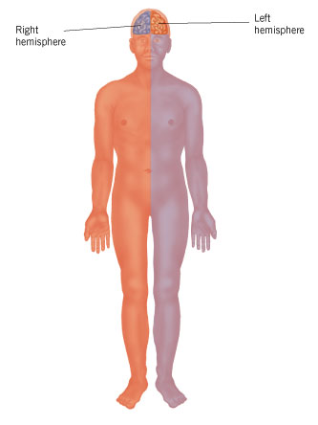
Right and Left hemispheres and the Right and Left sides of the body
Which side of the brain controls the left side of the body?
Which side of the brain controls the right side of the body?

Slide 8
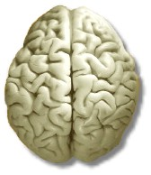
The Biological Area: Sperry

Slide 9
The Biological Area: Sperry
1. Put your hand on your head. Which hand did you use?
Right or left

Slide 10
The Biological Area: Sperry
2. Cross your hands over your chest. Which hand is on top?
Right or left

Slide 11
The Biological Area: Sperry
3. Cross your legs. Which leg is on top?
Right or left

Slide 12
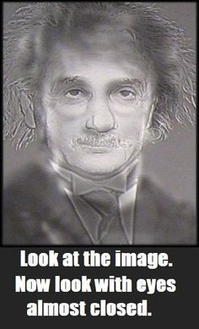
The Biological Area: Sperry
4. Look at this and close one eye. Which eye is still open?
Right or left

Slide 13
The Biological Area: Sperry
5. I'd make a good detective.
Yes / No

Slide 14
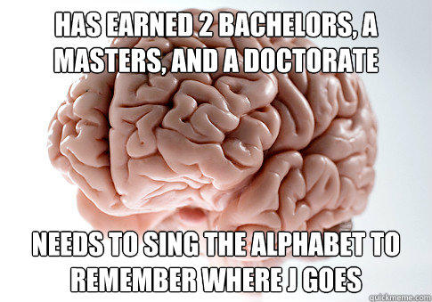
The Biological Area: Sperry
6. If I forgot someone's name, I'd go through the alphabet until I remembered it
Yes / No

Slide 15
The Biological Area: Sperry
7. I frequently let my emotions guide me.
Yes / No

Slide 16
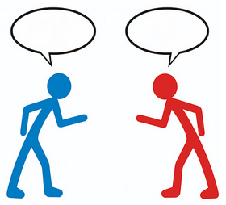
The Biological Area: Sperry
8. In a debate, I am objective and look at the facts before forming an opinion.
Yes / No

Slide 17
The Biological Area: Sperry
9. When somebody asks me a question, I turn my head to the…
Left or Right

Slide 18
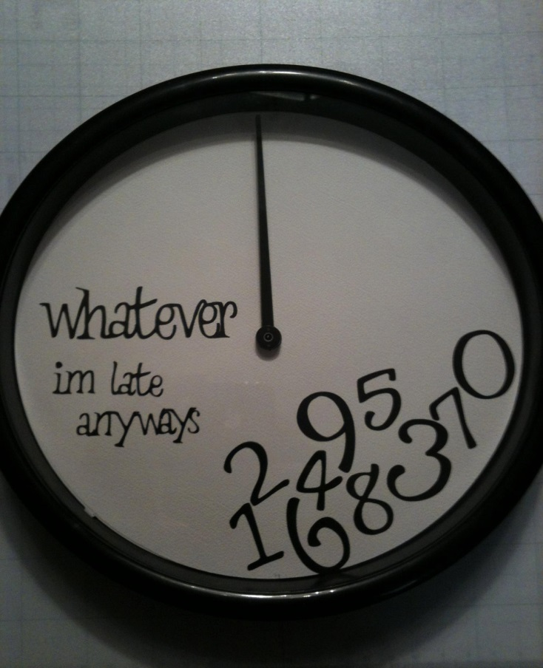
The Biological Area: Sperry
10. People tell me I am always late getting places.
Yes / No

Slide 19
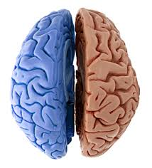
https://www.youtube.com/watch?v=zx53Zj7EKQE
https://www.youtube.com/watch?v=ZMLzP1VCANo

Slide 20
Scoring
Give yourself one point for each time you answered "A" for questions: 1, 2, 3, 7, 8, 9, 13, 14, 15, 19, 20, 21.
Give yourself one point for each time you answered "B" for questions: 4 ,5, 6, 10, 11, 12, 16, 17, 18.
Add all points. Totals imply: 0-4: strong left brain 5-8: moderate left brain 9-13: middle brain 14-16: moderate right brain 17-21: strong right brain

Slide 21
Lateralisation of Function
LEFT BRAIN FUNCTIONS uses logic detail oriented facts rule words and language present and past math and science can comprehend knowing acknowledges order/pattern perception knows object name reality based forms strategies practical safe | RIGHT BRAIN FUNCTIONS uses feeling "big picture" oriented imagination rules symbols and images present and future philosophy & religion can "get it" (i.e. meaning) believing appreciates spatial perception knows object function fantasy based presents possibilities impetuous risk taking

Slide 22
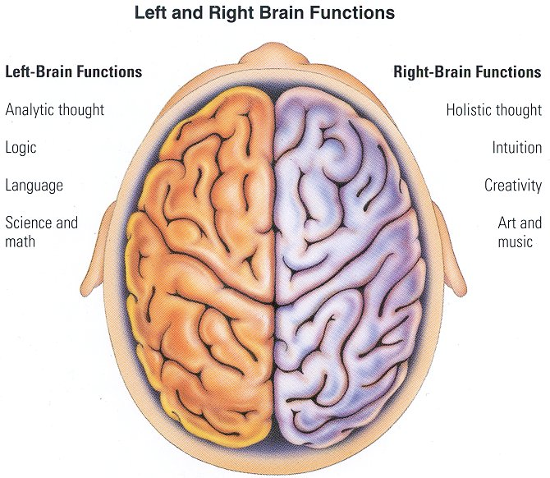

Slide 23
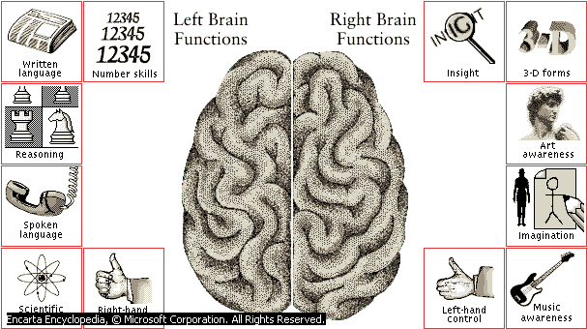
Sperry (1968) Split brain study

Slide 24
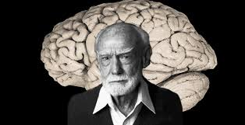
SPERRY
Aim
To understand the background to Sperry’s study that each brain hemisphere plays a different role
Learning objectives
Must - To identify the general roles the left and right hemispheres each play
Should - To describe the unusual ability and inability of split-brain patients
Could - To explain how the split-brain patients came to this point
Prep for Wed 6/3/19
Sperry short answer questions

Slide 25
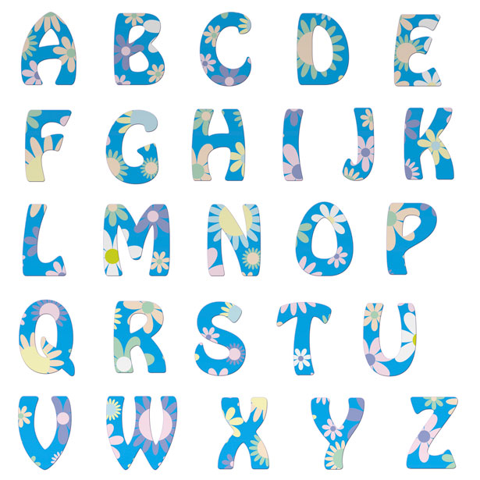
Key Terms: note down as many key terms relevant to Sperry’s study and the Biological Area.

Slide 26
Key Terms
Hemisphere (right and left)
Corpus callosum
Visual field (right and left)
Contra-lateral control
Lateralisation of function
Natural experiment
Split brain surgery
Cross-wiring
Tactile task
Visual task
Epilepsy
Brain
EEG

Slide 27
SPERRY (1968)
Hemispheric disconnection and unity in conscious awareness
https://www.youtube.com/watch?v=aCv4K5aStdU
https://www.youtube.com/watch?v=Kqy4XVcCf0w

Slide 28
What is a visual field?
If you look straightforward everything to the left of your nose is the left visual field and everything to the right is your right visual field.
Left
Visual
Field
Right
Visual
Field

Slide 29
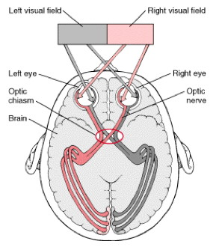
Visual fields – a little more detail
HOWEVER!
It’s more complex than right eye -> left hemisphere and left eye -> left hemisphere.
Information from both eyes goes to both hemispheres.

Slide 30
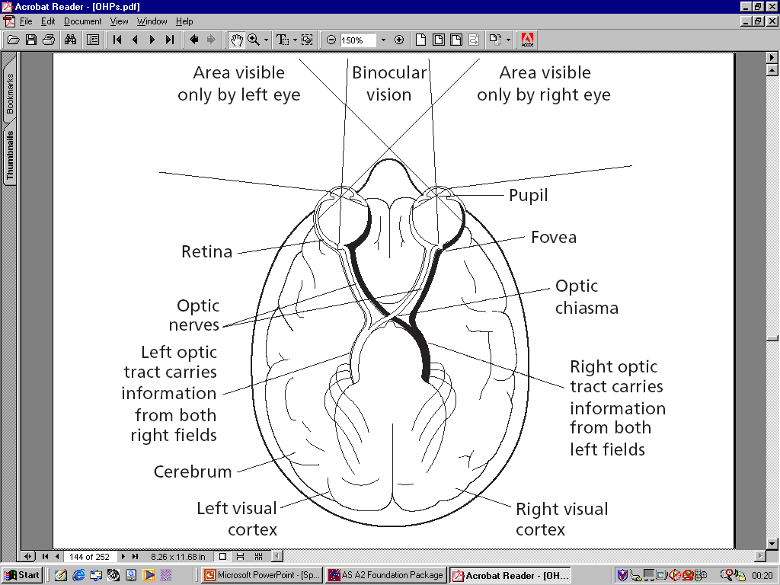
Left visual field
Right visual field

Slide 31
Left visual field

Slide 32
Humans are cross-wired – contralateral control
Left side
Right
side
Left
hemisphere
(Language)
Right
hemisphere
(drawing)
Left
Visual
Field
Right
Visual
Field

Slide 33
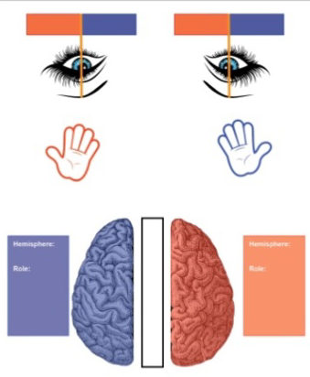
Contralateral Control
Left side
Right
side
Left
hemisphere
(Language)
Right
hemisphere
(drawing)
Draw a line from the VFs and body to the correct hemisphere
Left
Visual
Field
Right
Visual
Field

Slide 34
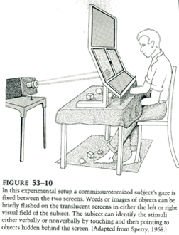
The Split Brain Studies - Sperry (1968)
THREE Questions...
What happens when the two halves of the brain are disconnected?
Do the hemispheres perform different functions?
Does each hemisphere have its own memories, perceptions and concepts?

Slide 35
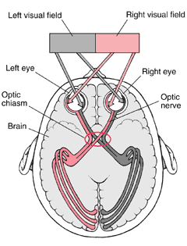
Brain Functions
The supposition
The left half of the brain is specialised for language
linguistic expression both symbolic and logical
The right half of the brain is specialised for perception
visuospatial and artistic

Slide 36
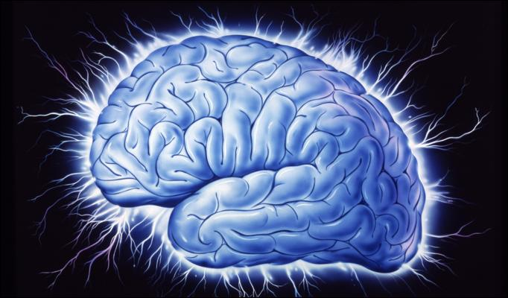
Brain Functions
Can this be supported by evidence?
Sperry’s experiment was
A NATURAL EXPERIMENT
11 participants
Sperry’s Ps were epileptics who could not be treated with drugs

Slide 37
What do we know about epilepsy?
Symptoms can range from;
Brief loss of consciousness → severely thrashing the legs and arms uncontrollably (Grand Mal).
What is the cause?
Abnormal firing of electrical impulses throughout the brain which interrupts normal brain patterns.

Slide 38
During a seizure, electrical impulses pass
from 1 hemisphere to the other.
How might we be able to stop this?
Cut the Corpus Callosum
This procedure is known as a
Split Brain Surgery (commisurotomy)
It is carried out as a last resort
when medication has failed.

Slide 39
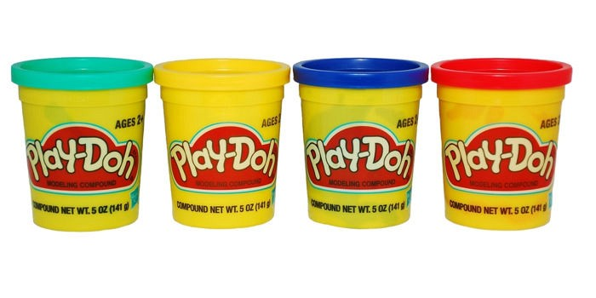
Show what you know
Commisurotomy
Contra-lateral control
Corpus callosum
Epilepsy

Slide 40
How many words can you make from these 2 words?
Right Hemisphere
20 words = good
30 words = great
40 words = fabulous

Slide 41
Sperry’s apparatus - Tachistoscope

Slide 42
Visual apparatus and procedure
Participants had one eye covered and asked to stare at a point (fixation point) on a projector screen.
Information (picture/word/symbol) was flashed to either the left visual field (LVF) or right visual field (RVF) for 1/10th second.
CONTROLS?
Notes:
Too quick for eyes to focus so data goes to only one hemisphere.

Slide 43
Tactile apparatus and procedure
Below the screen was a gap so participants could be handed objects or reach into a ‘grab bag’ and touch objects but could not see the objects or his hands.
CONTROLS?

Slide 44
Tachistoscope - Controls
The fixation point.
Image flashed for 0.1 seconds.
Always had one eye covered.
Standard pictures/words/symbols shown to each participant.
Participants can’t see their hands.
Same experimenter used.

Slide 45
Procedure
So the participants completed various visual and tactile tasks (with the experimenters attempting to see how the two hemispheres functioned).
Participants remained in silence during trials unless asked question by experimenter.
WHY?

Slide 46
Research Methodology
Independent Variable?
Dependent Variable?
Methodology?
Hemisphere disconnection (or not).
Performance on visual (sight) and tactile (touch) tasks.
Quasi-experiment (no control over IV) and case studies.

Slide 47
Results
What happened?
When an object is displayed on one half of the screen (i.e. the left) and then in the other the P has no recollection of seeing it before
Is this evidence for TWO SEPARATE MEMORIES?

Slide 48
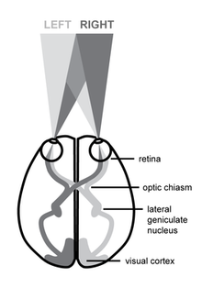
Results
Speech and writing
When an object is displayed in the right visual field (thus processed in the left hemisphere) Ps can describe it in speech and writing

Slide 49
Results
Speech and writing
When an object is displayed in the LVF (thus processed in the right hemisphere) Ps insist they have not seen anything
BUT
if asked to use the LEFT HAND to point to a matching object on the table can do so, while STILL insisting nothing was seen

Slide 50
Results: COMPOSITE words
TWO different objects displayed
e.g. RING and KEY
Ps asked to draw what they see with their left hand
DREW what was on the LEFT half of the screen (RING)
BUT said they had drawn what was on the RIGHT half of the screen (KEY)

Slide 51
How many COMPOSITE words can you think of?
20 words = good
30 words = great
40 words = fabulous

Slide 52
Results: Tactile Tests
OBJECTS placed in RIGHT HAND for IDENTIFICATION BY TOUCH
Ps described the object in speech and writing
OBJECTS placed in LEFT HAND for IDENTIFICATION BY TOUCH
Ps made wild guesses - seemed unaware of object in their hand

Slide 53
Results: Tactile Tests
Two different objects placed in each hand - then hidden for retrieval in pile of items
Each hand searches for its own object but ...If the left hand picks up the object which the right hand is looking for, the object is rejected… but the other hand continues to search!!!

Slide 54
The split brain procedure
An APPLE flashed LEFT side of the screen and participant asked to locate the item on the screen with his RIGHT hand
If the P uses his RIGHT HAND to find the displayed item (apple) on the ‘table’ he can name each object he picks up but cannot say what his RIGHT HAND is looking for
Because the item in the LEFT VISUAL FIELD is processed in the RIGHT HEMISPHERE

Slide 55
The split brain procedure: Match
A PEAR is projected on the LEFT screen and is processed in the RIGHT hemisphere
The left hand grabs the pear (matched) because the left hand is managed by the right brain - but the P cannot report what is held!

Slide 56
The split brain procedure: Mismatch
A PEAR is projected on the LEFT screen and is processed in the RIGHT hemisphere
The RIGHT hand searches and can name objects as found (RIGHT HAND IN LEFT HEMISPHERE) but cannot find the pear, because it does not know what HAND is looking for !!!

Slide 57
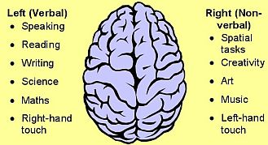
The split brain procedure: Conclusion
It seems that one half of the brain does not know what the other half is doing

Slide 58
The Biological Approach: Sperry
Consolidate your knowledge during the video, using the cloze passage – pages 14-15
Pages 14-15

Slide 59
Role of right and left hemisphere
Write LEFT on one side of your board and RIGHT on the other.
Show the correct side in response to the following questions ….
LEFT
RIGHT

Slide 60
Language is processed in which hemisphere?
LEFT

Slide 61
The right visual field is controlled by which hemisphere?
LEFT

Slide 62
Information from the left hand is sent to which hemisphere for processing?
RIGHT

Slide 63
If a patient had a seizure in their left hemisphere, which side of the body might be in danger of paralysis?
RIGHT

Slide 64
Information from the right hand is sent to which hemisphere for processing?
LEFT

Slide 65
Information from the left visual field is controlled by which hemisphere?
RIGHT

Slide 66
Left handed people tend to be which hemisphere dominant?
RIGHT

Slide 67
If a nude pin up was presented to the Ps on one specific visual field, they would blush but couldn’t say why.
Which visual field was it presented to?
LEFT

Slide 68
The split brain procedure: Summary
The LEFT hemisphere (in right handed people) is specialised for speech and writing and for the organisation of language
It can communicate the visual experiences of the RIGHT VISUAL FIELD and about the experiences of the RIGHT half of the body

Slide 69
The split brain procedure: Summary
The RIGHT hemisphere is MUTE and cannot speak or write
(aphasic and agraphic)
but can show NON VERBALLY that mental processes, centred around the LEFT VISUAL FIELD and the LEFT half of the BODY, are present

Slide 70
Sperry's study is a _________/natural ___________________ because the _____________________ variable – having a split brain or not – was not directly _____________________ by the _____________________. Ps with split-brains had already _________________ hemisphere _______________________ to reduce severe _______________. The _________________ variable was the Ps ability to _____________ a variety of visual and _____________ tests. Some say it is a collection of _______ studies, because so many _________ were made on just 11 Ps.

Slide 71
Sperry's study is a (quasi)/natural (experiment) because the (independent) variable – having a split brain or not – was not directly (manipulated) by the (researchers).
Ps with split-brains had already (undergone) hemisphere (deconnection) to reduce severe (epilepsy). The (dependent) variable was the Ps ability to (perform) a variety of visual and (tactile) tests. Some say it is a collection of (case) studies, because so many (tests) were made on just 11 Ps.

Slide 72
Case
Deconnection
Dependent
Epilepsy
Experiment
Independent
Manipulated
Perform
Quasi
Researchers
Tactile
Tests
Undergone

Slide 73
Conclusions
There’s evidence for lateralisation of brain function.
Language is associated with the left hemisphere.
Emotion associated with the right.
Split brain patients don’t usually have problems in daily life because they can see stimuli for more than 1/10th of a second.
https://create.kahoot.it/details/sperry/16c724b1-c63a-4121-85e0-0a83992c5b83

Slide 74
Sperry’s Results: Tactile tasks
Without looking, participants picked up an object with their right hand. Hemisphere used:
Participants were then asked to say out loud what they were holding. Could participants do this?
Why/Why not?
Without looking, participants picked up an object with their left hand. Hemisphere used:
Participants were then asked to say out loud what they were holding. Could participants do this?
Why/Why not?
https://create.kahoot.it/details/sperry/16c724b1-c63a-4121-85e0-0a83992c5b83

Slide 75
Sperry’s Results: Tactile tasks
Without looking, participants picked up an object with their right hand. Hemisphere used: LEFT
Participants were then asked to say out loud what they were holding.
Could participants do this? YES
Why/Why not? LH is in control of language
Without looking, participants picked up an object with their left hand. Hemisphere used: RIGHT
Participants were then asked to say out loud what they were holding. Could participants do this? NO
Why/Why not? RH is mute
https://create.kahoot.it/details/sperry/16c724b1-c63a-4121-85e0-0a83992c5b83

Slide 76
Sperry’s Results: Visual tasks
Participants were flashed a stimulus to one of their visual fields. Which visual field was the ‘?’ stimulus presented to?
Which hemisphere would have seen the stimulus?
Participants were then asked to identify what they saw. Would participants have been able to do this?
Why/Why not?
If not, what could they do?
https://create.kahoot.it/details/sperry/16c724b1-c63a-4121-85e0-0a83992c5b83

Slide 77
Sperry’s Results: Visual tasks
Participants were flashed a stimulus to one of their visual fields. Which visual field was the ‘?’ stimulus presented to? RVF
Which hemisphere would have seen the stimulus? LH
Participants were then asked to identify what they saw. Would participants have been able to do this? YES
Why/Why not? LH is in control of language
If not, what could they do? They could do this.
https://create.kahoot.it/details/sperry/16c724b1-c63a-4121-85e0-0a83992c5b83

Slide 78
Sperry’s Results: Visual tasks $
Participants were flashed a stimulus to one of their visual fields.Which visual field was the ‘$’ stimulus presented to?
Which hemisphere would have seen the stimulus?
Participants were then asked to identify what they saw. Would participants have been able to do this?
Why/Why not?
If not, what could they do?
https://create.kahoot.it/details/sperry/16c724b1-c63a-4121-85e0-0a83992c5b83

Slide 79
Sperry’s Results: Visual tasks $
Participants were flashed a stimulus to one of their visual fields.Which visual field was the ‘$’ stimulus presented to? LVF
Which hemisphere would have seen the stimulus? RH
Participants were then asked to identify what they saw. Would participants have been able to do this? NO
Why/Why not? RH is mute.
If not, what could they do? DRAW it with their left hand
https://create.kahoot.it/details/sperry/16c724b1-c63a-4121-85e0-0a83992c5b83

Slide 80
Sperry’s Results: Composite Words
Which visual field was each word presented to?
KEY = CASE =
Which hemisphere was each word presented to?
KEY = CASE =
Would the participant have been able to identify this stimulus verbally?
KEY = CASE =
If not, what could the participant do?
KEY =
CASE =

Slide 81
Sperry’s Results: Composite Words
Which visual field was each word presented to?
KEY = LVF CASE = RVF
Which hemisphere was each word presented to?
KEY = RH CASE = LH
Would the participant have been able to identify this stimulus verbally?
KEY = NO CASE = YES
If not, what could the participant do?
KEY = NO, but could DRAW it with their left hand
CASE = YES can identify it verbally

Slide 82
Timed Test – you can use your notes and folders

Slide 83
Starter Task
Determinism
Free will
Holism
Nature
Nurture
Psychology as a science
Reductionism
Usefulness

Slide 84
Evaluation of Sperry: Usefulness (DRUGV)
The research is useful for future research as it is one of the first studies to quantify the specific resources of the ‘silent’ side of the brain.
With this information future research can identify in more detail how the brains resources are used

Slide 85
Evaluation of Sperry: Usefulness
IS
IS NOT
Point
Sperry’s study is useful as it …
Explanation
Because …
Context
In Sperry’s study …
Conclusion
This is helpful because it helps to develop our understanding of the brain.
Point
Sperry’s study IS NOT useful …
Explanation
Because …
Context
In Sperry’s study …
Conclusion
This is unhelpful because research taken should develop our knowledge

Slide 86
Evaluation of Sperry: Validity
Validity (measurement):
+ The study was highly controlled as the procedure was identical for each participant
- As the method was a quasi it does not allow for complete control of the extraneous variables (participant variables)

Slide 87
Evaluation of Sperry: Ecological Validity
Ecological Validity (realism):
+ The sample was representative of the abnormal population (CC severed)
- The task had little mundane realism as you do not see things for 0.1 seconds at a time.

Slide 88
Evaluation of Sperry: Validity
IS
IS NOT
Point
Sperry’s study is valid as it …
Explanation
Because …
Context
In Sperry’s study …
Conclusion
This is helpful because we want research to be true / valid to give us better insight.
Point
Sperry’s study IS NOT valid…
Explanation
Because …
Context
In Sperry’s study …
Conclusion
This is unhelpful because if it is not true / valid there is no point in using the research

Slide 89
Evaluation of Sperry: Sample and Population
+ Sample had 10 man and 1 woman in it and was a large proportion of the abnormal population
The sample did not include a control group for objective comparison to normal behaviour
Nowadays practically no-one has their corpus callosum cut

Slide 90
Evaluation of Sperry: Sample
Advantage
Weakness
Point
It is an advantage of Sperry’s sample was …
Explanation
Because …
Context
In Sperry’s study …
Conclusion
This is helpful because …
Point
It is a disadvantage of Sperry’s sample was …
Explanation
Because …
Context
In Sperry’s study …
Conclusion
This is unhelpful because …

Slide 91
Evaluation of Sperry: Data
Data:
+ Large amounts of quantitative data allows for easy summary of results
- Lack of qualitative data does not allow for full explanation of what is occurring; no description

Slide 92
Evaluation of Sperry: Quantitative Data
Advantage
Weakness
Point
Collecting quantitative data is an advantage because …
Explanation
Because …
Context
In Sperry’s study …
Conclusion
This is helpful because …
Point
Collecting quantitative data is a disadvantage because …
Explanation
Because …
Context
In Sperry’s study …
Conclusion
This is unhelpful because …

Slide 93
Evaluation of Sperry: Ethics
Ethics:
+ Confidentiality
- Protection from psychological harm as they could be stressed and embarrassed

Slide 94
Evaluation of Sperry: Ethics
Ethical
Not Ethical
Point
Sperry’s study was ethical because it ensured confidentiality
Explanation
Because …
Context
In Sperry’s study …
Conclusion
This is helpful because …
Point
Sperry’s study was not ethical because the Ps were not protected from harm
Explanation
Because …
Context
In Sperry’s study …
Conclusion
This is unhelpful because …

Slide 95
Evaluation of Sperry: Nature / Nurture Debate
A Debate it adds to:
Nature-nurture as it suggests that behaviour can be completely determined by biology

Slide 96
Evaluation of Sperry: Nature / Nurture Debate
Advantage
Weakness
Point
It is an advantage to take the nature side of the nature nurture debate because …
Explanation
Because …
Context
In Sperry’s study …
Conclusion
This is helpful because …
Point
It is a disadvantage to take the nature side of the nature nurture debate because …
Explanation
Because …
Context
In Sperry’s study …
Conclusion
This is unhelpful because …

Slide 97
Links to debates: Free Will / Determinism
Sperry’s study suggests that our biology determines our behaviour, which is helpful as it does not blame them for abnormality.
But unhelpful as they may not train themselves to overcome this.

Slide 98
Evaluation of Sperry: Free Will / Determinism Debate
Advantage
Weakness
Point
It is an advantage to take the determinism side of the FW/D debate because …
Explanation
Because …
Context
In Sperry’s study …
Conclusion
This is helpful because …
Point
It is a disadvantage to take the determinism side of the FW/D debate because …
Explanation
Because …
Context
In Sperry’s study …
Conclusion
This is unhelpful because …

Slide 99
Links to debates: Psychology as a science
This study scientifically tested the participants’ abilities by using controlled conditions which can be replicated.
Is it possible to falsify the findings that Sperry collected through further testing? Because there are no more split brain patients, it is not possible to replicate fully.

Slide 100
Evaluation of Sperry: Psychology as a Science
IS
IS NOT
Point
Sperry’s study would suggest that Psychology IS a science …
Explanation
Because …
Context
In Sperry’s study …
Conclusion
This is helpful because it gives the subject credibility.
Point
Sperry’s study would suggest that Psychology IS NOT a science …
Explanation
Because …
Context
In Sperry’s study …
Conclusion
This is unhelpful because it reduces the subject’s credibility

Slide 101
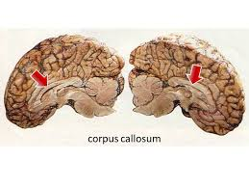
Links to areas/perspectives: Biological area because …
biological area because it is investigating the function of the corpus callosum, as well as the roles of each hemisphere of the brain.
Because it is only taking into account the brain as an explanation of behaviour, it does not really allow its findings to fit into other psychological areas.

Slide 102
Links to the key theme: Regions of the Brain
This study gives some insight into the function of the corpus callosum.
It does this by giving the participants controlled tasks and monitoring what participants could and could not do.
It helps us see how different REGIONS of the brain have different functions.

Slide 103
Evaluating Sperry
On lined paper / computer, you are going to answer 3 questions
Choose one question from Q1-3
Choose one question from Q4-5
Choose one question from Q6-8
Page 29

