Slide 1
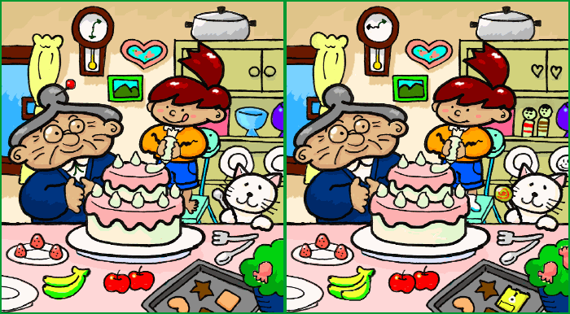

Slide 2
Simons and Chabris (1999) Sustained inattentional blindness for dynamic events
https://www.youtube.com/watch?v=v3iPrBrGSJM
https://www.lenstore.co.uk/vc/spot-the-difference/?utm_source=affiliate_window&utm_medium=affiliates&utm_campaign=Skimlinks
https://www.youtube.com/watch?v=h-PxuBW2DQY

Slide 3
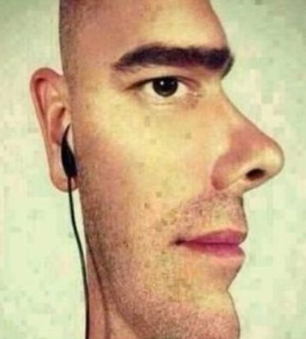
Background
Have you ever…
accidently ignored a friend when out walking?
not noticed when someone you know has changed their hairstyle?
completely ignored an obvious instruction, even when it’s written down in front of you? (ATQ!!!!)
How perceptive do you think you are?
Watch the following clip: www.youtube.com/watch?v=vJG698U2Mvo

Slide 4
Why might we miss a gorilla?!
To answer this question we need to understand the difference between looking and perceiving.
When we look at our environment, we don’t pay attention to everything in our field of vision – there’s just too much to take in.
To perceive something you need to see it and pay attention to it.
Key term
Inattentional blindness – when we don’t see something we’ve looked at because our attention was not focused on it.

Slide 5
Aims and Research questions
Daniel Simons and Christopher Chabris built on previous research from Neisser (1975) to investigate the nature of inattentional blindness.
They had two questions:
To what degree are the details of our visual world perceived and represented?
What role does attention play in this process?

Slide 6
Method
The sample consisted of 192 participants. All
university students.
volunteered to take part and gave consent.
Each participant was tested individually and each testing session lasted 5–10 minutes.
Every P was either given a large chocolate bar for participating, or were given a fee for taking part in a number of studies.

Slide 7
Method
Participants were told that they would be watching two basketball teams, each team having three players. One team would be wearing white and the other team would be wearing black.
Participants were told to keep a silent mental count of the number of passes made by the team they had been told to watch.

Slide 8
Method
A video was then played of the teams passing balls by some lift doors – and during the clip an ‘unexpected event’ (e.g. a gorilla appearing) occurred.
After the video clip, participants had to immediately write down the number of passes they had counted and then answer some further questions.

Slide 9
Conditions/groups
Not all participants did the same task – variations:
Count the passes made by the white team / black team
Unexpected event - tall lady walking across the scene with an umbrella / person in a full gorilla outfit
Count how many passes were made (easy task) / count bounce passes and aerial passes made (hard task).
The way the participants saw each of the teams also varied (transparent/opaque).

Slide 10
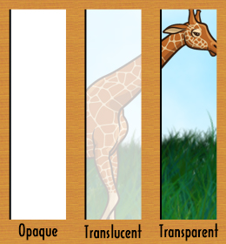
The video clip
There were two styles of video, which were played to different Ps.
In the opaque video, the black team, the white team and the unexpected event were filmed at once in one location. Only one clip was used.

Slide 11
The video clip
In the other style, three clips were used. The white team was filmed on their own (without the others); the black team was also filmed on their own.
Finally, the unexpected event was filmed on its own. The three clips were then digitally edited to all play at the same time on the same screen, so participants were watching all three clips at once. This is the transparent video style.

Slide 12
The video clip
Each video lasted 75 secs.
After about 44–48 seconds, the unexpected event (gorilla / umbrella lady) would occur.
Players moved around in random fashion in front of three lift doors, passing a standard orange basketball to each other using bounce and aerial passes.

Slide 13
Conditions/groups

Slide 14
Controls
21 experimenters tested the participants separately. To ensure that the experimenters all acted in the same way, a protocol was put in place that specified:
What the experimenters would say to each participant.
How they would say it.
When they would show the video.
How they would record the results.
How they would debrief participants afterwards.
What questions the participants would be asked.

Slide 15
Questions asked
Once Ps had watched the video clip, they were all asked the same questions:
While you were doing the counting, did you notice anything unusual on the video?
Did you notice anything other than the six players?
Did you see anyone else appear in the video?
Did you see a gorilla / woman with an umbrella?

Slide 16
Questions asked
If participants said yes to any of these questions, they had to elaborate on their answer.
If at any point the observer mentioned the unexpected event, the rest of the questions were skipped.

Slide 17
Questions asked
Yes / No questions = quantitative data
Elaboration questions = qualitative data.
Why are both types of data here PRIMARY data?

Slide 18
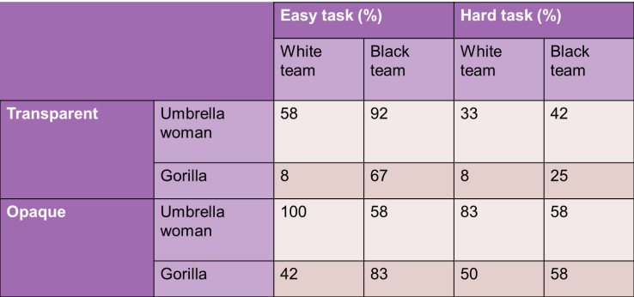
Starter task
What conclusions can you draw from this? Write down as many as you can.

Slide 19
Participants who saw the unexpected event
What conclusions can you draw from this? Write down as many as you can.

Slide 20
Key findings
46 per cent of participants did not notice the unexpected event, and 54 per cent did.
The unexpected event was seen less often in the transparent video style.

Slide 21
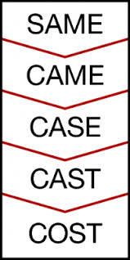
Starter Task

Slide 22
Grant
Uses the experimental method
which has good internal reliability
The greater the reliability, usually the less validity
Field experiments have high ecological validity
The research method of Piliavin is a field experiment
Piliavin

Slide 24
Learning Objectives
To understand the results of Simons and Chabris’s study
To evaluate Simons and Chabris’s study in terms of reliability, validity and ethics
To apply the results of Simons and Chabris’s study to real life

Slide 25
Key findings
More Ps noticed the unexpected event in the easy task condition (64%) than in the hard task condition (45%).
The gorilla was noticed more often when Ps were watching the black team. (Why do you think this is?)
Some participants failed to notice the unexpected event even if the gorilla/umbrella woman was directly behind the ball they were paying attention to.

Slide 26
Maths Moment
Stretch and Challenge:
Why would the mean be used in this study? [3]
Why would the standard deviation be used in this study? [3]

Slide 27
Maths Moment
Mean = 54
Median = 58
Mode = 58
Range: 92
Number of pieces of data = 16

Slide 28
Maths Moment
$\overline{x}$ = 54
n = 16
$$\sum{=sum}$$

Slide 29
Maths Moment
Standard deviation = 27.4
Variance = 752.8

Slide 30
Evaluation
Ecological validity – Did the task relate to real life?
Ethics – Which ethical issues were broken and which were kept?
Validity – Did the researchers take any steps to make sure they reduced demand characteristics? Was the study well controlled?
Reliability – Was the procedure standardised? Can it be easily repeated? Were the results consistent?
Usefulness – Can the results of this study help anyone in the real world?
Generalisability – Was the sample generalisable to others?

Slide 31
Evaluation
https://www.youtube.com/watch?annotation_id=annotation_262395&feature=iv&src_vid=voAntzB7EwE&v=v3iPrBrGSJM
Explain each of the 9 points
The words at the bottom can be used to help you
Stretch & Challenge
To what extent is Simons and Chabris’ study reliable?
To what extent is Simons and Chabris’ study valid?
To what extent is Simons and Chabris’ study ethical?

Slide 32
Links to debates: Individual v Situational
Do you think the Ps’ inability to see the unexpected events was due to the individual or to the situation they were in?
Consider that the overall level of inattentional blindness from participants was 46% (meaning that 54% did see the unexpected events).

Slide 33
Links to debates: Free Will v Determinism
Does this study show that we have a choice on what to focus our attention, or are we determined to miss certain things?
Consider the findings of the study.

Slide 34
Links to areas/perspectives: Cognitive Area
This is because it is investigating attention which is a mental process, i.e. a cognition.
This study was specifically investigating whether unexpected visual events are missed when participants are paying attention to something else.

Slide 35
Links to key themes: Attention
This study suggests that even though we may see things in our visual field, we might not perceive them if our attention is focused in another direction.
This can change our understanding of this theme. It builds upon Moray’s work on auditory attention by concluding that individuals’ inattention is limited not just to sound but also to sight.

Slide 36
Links to key themes
Although this study did suggest some general trends towards attention, there was still a significant amount of individual diversity.
46% did not notice the unexpected event, while 54% did. This could change our understanding as it shows that unlike what Moray suggests, not everyone is guaranteed use their attention in the same way.

Slide 37
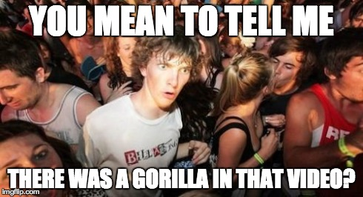
Starter Task
What was the overall level of inattentional blindness?
What did the Ps have to do in the 'hard task'?
What were the two video formats?
How long was the unexpected event?
How long was the video clip?
What was the initial sample size before Ps were rejected?
What was the final sample size after Ps were rejected?
Answers
192
228
46%
5 seconds
75 seconds
Count the # of aerial and # of bounce passes separately
Opaque and Transparent

Slide 38
Starter Task
What was the overall level of inattentional blindness? C 46%
What did the Ps have to do in the 'hard task'? F. Count the # of aerial and # of bounce passes separately
What were the two video formats? G. Opaque and Transparent
How long was the unexpected event? D. 5 seconds
How long was the video clip? E. 75 seconds
What was the initial sample size before Ps were rejected? B. 228
What was the final sample size after Ps were rejected? A. 192
Answers
192
228
46%
5 seconds
75 seconds
Count the # of aerial and # of bounce passes separately
Opaque and Transparent

Slide 39
Simons and Chabris vs. Moray
What type of attention was being investigated
Research method (correlation, observation, self-reports, experiments)
Sampling method (random, opportunity, self-selected, snowball)
Size of the sample
Experimental design – repeated / independent / matched pairs
What type of data were collected (quantitative, qualitative)
Which measure of central tendency (mean, median, mode)
What type of graph would be used
What type of inferential statistical test would be used
How ethical the studies were – deception, confidentiality, informed consent
What controls were used
Reliability
Validity
Moray
Simons
And
Chabris
https://create.kahoot.it/details/simons-chabris-and-moray/da069525-3a2b-4bb0-8f2e-7ee4f1bf47f6
https://quizlet.com/265409694/simons-and-chabris-outline-and-evaluation-flash-cards/

Slide 40
On the whiteboard, add your answers
Moray
Simons
And
Chabris

Slide 41
Comparison Questions: Similarities and Differences
You can be asked to compare
Research methodologies
Pairs of study
Areas and perspectives
Debates
Explanations and treatments of mental health

Slide 42
Comparison Questions: Similarities and Differences
Research methodologies
Explain one difference between random and volunteer sampling

Slide 43
Comparison Questions: Similarities and Differences
Pairs of studies
To what extent does Simons and Chabris’ study change our understanding of attention?
Explain one similarity between Moray’s study and Simons and Chabris’ study.

Slide 44
Comparison Questions: Similarities and Differences
Areas and Perspectives
Explain one similarity and one difference between the Developmental area and the Behaviourist perspective

Slide 45
Comparison Questions: Similarities and Differences
Debates
Explain how the determinism/freewill debate is similar and different to nature/nurture debate

Slide 46
Comparison Questions: Similarities and Differences
Explanations / Treatments for mental health
Explain one difference between one Medical Model treatment of mental illness and one alternative [4]
Explain one difference between the genetic and biochemical explanations of mental illness [4]

Slide 47
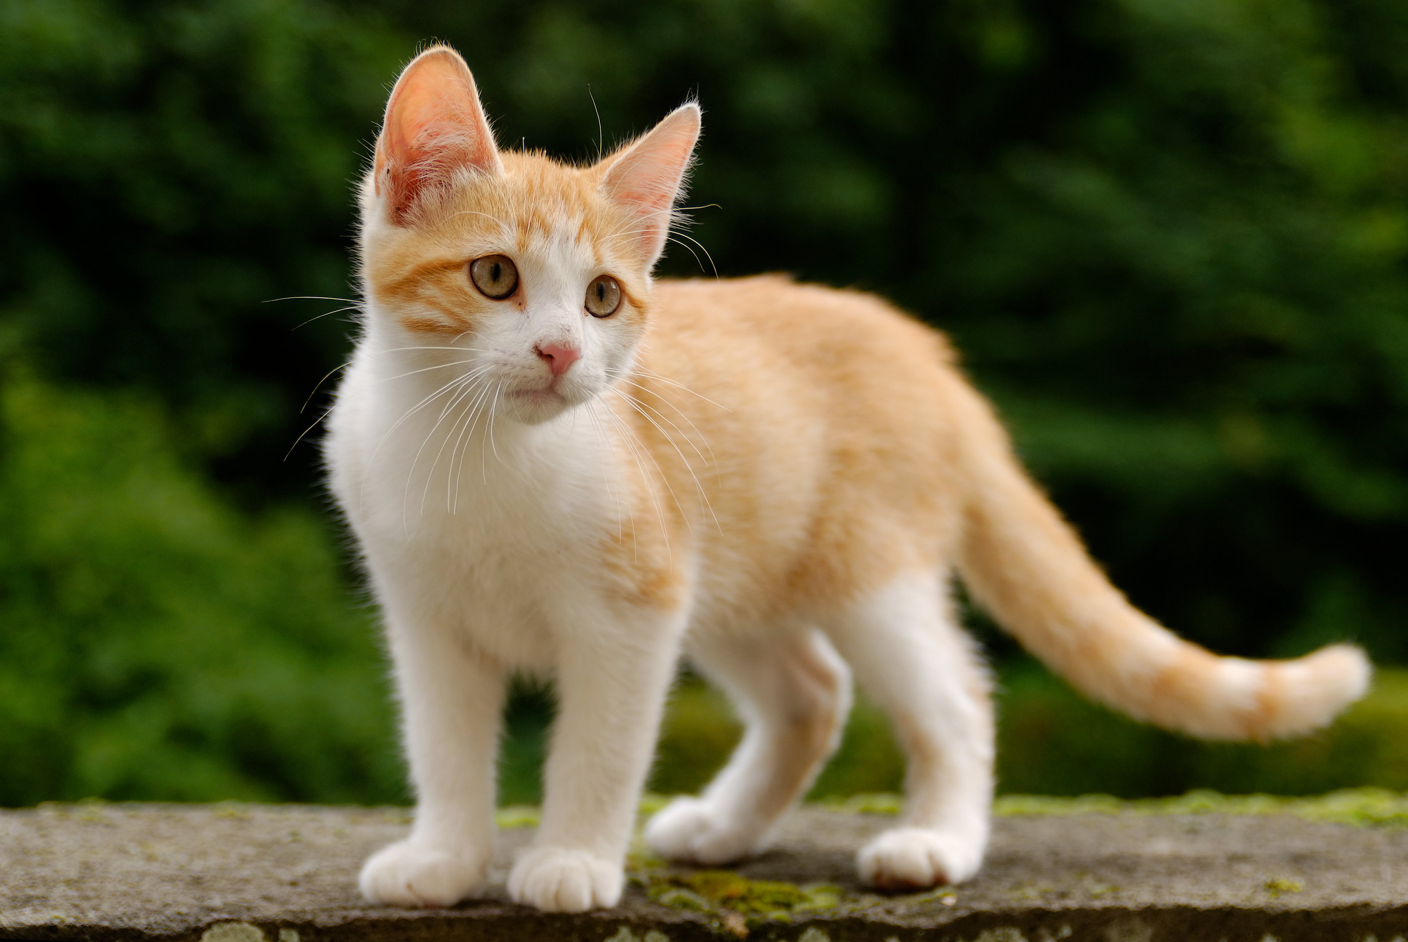
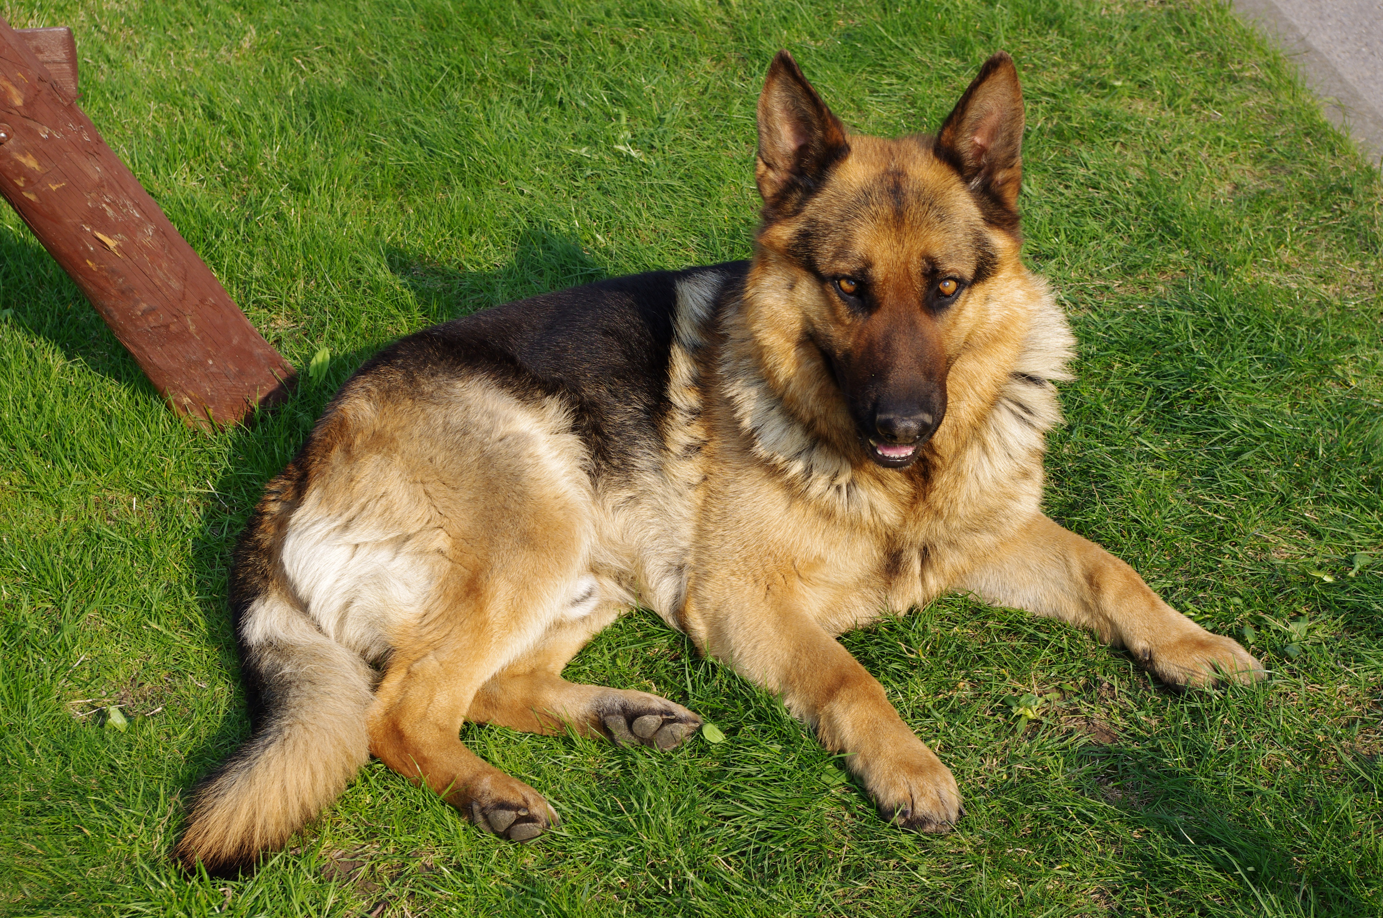
Comparison Questions: Similarities and Differences
Similarity / difference is identified
Discussed / elaborated
and supported by evidence from one side
and supported by evidence from the other side.

Slide 48
Comparison Questions: Similarities and Differences
Dog
Barks
Needs a lot of looking after
Don’t clean themselves
Cats
Meow
Needs less looking after
Clean themselves
Mammals
Pets
4 legs
Fur
Tails

Slide 49
Comparison Questions: Similarities and Differences
Dog
Barks
Cats
Meow
Explain one difference between cats and dogs. [4]
Dogs bark whereas cat meow. (only achieved 2 marks)

Slide 50
Explain one difference between cats and dogs. [4]
Needs a lot of looking after
Needs less looking after
A difference between cats and dogs is their level of dependency [1] on their owners to care for them [1] Dogs need a lot of looking after [1] whereas cats are more independent [1]
Point of comparison
Elaboration
Evidence #1
Evidence #2

Slide 51
Explain one difference between cats and dogs. [4]
Needs a lot of looking after
Needs less looking after
Point of comparison
A difference between cats and dogs is their voice [1] and how they communicate [1] Dogs bark to each other and to humans[1] whereas cats meow, but this is only dirrectioned to humans[1]
Elaboration
Evidence #1
Evidence #2

Slide 52
Explain one difference between time and event sampling. [4]
The difference between time and event sampling is length of time the observer observes for [1].
If it's the whole time or at intervals [1].
Event sampling looks for specific behaviour over the whole event being observed (this is seen in Ainsworth's study) then a note is made
whereas time sampling is where behaviour is observed at predetermined intervals such as every 10 minutes (this is seen in Bandura's study) [1].

Slide 53
Similarities / Differences
https://www.classtools.net/random-name-picker/91_A6fBQ6

Slide 54
So what? How is this relevant to real life?
Consequences of inattentional blindness
https://www.youtube.com/watch?v=h-PxuBW2DQY

Slide 55
Paper 2 Section C style Questions
Explain why this article can be viewed as being relevant to cognitive psychology. (4)
Briefly outline one core study and explain how it could relate to this article. (5)
Identify one psychological issue/problem or content raised by the above article. Support your answer with evidence from the article. (4)
Use your psychological knowledge to suggest a way to manage the issue you have identified in the question above. (6)
Evaluate your suggestion for how to manage the issue in this article. (6)
Page 13

Slide 56
Paper 2 Section C style Questions
Explain why this article can be viewed as being relevant to cognitive psychology. (4)
Learn the # for each area / perspective
Highlight the key words and phrases that could be evidence of a particular area or perspective.
Explain what the area / perspective believes CAUSES behaviour
Link this to the article
Use quotes.

Slide 57
Paper 2 Section C style Questions
Area / Perspective | Cause of Behaviour | #
Biological | Behaviour is caused by brain / chemicals / genes | Physiological Nomothetic
Individual difference | Behaviour is caused by different things for each person | Idiographic Personality Unique
Developmental | Behaviour is caused by level of development reached | Lifespan Nurture Pre-determined stages
Social | Behaviour is caused by people / place | Environment Situational factors
Cognitive | Behaviour is caused by thinking processes | Thinking patterns Input-process-output Schema
Psychodynamic | Behaviour is caused by unconscious processes | Personality Tripartite personality
Behaviourist | Behaviour is learnt | Classical Operant Social learning

Slide 58
Paper 2 Section C style Questions
Briefly outline one core study and explain how it could relate to this article. (5)
Learn the taglines for the 10 pairs of studies
Highlight the key words and phrases that could be evidence of a key word from the tagline.
Detail from the Core Study:
Aim
Ps/sample
Method
Results
Conclusion
Link this to the article
Use quotes.

Slide 59
Paper 2 Section C style Questions
Moray | Attention | Simons and Chabris
Blakemore and Cooper | Brain plasticity | Maguire
Bandura | External influences on children’s behaviour | Chaney
Gould | Measuring differences | Hancock
Loftus | Memory | Grant
Kohlberg | Moral Development | Lee
Sperry | Regions of the brain | Casey
Milgram | Responses to people in authority | Bocchiaro
Piliavin | Responses to people in need | Levine
Freud | Understanding disorders | Baron Cohen

Slide 60
Paper 2 Section C style Questions
Explain why this article can be viewed as being relevant to cognitive psychology. (4)
Briefly outline one core study and explain how it could relate to this article. (6)
Identify one psychological issue/problem or content raised by the above article. Support your answer with evidence from the article. (4)
Use your psychological knowledge to suggest a way to manage the issue of people paying less attention while driving with a hands free mobile. (6)
Evaluate your suggestion for how to manage the issue in this article. (10)

Slide 61
Paper 2 Section C style Questions
Use your psychological knowledge to suggest a way to manage the issue you have identified in the question above. (6)
Explain WHAT you want to change and HOW you will change it
Know the types of application (prevention, intervention, treatment, therapy)
State which type of application it will be.
The majority of the marks are for HOW you would do it. For example: Social learning (grab their attention, repeat it to keep it in LTM, give them opportunity to reproduce it, with a motivation (vicarious or not).

Slide 62
Paper 2 Section C style Questions
Evaluate your suggestion for how to manage the issue in this article. (6)
It is OK to give weaknesses as well as strengths.
Can it be generalised to a variety of behaviours?
Practical issues especially time and cost
Which side of the debates will the suggestion be on - such as reductionism/holism, nature/ nurture and individual/situational.

Slide 63
Paper 2 Section C style Questions
Evaluate your suggestion for how to manage the issue in this article. (6)
It is OK to give weaknesses as well as strengths.
Can it be generalised to a variety of behaviours?
Practical issues especially time and cost
Which side of the debates will the suggestion be on - such as reductionism/holism, nature/ nurture and individual/situational.
http://www.theinvisiblegorilla.com/videos.html#studyvids

Slide 64
Paper 2 Section C style Questions: Peer Assessment
Have they detailed at least 1 principle of the Cognitive area? Have they referred to behaviour?
Have they mentioned aim, sample, procedure, results, conclusions?
Have they stated the issue carefully? Have they explained WHY it is an issue / WHY psychologists would want to do something about this?
Have they said WHAT they want to change? Have they said which TYPE of strategy it is (prevention, intervention, therapy, treatment)?
Have they mentioned at least 4 points? Have they explained the points that they have made?

Slide 65
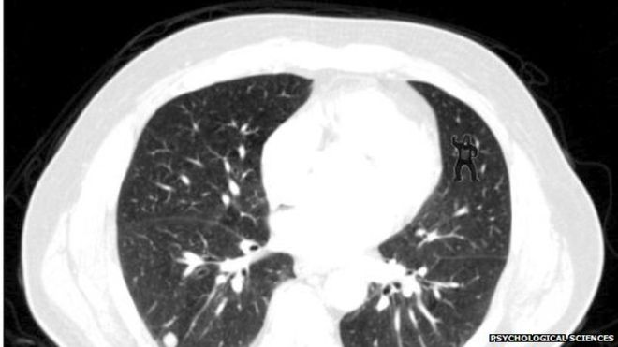
Paper 2 Section C style Questions

