Slide 1
Paper 3

Slide 2
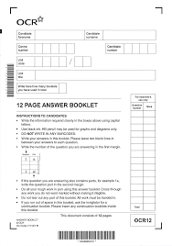
Paper 3
One question paper and one answer booklet.
You can answer in ANY order.
Make sure you write the number of the question in the margin

Slide 3
Paper 3
It is better to put your notes / plans on the ANSWER booklet … so you can get credit for it

Slide 4
Paper 3
It is 2 hours long and everyone runs out of time … plan accordingly

Slide 5
Paper 3
Section A: Issues of Mental Health
Section B: Option 1: Child
Section B: Option 2: Crime

Slide 6
Paper 3 Section A: Issues of Mental Health
Has 35 marks
Will most likely have 5-6 shorter answer questions
Will most likely have 1-2 questions on each of the 3 parts of the section

Slide 7
Paper 3: Issues of Mental Health
Historical Views
Medical Model
Alternatives to the Medical Model

Slide 8
Paper 3: Issues of Mental Health
Each of these 3 has
Background
Key research
Application
Historical Views
Medical Model
Alternatives to the Medical Model

Slide 9
Paper 3 Section A
Background =
Historical views of mental illness
Defining abnormality
Categorising mental disorders
Key Study =
Rosenhan (1973) On being sane in insane places – remember there are 2 parts to this study
Application =
Characteristics of an affective disorder, a psychotic disorder and an anxiety disorder.

Slide 10
Paper 3 Section A style Questions
Background =
The biochemical explanation of mental illness
The genetic explanation of mental illness
Brain abnormality as an explanation of mental illness
Key Study =
Gottesman - Disorders in offspring with two psychiatrically ill parents.
Application =
Biological treatment of one specific disorder.
General
Specific

Slide 11
Paper 3 Section A style Questions
Background =
The behaviourist explanation of mental illness
The cognitive explanation of mental illness
The psychodynamic explanation of mental illness
Key Study =
Szasz (2011) The myth of mental illness: 50 years later.
Application =
Non-biological treatment of one specific disorder.
General
Specific

Slide 12
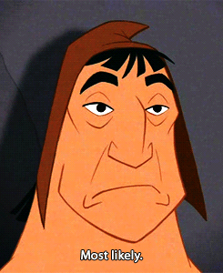
Paper 3 Section A style Questions
Most likely to have a 10 mark question relating debate or issue to:
Diagnosing mental illness (e.g. reliability / validity)
Any of the 6 explanations of mental illness
Either of the 2 treatments
Or the 3 Key studies

Slide 13
Paper 3
Section A: Issues of Mental Health
Section B: Option 1: Child
Section B: Option 2: Crime

Slide 14
Paper 3 Section B style Questions
3 styles of questions:
A = 10 marks on the topic area and key study
B = 15 marks relating an issue or debate to the area (NOT just the key study)
C = 10 mark application question

Slide 15
Paper 3 Section B style Questions
All 3 questions come from the SAME topic area. So … if
The material answers more than one question and
you think you cannot write something, because you already wrote it in the previous question(s)
– still write it.

Slide 16
Paper 3 Section B style Questions
A Questions
Explain how the research by … can be applied to … [10]
5 marks for KNOWLEDGE of the study
5 marks for APPLICATION to the topic area

Slide 17
Paper 3 Section B: A style Questions
A Questions
Using the key research by xxx
Explain the topic
Your question

Slide 18
The topic means …
Explain the topic means ….

Slide 19
A Questions – apply the key study to ….
The name of the topic area – for example:
Attachment
Collection of evidence from suspects and witnesses
The effects of imprisonment

Slide 20
A Questions – apply the key study to …..
OR the background to the topic

Slide 21
A Questions – apply the key study to …..
The background to the topic – for example:
impact of the failure to develop attachments
Punishment and reform as responses to criminal behaviour

Slide 22
Background can be referred to
So … make sure you know the background

Slide 23
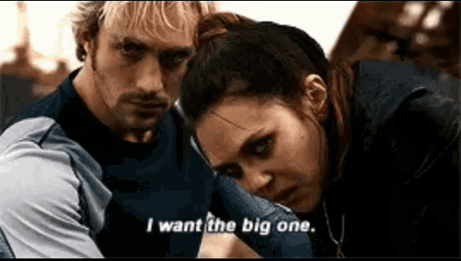
Child and Crime
B questions

Slide 24
B style Questions
B Questions
The topic name
Debate
Your question

Slide 25
B style Questions
B Questions
Your question
The topic name
Issue / Debate
This is NOT just the key research, so make sure your evidence is coming from a number of sources (e.g. Paper 2 studies, background)

Slide 26
https://quizlet.com/139827798/ocr-psychology-terminology-flash-cards/

Slide 27
The issues and debates are:
1. Nature/nurture
2. Freewill/Determinism
3. Reductionism/Holism
4. Individual/Situational Explanation
5. Usefulness of Research
6. Ethical Considerations
7. Conducting Socially Sensitive Research
Psychology as a Science
Methodological Issues
Reliability
Validity
Ethnocentrism
Notes:
*
07/16/96
*
##

Slide 28
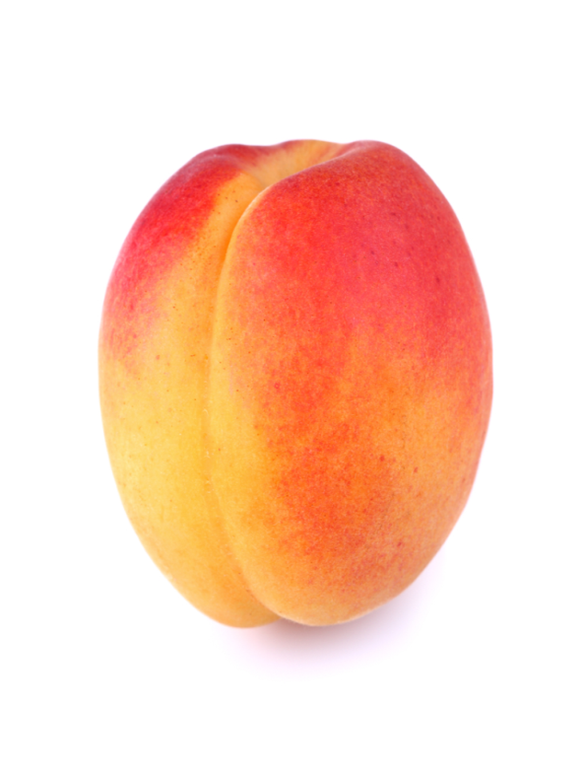
Assess the methodological issues raised when researching ….. [15]
For 15 marks, you need to have 3+ PEECChs
Point
Explanation
Example
Conclusion
Challenge
Topic title goes in here

Slide 29
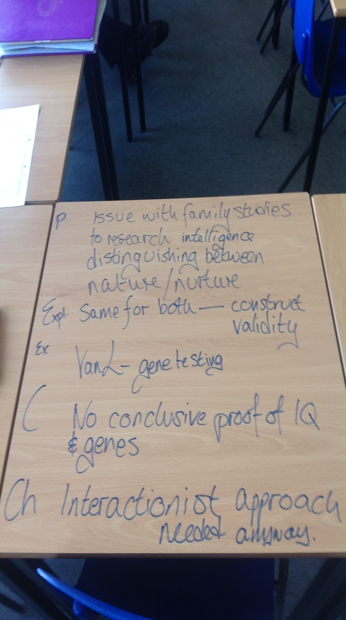
Assess the methodological issues raised when researching
Attachment [15]
The collection of evidence from witnesses [15]
The effects of imprisonment[15]

Slide 30
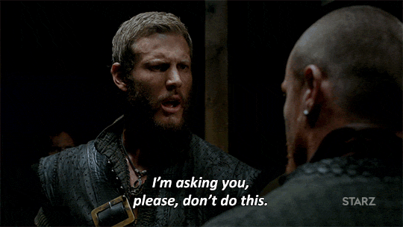
Methodological Issues
NOT just the key research
Give evidence from a number of sources (e.g. Paper 2 studies, background, Child or Crime in general)

Slide 31
Methodological Issues
Methodological ‘issues’ can be good or bad

Slide 32
Generic Methodological Issues
Can’t remember which methodological issues to mention? Sample, reliability and validity work for nearly every topic

Slide 33
Validity and Reliability

Slide 34
Validity and Reliability
Internal Reliability | Outside of the test, what can we replicate? Would we get the same results again?
External Reliability | Within the test itself, what has been kept consistent? The same for all participants?
Split-half | Where a test is split into two and each half is compared to each other to check for consistency.
Inter-rater | Where two or more researchers gain consistent results and agree on the findings.
Test-retest | Where a test can be replicated and the same result can be found.
Internal Validity | Within the test itself, does everything appear to be measuring what it intends to measure?
External Validity | Outside of the test, do the results hold true? Can they be applied in alternative settings? Or with alternative people?
Face Validity | On the surface does the test appear to be measuring what it intends to measure?
Construct Validity | The degree to which everything in the test is measuring what it claims to measure.
Concurrent Validity | Where the test is measured against a pre-existing standardised and established test.
Criterion Validity | How well one variable predicts another variable of future performance?
Population Validity | Do the results from the sample hold true if compared to the target population?
Ecological Validity | Do the results from the original setting of the study hold true in alterative settings, e.g. real-life?
Temporal Validity | Can the results be applied to different times and places?

Slide 35
Paper 3 Section B style Questions
Reliability: split half, inter-rater, test retest, controls, standardised procedures, standardised materials, counter-balancing
Validity: criterion, construct, concurrent, content, temporal, population, ecological, predictive

Slide 36
Paper 3 Section B style Questions
B Questions
15 marks:
3 = AO1 = Knowledge
12 = AO3 = Evaluation
It is crucial to show PEECCHs and links between paragraphs

Slide 37
C questions are applying your knowledge
The exact application is NOT stated. You decide where the strategy comes from, as long as it is relevant and answers the question.

Slide 38
C = Applications
Strategies
5 marks for HOW is done
5 marks for WHY it is done
Constantly refer to the unique words of the question to show application

Slide 39
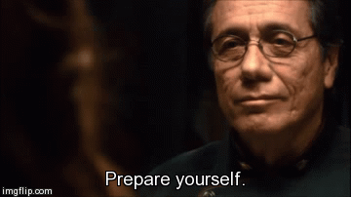
Strategies
WHAT are you going to do?
HOW are you going to do this?
WHEN?
WHERE?
WHEN?

Slide 40
Strategies
WHAT are you going to do?
Which piece of psychological research says that this will work?
HOW are you going to do this?
Why will this help the person in the story
WHEN?
Why is this suitable for the person in the story?
WHERE?
WHEN?

