Slide 1
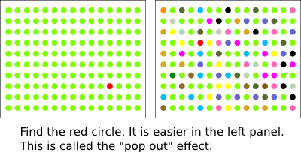

Slide 2
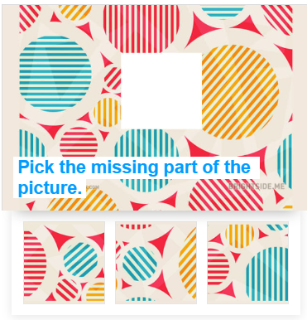
https://www.playbuzz.com/yanazr10/this-test-will-reveal-if-you-re-attentive-to-details

Slide 3
Starter Task 1: How attentive are you?
Without looking, can you identify:
What colour socks you have on?
What app is in the upper right-hand corner on the 2nd page on your phone?
What clothes your tutor was wearing today?
Which direction your bag is facing right now?
Which house’s flag is closest to the toaster?
Although we are constantly flooded with information, we don’t take everything in. There are some things that we pay attention to and others we don’t.

Slide 4
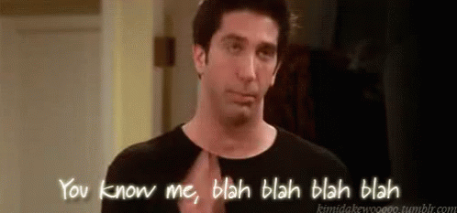
Starter Task 2: How attentive are you?
Whose voice can you ignore?
Whose voice can you not ignore?
https://www.youtube.com/watch?v=OsTTacH0jx0

Slide 5
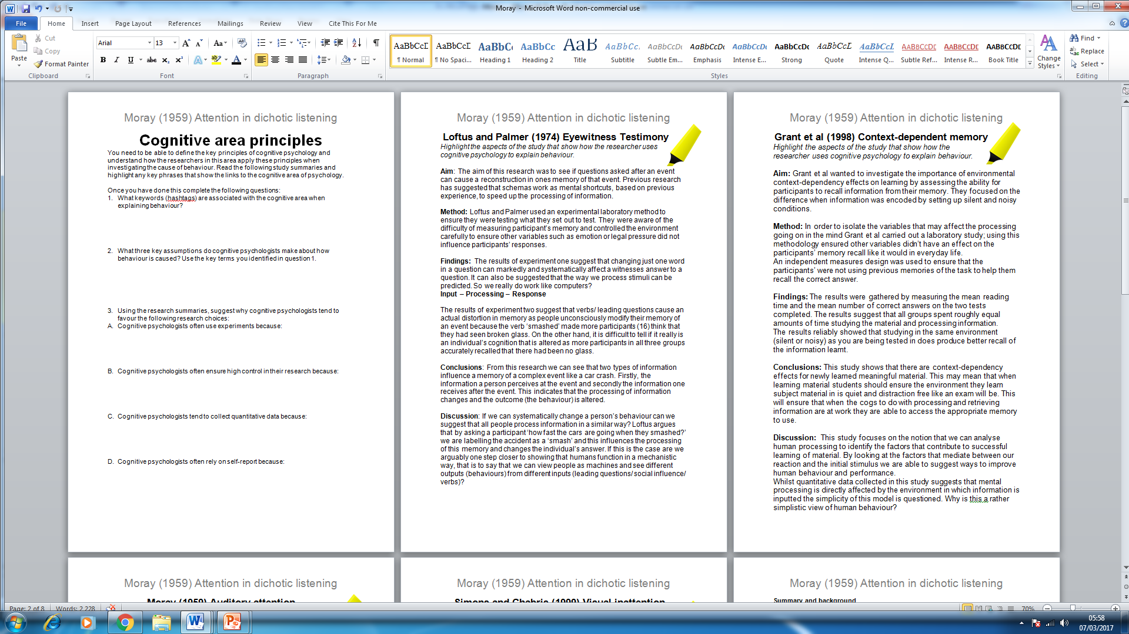
Starter Task 3: Cognitive Area Principles
Recap from last year

Slide 6
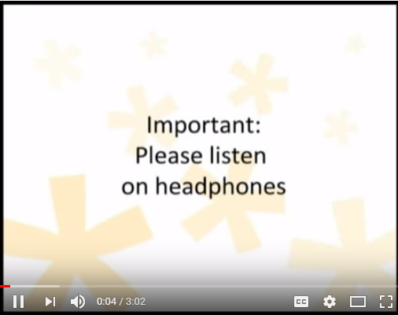
Starter Task 3: Auditory Attention
https://www.youtube.com/watch?v=zGKADgFCoeU
Got headphones?
Go to Youtube
Search for attentionlab
Then test of auditory awareness

Slide 7
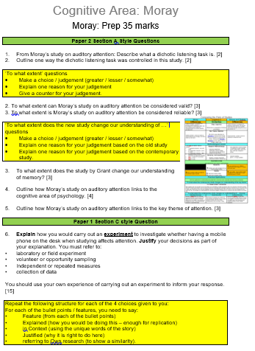
Moray (1959)
Attention in dichotic listening: affective cues and the influence of instructions
Prep due Tuesday 12/2/19

Slide 8

What is attention?
Cognitive overload. Attention is the process that lets us select some of it = selective or focused attention.

Slide 9

What is attention?
Attention is a cognitive process. It allows us to select what information in the world we want to focus on and to reject all the other information we don’t want.
Attention can be focused on visual as well as on auditory information.
It is very difficult to pay attention to everything around you.
There are certain cues, however, that make us automatically focus and pay attention to certain information.

Slide 10
What is attention?
For example, if you heard a gunshot at a party, you would probably stop listening to the person talking to you and look around for the source of the noise.
What other things grab our attention?

Slide 11

Cherry: cocktail party phenomenon
https://www.youtube.com/watch?v=9yRm7iWwFws
http://www.wsj.com/video/understanding-the-cocktail-party-effect/C743BE57-0623-4031-BE46-9223C25F0EBB.html

Slide 12

Cherry.
People are skilled at ‘tuning’ into one conversation among many while tuning out all others.
He came up with the idea of shadowing= Ps repeat one message they are listening to out loud whilst listening to a different message in each ear via headphones. Found little was remembered from unattended message (even that it's in a foreign language!

Slide 13
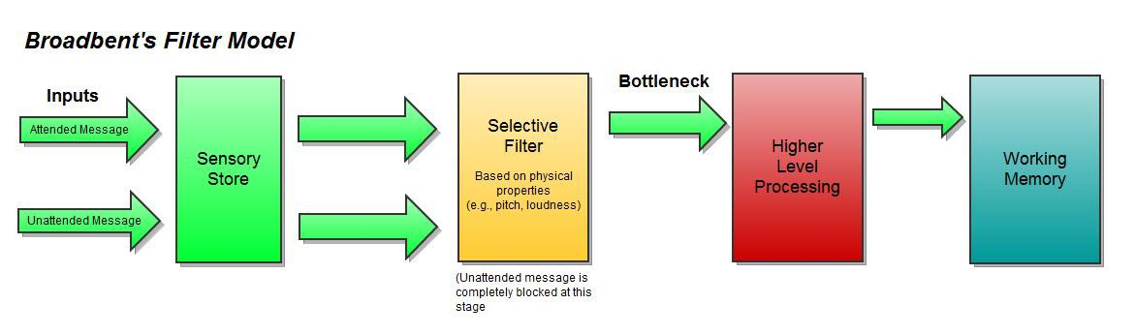
Broadbent. Filter model of selective attention
1950s He tried to solve problems of air traffic controllers listening to many messages at once.
Proposed filter model of selective attention. It proposes we tune into one channel and tune out all others The sensory filter mechanism achieved this early in the process.

Slide 14
Background
There are two main methods of studying attention:
Selective attention – here people are presented with two or more simultaneous ‘messages’, and are instructed to process and respond to only one of them. The most popular way of doing this is to use shadowing in which one message is fed into the left ear and a different message into the right ear (through headphones). Participants have to repeat one of these messages aloud as they hear it. The shadowing technique is a form of dichotic listening which was first used by Cherry (1953) when he studied the cocktail party phenomenon.

Slide 15
Background
There are two main methods of studying attention:
Divided attention – this is a dual-task technique in which people are asked to attend and respond to both (or all) the messages. Whereas shadowing focuses attention on a particular message, the dual-task method deliberately divides people’s attention.

Slide 16
Research Methods Focus
Selective attention / Divided Attention
Divided attention – this is a dual-task technique in which people are asked to attend and respond to both (or all) the messages. Whereas shadowing focuses attention on a particular message, the dual-task method deliberately divides people’s attention.

Slide 17

Aim
To test Cherry’s findings on attention ‘more rigorously’.
Sample
Undergraduate students and research workers of both genders at Oxford University.

Slide 18

Procedure
In this study there were three experiments.
All of the experiments were dichotic listening tasks (participants listened to two different messages, one in their right ear and another in their left ear).
The messages were passages of prose that were read by the same voice (a male speaker).
To make participants pay attention to only one message, participants had to shadow (repeat out loud what was being said) one of the two passages that they could hear.

Slide 19
Experiment 1
Participants had to shadow a piece of prose that they could hear in one ear. This was the attended message because participants were focusing on it.
In the other ear (the message that they were not paying attention to) a list of simple words was repeated 35 times. This was the rejected message.
At the end of the task participants completed a recognition task.

Slide 20
The recognition task
Participants were shown 21 words. Unknown to them, the words were split into three categories:
Seven were from the shadowed passage.
Seven were from the rejected message.
Seven were words not found in either passage.
Participants looked at the list of 21 words and chose the words they recognised from the shadowed passage.

Slide 21
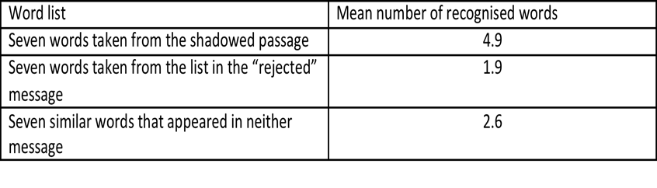
Experiment 1: Results
Conclusion
Participants are much more able to recognise words from the shadowed passage.
Almost none of the words from the rejected message are able to break the ‘inattentional barrier’.

Slide 22

Experiment 2
Now that Moray had found out that little or no information is able to pass through the ‘inattentional barrier’, he wanted to find out what could break it.
Experiment 2 was designed to see if a message with a strong enough meaning to the participant (an affective cue) would make the participant pay attention to the rejected message.
The affective cue used in this experiment was the participant’s own name.

Slide 23

Experiment 2: Procedure
Participants shadowed ten passages of fiction in this experiment.
They were told when shadowing to make as few mistakes as they could.
All ten passages had instructions at the start of the rejected passage.
Six of the ten passages also had instructions within the rejected passage.

Slide 24
Experiment 2: Procedure
Participants shadowed ten passages of fiction in this experiment.
They were told when shadowing to make as few mistakes as they could.
All ten passages had instructions at the start of the rejected passage.
Six of the ten passages also had instructions within the rejected passage.
Three instructions had non-affective cues. For example:
‘All right, you may stop now.’
‘Change to your other ear.’

Slide 25
Experiment 2: Procedure
Three instructions had affective cues. For example:
‘John Smith, you may stop now.’
‘John Smith, change to your other ear.’
The remaining four out of ten passages had no instructions in the rejected message.

Slide 26
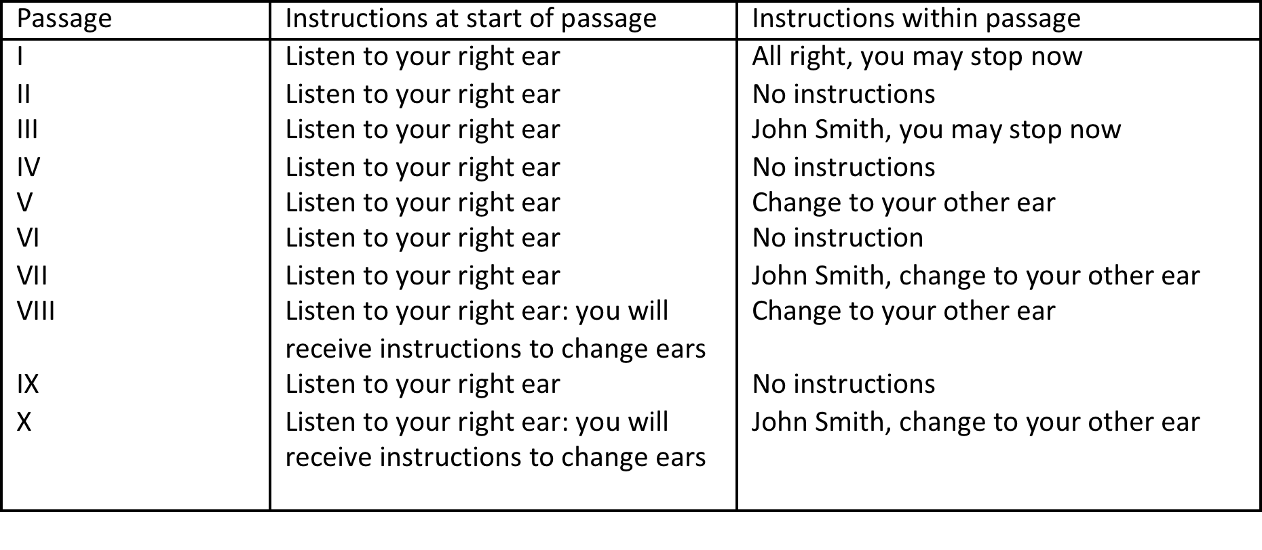
Twelve undergraduate students and research workers were used in Experiment 2.
Their performance on the shadowing tasks was recorded.

Slide 27
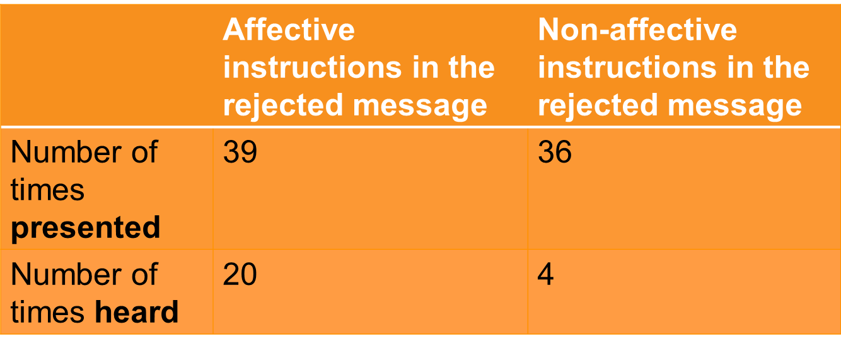
Experiment 2: Results
Instructions ‘presented’ were all the instructions presented to the participants, even if they were not paying attention to them.
Instructions ‘heard’ were instructions that participants actually followed or that they asked about after the task had finished.
Participants were far more likely to hear instructions that were affective than non-affective.

Slide 28

Experiment 3
Moray now wanted to find out if other material could break the inattentional barrier.
In this final experiment, two groups of 14 participants were used.
Once again, participants were presented with two simultaneous messages and had to shadow one of them.
In these messages spoken numbers (digits) were said out loud towards the end of the message.
Group 1 was told they would be asked questions about the shadowed message.
Group 2 was told specifically to remember as many digits as possible.

Slide 29
Experiment 3
The digits were:
sometimes present in both the shadowed and the rejected message
sometimes present only in the shadowed message
sometimes present only in the rejected message
sometimes not present in either message (control).
Experiment 3: Results
Showed that there was no significant difference between the number of digits recalled between Group 1 (told they would be asked general questions about the passage) and Group 2 (told specifically to remember as many digits as possible).
Conclusion
Numbers are not able to break the inattentional barrier in the same way that the participant’s own name can.

Slide 30

Overall conclusion
Moray drew several conclusions from his three experiments.
When asked to focus on one message, the rejected message is almost completely unable to break the attentional barrier, even if it is presented multiple times.
Some messages (like a person’s name), however, are able to break the attentional barrier if the message is important to that person.
It is difficult to make neutral material (e.g. digits) important enough to break the attentional barrier.

Slide 31

Moray: Quick Thinking
On the whiteboard, write
3 key terms for the study as a whole
3 key terms for experiment 1
3 key terms for experiment 2
3 key terms for experiment 3
3 reasons why the study has / lacks reliability
3 reasons why the study has / lacks validity
3 # for the cognitive area

Slide 32
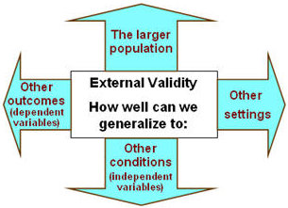
Evaluation: Research Method
Research method: The experimental conditions and the procedures that Moray created were highly controlled in a laboratory, therefore showing high internal validity.
However, due to the nature of the study and the sample, responses may have been a result of demand characteristics.
Furthermore, listening to sounds through headphones and being asked to block out or shadow the noises is extremely artificial and not true to real life; therefore, the study lacks ecological validity.

Slide 33

Evaluation: Reliability
Reliability: The procedures of the study, including instructions given to participants, are highly standardised which allows the study to be easily replicated and to check for the reliability of the findings.

Slide 34
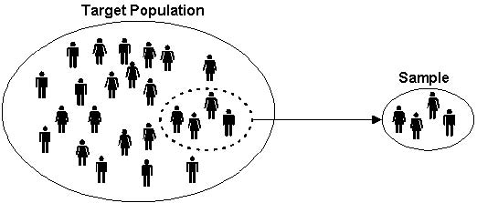
Evaluation: Sampling Bias
Sampling bias: As with many psychology studies, University students took part (as well as research workers).
This sample is easily accessible, so saves time and money on obtaining participants.
However, the sample is not representative of everyone, as students and research workers are likely to have higher cognitive abilities and may perform better on attention tasks. Therefore the study lacks population validity.

Slide 35

Link to debates
Psychology as a science – Moray was very careful to ensure that his study was carried out in controlled laboratory settings.
By doing this he ensured that this study was replicable, which is one of the standards required to consider psychology as a science.

Slide 36
Link to areas/perspectives
Moray’s study belongs to the cognitive area.
This is because the process of attention is a mental process.
The study investigates what material is required to ‘break’ the inattentional barrier.

Slide 37

Links to key themes
This study is related to the key theme of ‘attention’.
It investigated Cherry’s ‘cocktail party effect’ and found that information that is considered important to an individual (i.e. their name) will be significant enough to allow a participant to pay attention to it, even if they were paying attention to something else.
Do you think the findings from this study are generalisable only to auditory attention, or can the results be generalised to other types of attention (e.g. visual)?

Slide 38
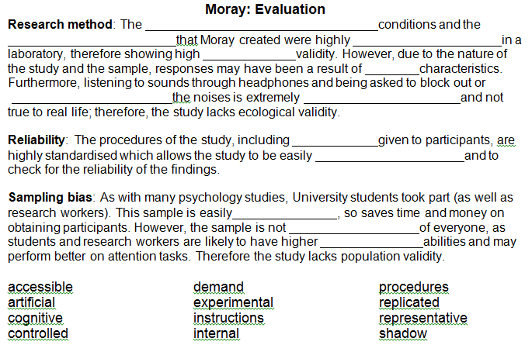
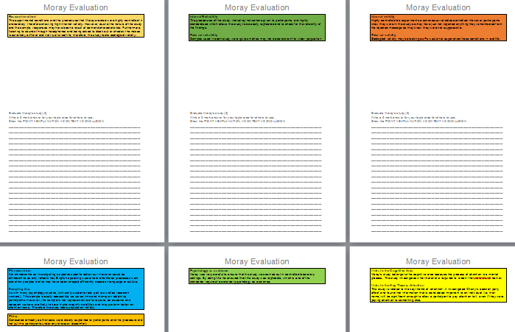
Moray Evaluation

Slide 39
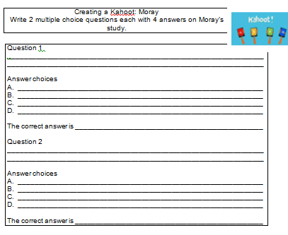
Moray Evaluation

Slide 40
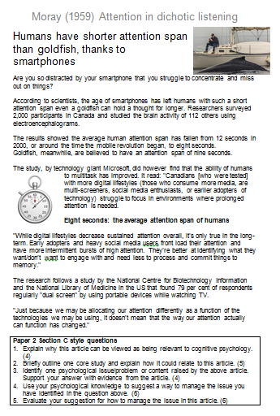
Paper 2 Section C style Questions
Explain why this article can be viewed as being relevant to cognitive psychology. (4)
Briefly outline one core study and explain how it could relate to this article. (5)
Identify one psychological issue/problem or content raised by the above article. Support your answer with evidence from the article. (4)
Use your psychological knowledge to suggest a way to manage the issue you have identified in the question above. (6)
Evaluate your suggestion for how to manage the issue in this article. (6)

Slide 41
Paper 2 Section C style Questions
Explain why this article can be viewed as being relevant to cognitive psychology. (4)
Learn the # for each area / perspective
Highlight the key words and phrases that could be evidence of a particular area or perspective.
Explain what the area / perspective believes CAUSES behaviour
Link this to the article
Use quotes.

Slide 42
Paper 2 Section C style Questions
Briefly outline one core study and explain how it could relate to this article. (6)
Learn the taglines for the 10 pairs of studies
Highlight the key words and phrases that could be evidence of a key word from the tagline.
Detail from the Core Study:
  Aim
  Ps/sample
  Method
  Results
  Conclusion
Link this to the article
Use quotes.

Slide 43
Paper 2 Section C style Questions
Identify one psychological issue/problem or content raised by the above article. Support your answer with evidence from the article. (4)
Issues can be good or bad or neither
These are just areas where psychologists might want to change behaviour or are interested in the ideas.
Learn the taglines for the 10 pairs of studies
Highlight the key words and phrases that could be evidence of a key word from the tagline.
State the issue clearly – the issue is …
Explain why psychologists would be interested in this
Use quotes to link this to the article.

Slide 44
Paper 2 Section C style Questions
Use your psychological knowledge to suggest a way to manage the issue you have identified in the question above. (6)
Explain WHAT you want to change and HOW you will change it
Know the types of application (prevention, intervention, treatment, therapy)
State which type of application it will be.
The majority of the marks are for HOW you would do it. For example: Social learning (grab their attention, repeat it to keep it in LTM, give them opportunity to reproduce it, with a motivation (vicarious or not).

Slide 45
Paper 2 Section C style Questions
Evaluate your suggestion for how to manage the issue in this article. (6)
It is OK to give weaknesses as well as strengths.
Can it be generalised to a variety of behaviours?
Practical issues especially time and cost
Which side of the debates will the suggestion be on - such as reductionism/holism, nature/ nurture and individual/situational.

