Slide 1
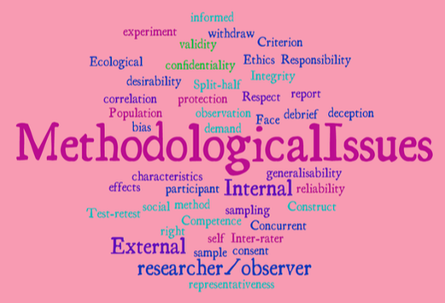
Methodological Issues
On Paper 3, you can be asked about the topic and the methodological issues with it.
Notes:
1

Slide 2
Methodological Issues
For each section / topic in Paper, you could have a 15 mark question on methodological issues:
Notes:
2

Slide 3
The question will usually have this beginning….
Assess the methodological issues of researching:
Plus the name of the topic / section title
Issues of Mental Health
Historical views about mental illness
Medical Model
Alternatives to the Medical Model
Notes:
3

Slide 4
Assess the methodological issues of researching
Child
Intelligence
Pre-adult brain development
Perceptual development
Cognitive development & education
Development of Attachment
Impact of advertising on children
Notes:
4

Slide 5
Assess the methodological issues of researching
Crime
What makes a criminal?
The collection and processing of forensic evidence
Collection of evidence
Psychology and the courtroom
Crime prevention
Effect of imprisonment
Notes:
5

Slide 6
General not specific
You will be thinking about HOW the topic in general has been researched, not just the Key Study.
You can bring use studies from Paper 2, the background to the topic and the topic’s strategy, as well as the key study as EVIDENCE.
Notes:
6

Slide 7
General not specific
If you evaluate the methodological issues of just the Key Study, you are NOT answering the question.
Notes:
7

Slide 8
General not specific
If you evaluate the methodological issues of just the Key Study, you are NOT answering the question.
Notes:
8

Slide 9
General not specific
If you evaluate the methodological issues of just the Key Study, you are NOT answering the question.
NAQ
Notes:
9

Slide 10
General not specific
You can bring use studies from Paper 2, the background to the topic and the topic’s strategy, the key study and studies from other topics as EVIDENCE.
Notes:
10

Slide 11
What are Methodological Issues?
These are any positive or negatives about HOW research into the topic is done
Research method
Procedures / Tasks / Equipment used
Equipment used
Research length
Experimental design
Collection of data
Sampling method
Sample size and features
Reliability
Validity
Ethics
Notes:
11

