Slide 1
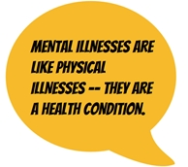
Is Mental Illness a Medical Matter?
Learning Objectives
AO1 – to explain the 3 medical model explanations of mental illness
AO2 – to apply these explanations to specific phobias
AO3 – to evaluate the strengths and weaknesses of these explanations, and their research methodology
3 explanations from the medical model of mental illness:
biochemical
brain abnormality
genes

Slide 2
Is Mental Illness a Medical Matter?
Summer Prep due Friday 13/9/19
5 mark summaries
Prep due Wed 26/6/19
To what extent are the medical model’s explanations of mental illness determinist? [10] (Past paper question 2018)

Slide 3
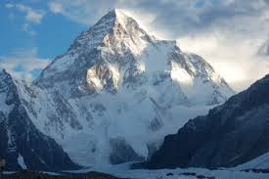
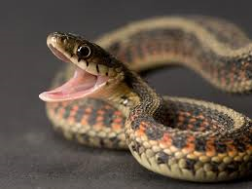
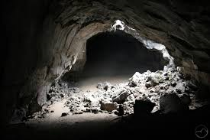
Phobia?
An irrational fear of an object or situation.

Slide 4
Pair task: Answers
Aichmophobia- fear of pointed objects
Amathophobia- fear of dust
Bacteriophobia-fear of bacteria
Chronomentrophobia- fear of clocks
Cyberphobia- fear of computers
Dentophobia- fear of going to the dentist
Didaskaleinophobia- fear of going to school
Eisotrophobia- fear of looking at oneself in the mirror
Gamophobia- fear of marriage
Hemaphobia- fear of blood
Iatrophobia-fear of going to the doctors
Ligyrophobia- fear of loud noises
Linonophobia- fear of string
Octophobia- fear of the number eight
Orphidiophobia- fear of snakes
Pteronophobia- fear of feathers
Siderodromophobia- fear of trains and tunnels
Sinistrophobia- fear of left handed objects
Trypanophobia- fear of injections

Slide 5
Types of phobias
Specific phobia
Phobia of a particular object or specific situation e.g. animal types, natural environment types (e.g. heights, water), blood-injection types (e.g. blood, syringes), situational types (e.g. lifts, planes) and other types that do not fit (e.g. clowns, choking).

Slide 6
Types of phobias
Social phobia
Phobia of a social situation e.g. restaurants, meetings, public speaking
Agoraphobia
Phobia of being in situations that the person cannot easily leave, such as in open spaces, crowds, public transport

Slide 7
Types of phobias
Behavioural
Ways in which people act
Cognitive
Refers to the process of thinking – knowing, perceiving, believing
Emotional
Ways in which people feel

Slide 8
Behavioural characteristics of phobias
Avoidance
Unless intentionally trying to face their fear, sufferers tend to go to great lengths to avoid their phobic item/situation.
This can interfere with a normal daily life in terms of routine, occupation, relationships.
Panic behaviours
This is in response to the presence of the phobic stimulus – crying, screaming, running away, freezing.

Slide 9
Cognitive characteristics of phobias
Irrational thinking
The fear regarding the phobic item/situation is irrational and excessive and is resistant to rational arguments
The person recognises that their fear is excessive/unreasonable (although may be absent in children).
Irrational beliefs
Illogical ways of interpreting situations
For example “I might suffocate if trapped in a lift” for an agoraphobic, or “that spider is going to kill me” or “I’m going to be an outcast if I go to that party”

Slide 10
Emotional characteristics of phobias
Anxiety
An emotional response of anxiety and fear that is marked and persistent, excessive.
It is triggered by the presence or anticipation of the phobic item.
Anxiety is the unpleasant state of high arousal and prevents relaxation.
It is probably accompanied by a panic attack (a feeling of panic but with biological characteristics as well).

Slide 11
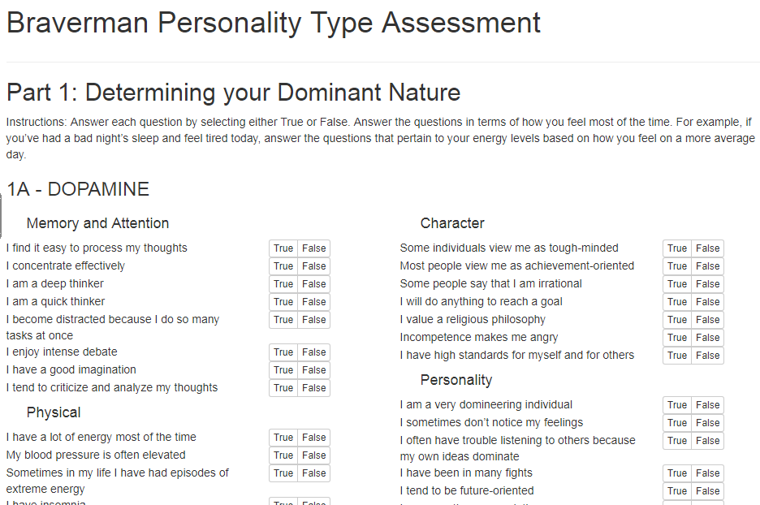
Is Mental Illness a Medical Matter?
https://www.bravermantest.com/

Slide 12
AO1 Knowledge How the Medical Model Explains Mental illness

Slide 13
How the Medical Model Explains Mental illness
The medical model views mental illnesses just like other illnesses.
They have a physical cause.
They can be diagnosed by listing the symptoms.
They can be treated by adjusting the physical cause.

Slide 14
How the Medical Model Explains Mental illness
Example of a psychotic disorder: schizophrenia
Example of an anxiety disorder: OCD
Example of an affective psychotic disorder: bipolar depression
The ICD-10 and DSM-V list the symptoms of mental illnesses. These have strong external reliability but poor external validity.

Slide 15
How the Medical Model Explains Mental illness
There are 3 explanations from the medical model of mental illness:
biochemical
brain abnormality
genes
Explanation | Example | How to study this | Treatment
Biochemical | Too much dopamine
Brain abnormality |  | Brain scans
Genetic |  |  | Gene counselling

Slide 16
How the Medical Model Explains Mental illness
Explanation | Example | How to study this | Treatment
Biochemical | Too much dopamine
Brain abnormality |  | Brain scans
Genetic |  |  | Gene counselling

Slide 17
How the Medical Model Explains Mental illness
Explanation | Example | How to study this | Treatment
Biochemical | Too much dopamine | Taking medication | Medication
Brain abnormality | Under / over activity | Brain scans | Psychosurgery
Genetic | Specific genes | Family, twin studies | Gene counselling

Slide 18
AO3 Evaluation Strengths and weaknesses of the Medical Model’s explanation of Mental illness

Slide 19
Strengths and Weaknesses: Medical Model in general
Strengths of the medical model include:
Useful
Psychology as a Science
Weaknesses of the medical model include:
use of labels as a way of pathologising people whose behaviour we do not like or cannot explain
concurrent validity
inter-rater reliability
reductionist approach
nature not nurture
Deterministic

Slide 20
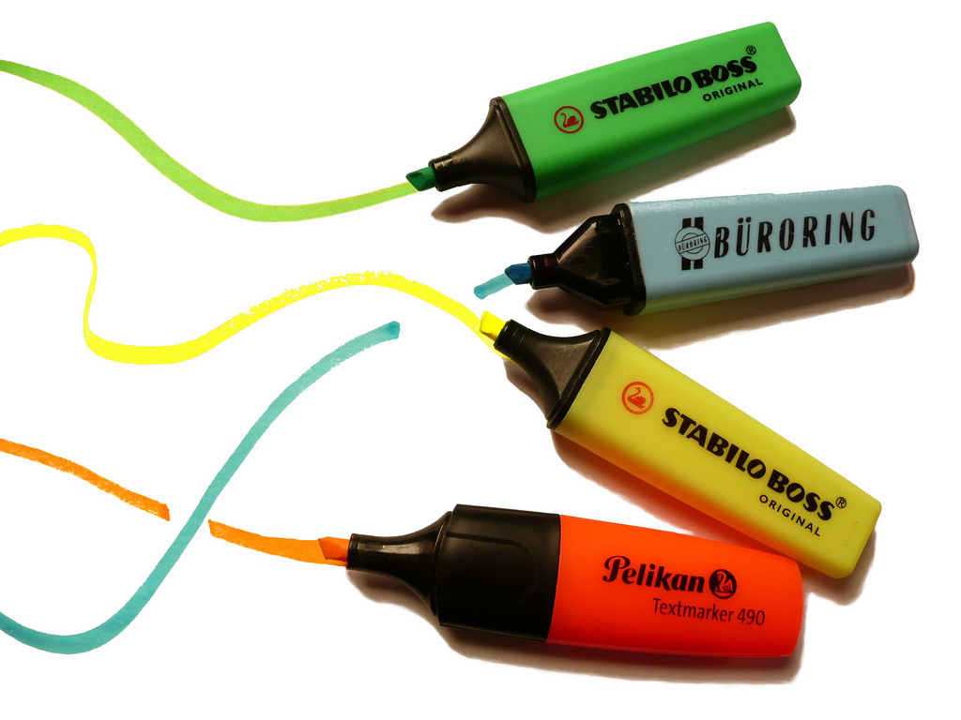
Strengths and Weaknesses: Medical Model in general
Identify the
Point
Explanation
Example
Conclusion
Challenges
in the following developed evaluation points

Slide 21
Strengths of the Medical Model
Strengths of the medical model include:
P Not blaming people for their abnormal behaviour.
E The person’s body has caused the behaviour, not their personality or intentions.
C This is useful as it has led to more human treatment of the mentally ill.

Slide 22
Strengths of the Medical Model
Strengths of the medical model include:
P. Objective evidence shows that biological causes can be linked to psychological symptoms,
E. such as high dopamine levels in schizophrenia.
C. This helps Psychology to be viewed as a Science, as objective, replicable and empirical methods have been used.

Slide 23
Weaknesses of the Medical Model
P. Psychiatrists such as Szasz see the use of labels, such as ‘mentally ill’ as a way of pathologising people
E. whose behaviour we do not like or cannot explain.
C. This is a problem because the labels are being used for political not helpful reasons.

Slide 24
Weaknesses of the Medical Model
P. There may be problems of concurrent validity in the diagnosis of mental health
E. as there are a range of different diagnostic tools such as the DSM-V and ICD-10.
C. This is a problem as some may be diagnosed and others not.

Slide 25
Weaknesses of the Medical Model
P. There may be problems of inter-rater reliability in the diagnosis,
E. especially as different diagnostic tools such as the DSM-V and ICD-10 are used.
C. A diagnosis should have external reliability – consistency over time, place and people.

Slide 26
Weaknesses of the Medical Model
P. The medical model takes a reductionist approach to mental illness.
E. It ignores the behaviourist, cognitive and psychodynamic factors which may also cause the behaviour.
C. This is problematic as an incomplete explanation of the illness will mean any treatment might not be fully curative.

Slide 27
Weaknesses of the Medical Model
P. The medical model takes a nature not nurture approach to mental illness, especially if genetic explanations are given.
E. This suggests that people are ‘born’ to become mentally ill and
C. this level of determinism means that people may believe there is little or nothing that they can do about it.

Slide 28
Weaknesses of the Medical Model
P. This view is also determinist
E. as it suggests that a chemical imbalance will cause mental illness.
Ch. However, it can be argued that not all individuals with psychological disorders have abnormal levels of neurotransmitters
Ch. and not everyone with a chemical imbalance develops a mental illness.

Slide 29
Strengths and Weaknesses: Medical Model in general
Nature /Nurture debate
In the list below colour in ONE colour the words relating to the nature side of the arguments and colour in ANOTHER colour the terms relating to the nurture side

Slide 30
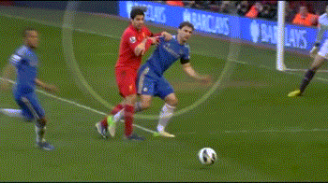
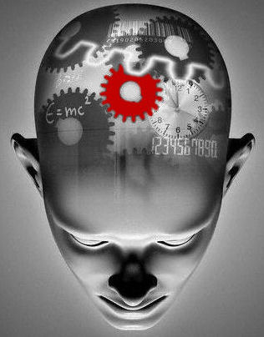
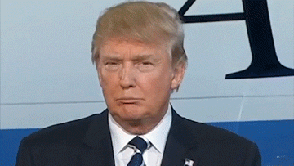
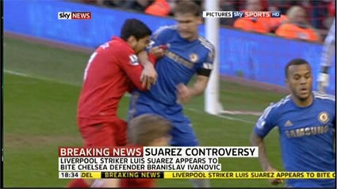
How would the medical model explain this behaviour?

Slide 31
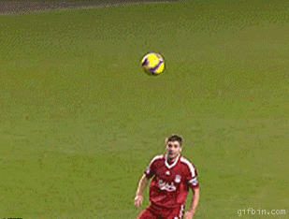
How would the medical model explain this behaviour?

Slide 32
AO1 Knowledge Medical Model’s biochemical explanation of Mental illness

Slide 33
Biochemical explanation of mental illness: Summary
AO1 – knowledge
The biochemical explanation believes that the cause of mental illness is abnormal levels of neurotransmitters – too much or too little.
AO2 – application
The cause of specific phobias is too little GABA
AO3 – evaluation
Difficult to establish cause and effect
Reductionist
Deterministic

Slide 34
Biochemical explanation of mental illness in general
The cause of mental illness is abnormal levels of neurotransmitters.
Neurotransmitters are chemicals made by the body. They are released at the end of nerve cells (neurons). This happens an electrical charge has passed along the neuron. They pass across the gap (synapse) between nerve cells. They activate receptors in the next neuron, depending on the quantity required.
https://www.youtube.com/watch?v=p5zFgT4aofA

Slide 35
Biochemical explanation of mental illness in general
The neurotransmitters have either excitatory or inhibitory effects on the next neuron. Excitatory (e.g. serotonin) neurotransmitters make the next (post-synaptic) cell more likely to fire. Inhibitory (e.g. GABA) make them less likely to fire.
Mental illness can result from too many or too few neurotransmitters binding to receptors.
Page 7

Slide 36
Biochemical explanation of mental illness in general
Action of the Neurotransmitter | Example | Too much | Too little
Excitatory
Inhibitory | GABA | Inhibits too much so there is no activity | Does not inhibit enough so there is too much activity
Page 7

Slide 37
Biochemical explanation of mental illness in general
Page 7
Action of the Neurotransmitter | Example | Too much | Too little
Excitatory | Serotonin | Causes too much activity to occur, leading to erratic behaviour | Does not allow for any activity
Inhibitory | GABA | Inhibits too much so there is no activity | Does not inhibit enough so there is too much activity

Slide 38
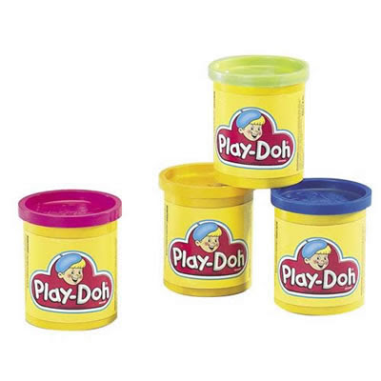
Medical Model
Medical Model
Biochemical explanation
Brain abnormality explanation
Genetic explanation
Nature not nurture
..\..\Teaching and Learning\Lesson Activities\Countdown.pptx

Slide 39
AO2 Application Applying the Medical Model’s biochemical explanation to specific phobias

Slide 40
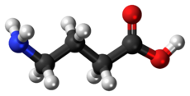
Biochemical explanation of specific phobias
The biochemical explanation believes that the cause of specific phobias is low levels of the neurotransmitter GABA.
Neurotransmitters are chemicals made by the body. They are released at the end of nerve cells (neurons). This happens an electrical charge has passed along the neuron. They pass across the gap (synapse) between nerve cells. They activate receptors in the next neuron.
One big problem for this is that it is difficult to establish cause and effect.
Did the imbalance cause the mental health issue or did the mental health issue cause the imbalance?
gamma-Aminobutyric acid

Slide 41
AO3 Evaluation Strengths and weaknesses of the Medical Model’s biochemical explanation of specific phobias

Slide 42
Biochemical explanation of mental illness in general: Getting Empirical Evidence
Getting Empirical Evidence
post mortems
collecting spinal fluid
giving medication to see any adjustment in behaviour
Pande et al (1999) randomly assigned 69 patients with social phobia to 2 groups:
experimental group where they took medication to increase the levels of GABA for 14 weeks
control group who took a placebo instead.
The experimental group showed a significant reduction in symptoms compared to the control group.

Slide 43
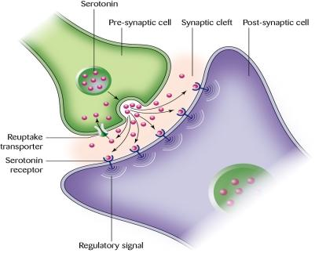
Biochemical explanation of mental illness in general: Evaluation
Success of drug treatments
Unable to establish cause and effect
Individual differences
Reductionist
Deterministic

Slide 44
Evaluation Challenge
Do smiling CAUSE you to be happy?
Or does being happy CAUSE you to smile more?

Slide 45
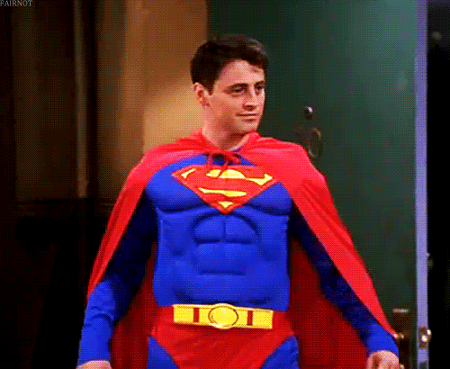
Evaluation Challenge
Do higher testosterone CAUSE you to do more powerful poses
Or do powerful poses CAUSE you to produce more testosterone?

Slide 46
Evaluation Challenge
Page 7
Do phobias CAUSE GABA to decrease?
Or does a decrease in GABA CAUSE more phobic behaviours?

Slide 47
Evaluation Challenge
Also, it is unclear whether the link is the correct way around, particularly if low GABA is an effect / symptoms of phobias and not a cause.
Page 7

Slide 48
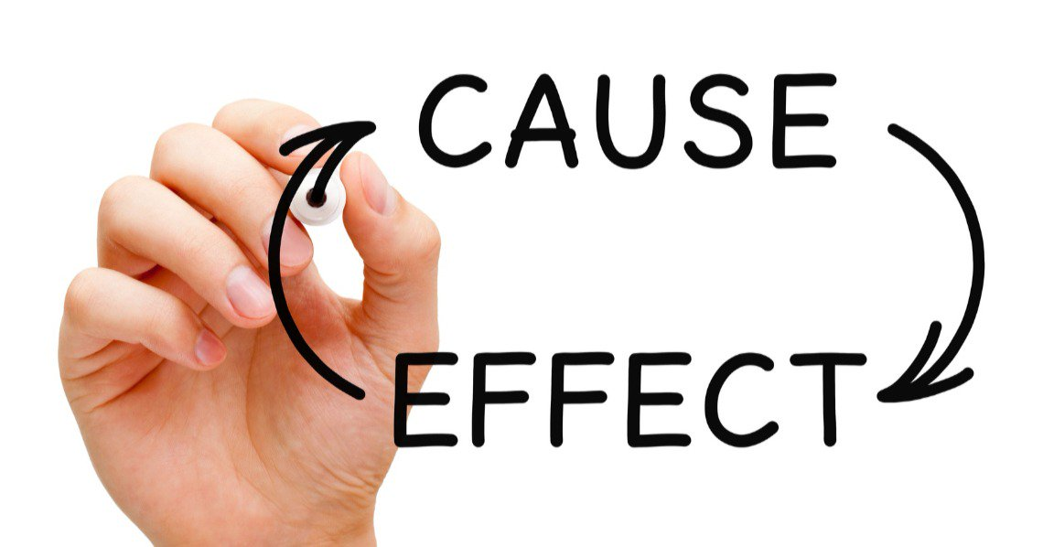
Evaluation Challenge: The Aetiological Fallacy
Also, it is unclear whether the link is the correct way around, particularly if low GABA is an effect / symptoms of phobias and not a cause.

Slide 49
Evaluation Challenge: The Aetiological Fallacy
If the treatment WORKS does that prove that the CAUSE identified by that treatment is CORRECT?

Slide 50
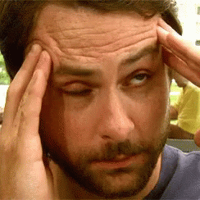
Evaluation Challenge: The Aetiological Fallacy
How do you treat a headache? Does this treatment show what the cause really is?

Slide 51
Evaluation Challenge: The Aetiological Fallacy
How do you treat period pain? Does this treatment show what the cause is?

Slide 52
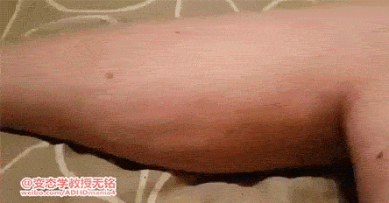
Evaluation Challenge: The Aetiological Fallacy
How do you treat muscle spasm? Does this treatment show what the cause is?

Slide 53
Strengths and Weaknesses: Biochemical Explanation
Identify the
Point
Explanation
Example
Conclusion
OR Challenges
in the developed evaluation points
Page 7

Slide 54
Strengths and Weaknesses: Biochemical Explanation
Page 7
POINT The success of drug treatments for some individuals supports the biochemical explanation
EXPLANATION as these drugs stabilise levels of the neurotransmitters and reduce symptoms.
CONCLUSION This suggests that the cause was biochemical in the first place
CHALLENGE: But this shows the aetiological fallacy.

Slide 55
Strengths and Weaknesses: Biochemical Explanation
Page 7
POINT: Biological explanations of mental illness are unable to establish cause and effect.
EXPLANATION: The abnormal levels of neurotransmitters may be the cause or a symptom of the mental illness

Slide 56
Strengths and Weaknesses: Biochemical Explanation
Page 7
POINT: Medication does not work for all patients
EXPLANATION: (individual differences), and this ignores other causes
EXAMPLES: such as cognitive, behavioural or psychodynamic explanations
CONCLUSION: (reductionist).

Slide 57
Strengths and Weaknesses: Biochemical Explanation
Page 7
POINT: This view is also determinist
EXPLANATION: as it suggests that a chemical imbalance will cause mental illness.
CHALLENGE: However, it can be argued that not all individuals with psychological disorders have abnormal levels of neurotransmitters and not everyone with a chemical imbalance develops a mental illness.

Slide 58
AO1 Knowledge Medical Model’s brain abnormality explanation of Mental illness

Slide 59
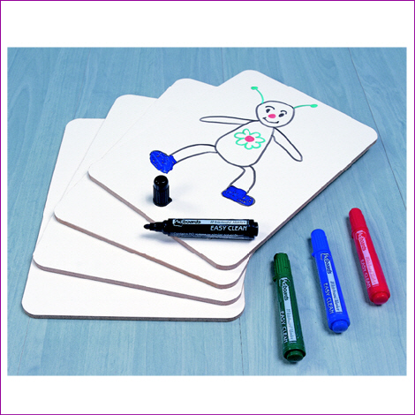
Recap – Sperry and Casey What does the word / phrase mean? What is the area responsible for?
Localisation of function
Lateralisation
Right hemisphere
Left hemisphere
Corpus callosum
Prefrontal cortex
Ventral striatum

Slide 60
AO1: Brain Abnormality as an Explanation of Mental Illness
Different parts of our brain are responsible for different behaviours (localisation of function), and the Medical Model suggest that different mental illnesses may be associated with specific parts of the brain.
The cause could be over-activity in the brain leading to excess functioning, or underactivity which could cause deficits in behaviour.

Slide 61
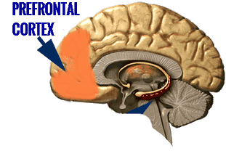
AO2: Brain Abnormality as an Explanation of Specific Phobias
The prefrontal cortex suppresses (inhibits) the fear response.
If the prefrontal cortex is not functioning effectively, it no longer stops fearful urges, like the fight or flight response which are sent from the amygdala.

Slide 62
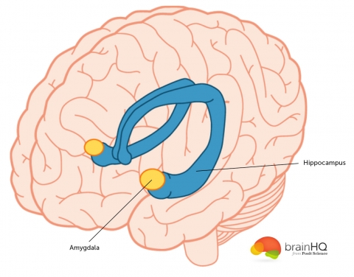
AO2: Brain Abnormality as an Explanation of Specific Phobias
The amygdala detects and responds to threats in the environment. People who suffer from anxiety and phobias have smaller amygdalae and these have greater blood flow. This leads to an inability to control the fear response to objects and situations.

Slide 63
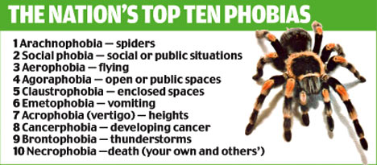
AO2: Brain Abnormality as an Explanation of Specific Phobias
Prefrontal cortex = lower activity
Amygdala = greater activity

Slide 64
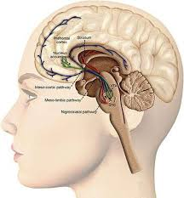
Prefrontal cortex (inferior frontal gyrus = lower activity
Ventral striatum = greater activity

Slide 65
AO2: Getting Empirical Evidence Brain Abnormality as an Explanation of Specific Phobias
Post mortems and brain scans
Ahs et al (2009) used PET scans to measure blood flow in the amygdala and prefrontal cortex of patients with snake / spider phobia.
They found:
Increased blood flow and activity in the amydala
Reduced blood flow and activity in the prefrontal cortex
When they showed objects that were fearful to the patients.
Page 8
https://www.youtube.com/watch?v=lk-VzATcv4M

Slide 66
AO3: Strengths and Weaknesses: Brain Abnormality Explanation
The use of equipment such as PET scans and MRI scans ensures that supporting evidence for this explanation is valid. We measure brain abnormalities in an objective, scientific way, which can easily be replicated.
There is evidence that our behaviour is controlled by our brains which supports the determinism debate. However, this ignores the role of free will in that we are in control of our own cognitions and behaviours.
Page 8

Slide 67
AO3: Strengths and Weaknesses: Brain Abnormality Explanation
There is a danger of biological determinism: just because an individual has a smaller amygdala does not mean they will definitely develop phobias, this is just one of a number of risk factors.
This explanation also supports the individual debate in that our individual characteristics such as anatomical differences can cause mental illness, regardless of the situations that we are exposed to.
Page 8

Slide 68
AO3: Strengths and Weaknesses: Brain Abnormality Explanation
Identify the
Point
Explanation
Example
Conclusion
Challenges
in the developed evaluation points
Page 8

Slide 69
AO3: Strengths and Weaknesses: Brain Abnormality Explanation
POINT: The use of equipment
EXAMPLES: such as PET scans and MRI scans
POINT: ensures that supporting evidence for this explanation is valid.
EXPLANATION: We measure brain abnormalities in an objective, scientific way, which can easily be replicated.
Page 8

Slide 70
AO3: Strengths and Weaknesses: Brain Abnormality Explanation
POINT: There is evidence that our behaviour is controlled by our brains which supports the determinism debate.
CHALENGE: However, this ignores the role of free will in that we are in control of our own cognitions and behaviours.
Page 8

Slide 71
AO3: Strengths and Weaknesses: Brain Abnormality Explanation
POINT: There is a danger of biological determinism
EXPLANATION: just because an individual has a smaller amygdala does not mean they will definitely develop phobias,
CONCLUSION: this is just one of a number of risk factors.
Page 8

Slide 72
AO3: Strengths and Weaknesses: Brain Abnormality Explanation
POINT: This explanation also supports the individual debate
EXPLANATION: in that our individual characteristics
EXAMPLE: such as anatomical differences
EXPLANATION: can cause mental illness, regardless of the situations that we are exposed to.
Page 8

Slide 73
AO3: Strengths and Weaknesses: Brain Abnormality Explanation

Slide 74
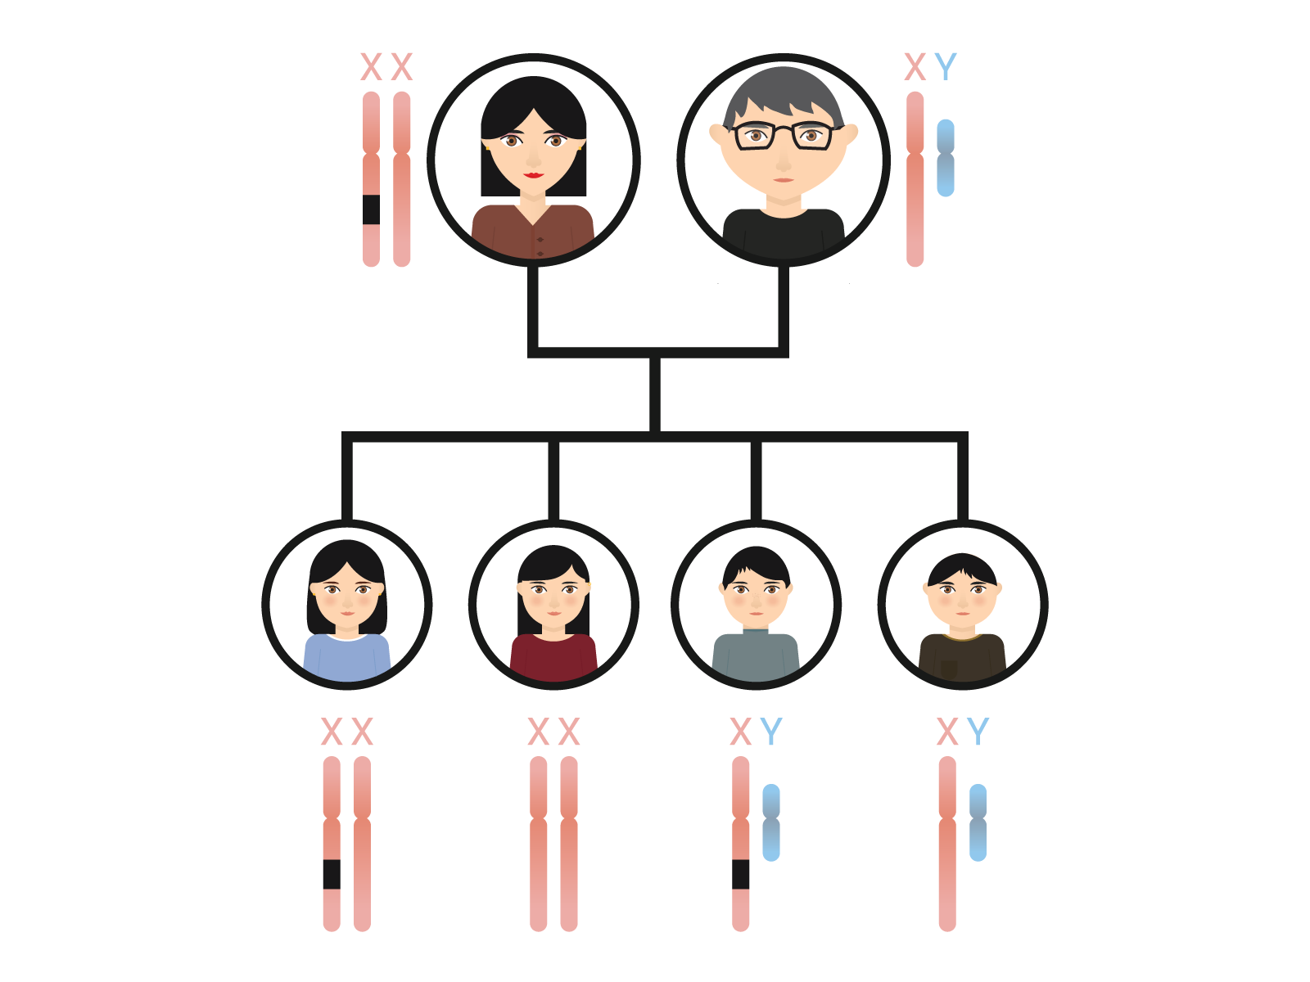
What have you inherited from a parent?

Slide 75
Could you have a single gene for …
An irritable temperament
A risk-taking personality
The number of children a woman will have
Schizophrenia
Anti-social behaviour

Slide 76
Could you have a single gene for …
An irritable temperament – variant MSRA
A risk-taking personality - – variant CADM2
The number of children a woman will have – variant ESR1
Schizophrenia - GRIA2
Anti-social behaviour – variant MAOA & cadherin 13

Slide 77
AO1: Knowledge: Genes as an Explanation of Mental Illness
The genetic explanation suggests that:
Family and twin studies show some mental illnesses are at least partly caused by innate factors
People inherit mental illnesses from their parents, through genes
People with mental illnesses are more likely to have close relatives with mental illnesses too
..\..\Psych Dept Admin\Displays\Pareidolia 2018.pptx

Slide 78
AO2: Application: Genes as an Explanation of Specific Phobias
Perhaps all humans have inherited, through natural selection, a tendency to fear certain potentially dangerous things e.g. heights.
Seligman argues this is because long ago people who did not fear and avoid them, died – so their genes were not passed on

Slide 79
AO2: Gaining Empirical Evidence: Genes as an Explanation of Mental Illness
One way of finding out whether a disorder has a genetic component is to see whether it runs in families. If relatives of sufferers have a higher than average risk of getting the disorder themselves, then it may be that the disorder has a genetic component.
However, family members typically share similar environments. Consequently, increased risk amongst close relative may simply indicate that that are exposed to the same set of environmental risks.
MZ concordance is significantly higher than DZ concordance | The disorder has a genetic component
MZ concordance is same or similar to DZ concordance | The disorder is environmentally caused.
MZ concordance is 100% | The disorder is genetically caused
MZ concordance is significantly less than 100% | The disorder has an environmental component

Slide 80
AO2: Gaining Empirical Evidence: Genes as an Explanation of Mental Illness
An alternative approach is to do a twin study. This looks at the concordance (similarity) of twins with respect to the disorder being considered. Concordance rates are expressed as a percentage. The percentage is the probability of one twin having the disorder if the other already has it.
MZ concordance is significantly higher than DZ concordance | The disorder has a genetic component
MZ concordance is same or similar to DZ concordance | The disorder is environmentally caused.
MZ concordance is 100% | The disorder is genetically caused
MZ concordance is significantly less than 100% | The disorder has an environmental component

Slide 81
AO2: Gaining Empirical Evidence: Genes as an Explanation of Mental Illness
In a twin study, MZ (identical) and DZ (non-identical) twins are compared. Whilst MZ twins have a greater degree of genetic similarity, both types of twin pair grow up in identical environments. So if we discover that MZ twins have a higher concordance, this cannot be because their environments are more similar than those of DZ twins; it must therefore be because their genes are more similar.
https://quizlet.com/413122984/the-medical-model-of-mental-illness-flash-cards/
https://create.kahoot.it/create#/edit/e7429eb1-3155-4a98-b03a-dcb3a0d33b75/done
MZ concordance is significantly higher than DZ concordance | The disorder has a genetic component
MZ concordance is same or similar to DZ concordance | The disorder is environmentally caused.
MZ concordance is 100% | The disorder is genetically caused
MZ concordance is significantly less than 100% | The disorder has an environmental component

Slide 82
Draft 1 P-E-E-C-CH for your birth month

Slide 83
Even if you have that gene … will you show the behaviour?
http://learn.genetics.utah.edu/content/epigenetics/rats/

Slide 84
Medical Model: Gottesman
https://www.youtube.com/watch?v=ahftOcYUR9E
Records of families from the national register in Denmark were used.
Participants were born or alive after 1968 and offspring followed up to 52 years old.
Patients were diagnosed using ICD-8 and ICD-10 which had been checked for concurrent validity.
The study measures the cumulative incidences of schizophrenia and bipolar disorder in the offspring up to the age of 52.
Gottesman’s work is a correlational analysis.
Summarise Gottesman's study into 5 marks worth of material (aim, sample, procedure, results, conclusions).

Slide 85
Learning Objectives
Identify the features of correlations.
Outline differences between positive and negative correlations and no correlations.
Outline features of a correlation coefficient.
Notes:
The aim of this session will be to introduce correlations to students. Teacher to deliver information about positive and negative correlations (most students should be familiar from GCSE Maths, so teacher should encourage students to give information rather than passively receive it)

Slide 86
Key terms
Correlation
Positive correlation
Negative correlation
No correlation
Correlation coefficient

Slide 87
Correlations
Correlation: a measure of how strongly two or more variables are related to each other:
Height is positively correlated to shoe size
The taller someone is, the larger their shoe size tends to be.
Like Self Report and Observation, there is no manipulation of data, conditions or groups in correlations.
No IV or DV, just to co-occurring variables (co-variables).
Stretch & Challenge: If there is no IV, what can’t we establish?
Notes:
Teacher to stress the correct use of terminology: co-variables rather than IV and DV.

Slide 88
Correlations
Still use the same sampling methods:
Volunteer, self selected, random, snowball
Still consider the same ethical issues:
How many of the ethical issues can you identify? Give an example of how each ethical issue may need to be considered in a correlation.
Notes:
Encourage students to recall how each of the sampling techniques would be used in addition to the ethical guidelines. Learners should be given a few minutes to recall independently, use a random name generator, or similar, to target students to share information

Slide 89
Unlike experiments there is no IV, just two variables that occur together as ‘co-variables.’
As there is no IV to manipulate we cannot establish cause and effect.
We don’t know which variable is causing the other, we just know there is a relationship between them.
DV
Experiment
IV
CAUSE
EFFECT

Slide 90
Unlike experiments there is no IV, just two variables that occur together as ‘co-variables.’
As there is no IV to manipulate we cannot establish cause and effect
We don’t know which variable is causing the other, we just know there is a relationship between them.
CoV
CoV
Correlation
?
NO CAUSE & EFFECT

Slide 91
Correlations can be both the primary method or secondary technique.
Self reports and observations can both be used as a way to gather data on variables, and then see if there is a relationship between them.
Primary method: Correlations
Secondary technique:
Self report/Observation
Experiments can compare the data between two groups using correlations.
I find out men have a stronger correlation between age and time spent looking in the mirror than women.
Primary method: Experiment
Secondary technique:
Correlation
Stretch and Challenge: which core study uses experiment as the method and correlation as the technique?
Notes:
Students should be aware of the difference between correlation as a method and as a technique. Encourage students to think of examples of core studies that use correlation.

Slide 92
Paper 1 Section B: Research design and response
Hypotheses questions – 3 marks
Variable 1 operationalised
Variable 2 operationalised
Correct type of hypothesis

Slide 93
Hypotheses
Unlike Observation and Self Report we can generate hypotheses for Correlation Research.
Recap:
Null Hypothesis
Alternate hypothesis (one tailed or two tailed).
What is the difference between a one tailed and a two tailed hypothesis?

Slide 94
Hypotheses
Correlations can’t show cause and effect
Can’t mention the effect one variable will have on the other so we talk about the ‘relationship’ between two variables
Still using the term significant
Still must clearly state the variables and how they have been operationalised
NEVER using the words cause, effect or difference.

Slide 95
Hypotheses
Null hypothesis: there will be no relationship
There will be no significant relationship between V1 and V2.
Alternate hypothesis:
One tailed: There will be a significant positive/negative relationship between V1 and V2
Two tailed: there will be a significant relationship between V1 and V2.
Which word(s) must you NEVER use in a correlational hypothesis?
Notes:
ACTIVITY - Give examples of variables, cut up key words and variables and have students sort into the correct order (or line up each with a different word from the hypothesis)

Slide 96
Paper 1 Section B: Research design and response
Correct type of hypothesis for correlations:
There will be ….. relationship / correlation between … and …

Slide 97
Paper 1 Section B: Research design and response
There will be a significant positive relationship between number of pets owned and the amount of money spent on pet food per week (£).
Null / 2 tailed non-directional / 1 tailed directional hypothesis?

Slide 98
Paper 1 Section B: Research design and response
There will be no significant relationship between a person’s mood (scores on affective index) and the amount of chocolate they consume (grams).
Null / 2 tailed non-directional / 1 tailed directional hypothesis?

Slide 99
Paper 1 Section B: Research design and response
There will be a significant negative relationship between the amount of time spent watching reality TV shows (minutes) and final exam grades (A* - U).
Null / 2 tailed non-directional / 1 tailed directional hypothesis?

Slide 100
Paper 1 Section B: Research design and response
There will be a significant relationship between amount of exercise (hours per week) and weight (kilos).
Null / 2 tailed non-directional / 1 tailed directional hypothesis?

Slide 101
Page 13
Writing your own hypothesis
A psychologist is researching whether there is a relationship between the amount of time listening to music and self-esteem. She gives participants a questionnaire with two items: how many hours they spend listening to music per week on average, and a likert scale question asking them to rate their self-esteem from one to ten (where one is low and ten is high).
Operationalisation
Unit of measurement for time
Operationalisation
Unit of measurement for self esteem

Slide 102
Page 13
Writing your own hypothesis
A psychologist is researching whether there is a relationship between the amount of time listening to music and self-esteem. She gives participants a questionnaire with two items: how many hours they spend listening to music per week on average, and a likert scale question asking them to rate their self-esteem from one to ten (where one is low and ten is high).
Null hypothesis = There will be no relationship between COVARIABLE #1 (operationalised) and COVARIABLE #2 (operationalised).

Slide 103
Page 13
Writing your own hypothesis
A psychologist is researching whether there is a relationship between the amount of time listening to music and self-esteem. She gives participants a questionnaire with two items: how many hours they spend listening to music per week on average, and a likert scale question asking them to rate their self-esteem from one to ten (where one is low and ten is high).
Directional = There will be a positive / negative relationship between COVARIABLE #1 (operationalised) and COVARIABLE #2 (operationalised).

Slide 104
Page 13
Writing your own hypothesis
A psychologist is researching whether there is a relationship between the amount of time listening to music and self-esteem. She gives participants a questionnaire with two items: how many hours they spend listening to music per week on average, and a likert scale question asking them to rate their self-esteem from one to ten (where one is low and ten is high).
Non-directional = There will be a relationship between COVARIABLE #1 (operationalised) and COVARIABLE #2 (operationalised).

Slide 105
Page 13
Writing your own hypothesis
A psychologist is researching whether there is a relationship between the amount of time listening to music and self-esteem. She gives participants a questionnaire with two items: how many hours they spend listening to music per week on average, and a likert scale question asking them to rate their self-esteem from one to ten (where one is low and ten is high).
H0 = There will be no relationship between
H1 = There will be a positive / negative relationship between
H2 = There will be a relationship between

Slide 106
Positive and negative correlations
Positive Correlation: as one variable increases, so does the other.
Negative Correlation: as one variable increases, the other decreases.
No Correlation: there is no relationship between the variables.
Stretch and Challenge: The more revision is done, the higher the final grade is. Is this a positive or negative correlation?

Slide 107
Scatter diagrams
We can display correlation data in scatter diagrams.
One variable (amount of revision done) along one axis and another variable (final grade) along the other.
Each ‘point’ on the scatter diagram represents one participant: how much revision they put in and what their final grade was.
Notes:
Students will be given the opportunity to plot their own scattergraph, identifying the need to include titles and label axes

Slide 108
Positive, negative and no correlations
Notes:
Students could be asked how correlations are represented graphically and what positive, negative and no correlations look like on a graph. This can then be presented after activity 2.

Slide 109
Positive, negative and no correlations
Perfect Positive Relationship
No relationship
Perfect Negative Relationship
Notes:
Students could be asked how correlations are represented graphically and what positive, negative and no correlations look like on a graph. This can then be presented after activity 2.

Slide 110
Correlation Co-efficient
We can measure the strength of the relationship, by using inferential statistics.
Which statistical test would we need to use? Why?
Being wealthy is correlated with living longer, BUT eating healthily and exercising has a stronger relationship with living longer.
Correlation Coefficient: a number between -1 and 1 that tells us how strong the relationship is.
Notes:
Encourage students to explain the difference between inferential and descriptive statistics and the reasons for using each. They must also be able to demonstrate why a particular inferential test would be used (ordinal / interval level data, correlational design = Spearman’s Rho)

Slide 111
Correlation Co-efficient
a number between -1 and 1 that tells us how strong the relationship is and in which direction.
Notes:
Encourage students to explain the difference between inferential and descriptive statistics and the reasons for using each. They must also be able to demonstrate why a particular inferential test would be used (ordinal / interval level data, correlational design = Spearman’s Rho)

Slide 112
Correlation Co-efficient
+1.0 | perfect positive correlation
+0.8 | strong positive correlation
+0.5 | moderate positive correlation
+0.3 | weak positive correlation
0 | no correlation
-0.3 | weak negative correlation
-0.5 | moderate negative correlation
-0.8 | strong negative correlation
-1.0 | perfect negative correlation

Slide 113
Strengths of Correlations
Makes a good pilot study to generate a hypothesis for an experiment.
Can research variables that would be unethical to manipulate.
Can understand the relationship between two variables (positive/negative, weak/strong).

Slide 114
Weaknesses of Correlations
Correlations do not show causation.
They have the same weakness as whatever method was used to gather the data (observation/self report).
Tell us nothing about other variables that may be the real cause
Often correlations are misleading
NEVER USE DIFFERENCE, EFFECT OR CAUSE when describing a correlation.

Slide 115
Medical Model: Gottesman
https://www.youtube.com/watch?v=ahftOcYUR9E
Records of families from the national register in Denmark were used.
Participants were born or alive after 1968 and offspring followed up to 52 years old.
Patients were diagnosed using ICD-8 and ICD-10 which had been checked for concurrent validity.
The study measures the cumulative incidences of schizophrenia and bipolar disorder in the offspring up to the age of 52.
Gottesman’s work is a correlational analysis.

Slide 116
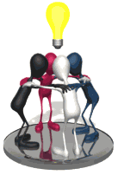
Medical Model: Gottesman

Slide 117
Medical Model: Gottesman
 | Both Parents with Sz | One Parent with Sz | Both parents with bipolar disorder | 1 parent with bipolar disorder | Neither parent ever admitted | General Population (unclean)
No. of couples | 196 | 8006 | 83 | 11995 | 1.08 million | 1.28 million
No. of offspring | 270 | 13878 | 146 | 23152 | 2.23 million | 2.7 million

Slide 118
Proportions of People Admitted to Hospital for Sz and Bipolar Disorder and their Parents

Slide 119
Starter Task: Guess which % goes in which column
Group A Both parents | Group B One parent | Group C Neither parent | Group D General pop. | Group E Both bipolar | Group F One Sz, one Bipolar
15.6%
1.12%
39.2%
7%
0.86%
4.8%

Slide 120
Group A Both parents | Group B One parent | Group C Neither parent | Group D General pop. | Group E Both bipolar | Group F One Sz, one Bipolar
39.2%
7%
0.86%
1.12%
4.8%
15.6%

Slide 121
Medical Model: Gottesman
Strengths | Weaknesses
High in ecological validity Representative sample Ethical – records were available. Anonymity assured Valid – diagnosis over time from ICD-8 to ICD-10 was valid Useful to advise people on risks associated with having children, adopting and genetic counselling | Difficult to rule out influence of shared environment May be unethical to use results to discriminate people from having children, adopting or for increasing health insurance premiums May only apply to Denmark

Slide 122
Gottesman: Evaluation: Sampling Bias
Point: A huge sample of 2.6 million was obtained,
Explanation: which included a wide range of individuals from Denmark.
Conclusion: Therefore, the study was high in population validity and results would be representative of people of different classes and socio- economic statuses.
Challenge: However, results would not be generalisable to different cultures, as other factors may be important in other countries.

Slide 123
Medical Model: Gottesman
Strengths | Weaknesses
High in ecological validity Representative sample Ethical – records were available. Anonymity assured Valid – diagnosis over time from ICD-8 to ICD-10 was valid Useful to advise people on risks associated with having children, adopting and genetic counselling | Difficult to rule out influence of shared environment May be unethical to use results to discriminate people from having children, adopting or for increasing health insurance premiums May only apply to Denmark
Explain 1 strength and 1 weakness of Gottesman’s study

Slide 124
Gottesman: Evaluation: Ethics
The study was approved by the Danish Data Protection Agency.
Because data was available for register‐based research and did not include information that could lead to the identification of individuals, approval from the National Scientific Ethical Committee was not required.
Therefore, all data was anonymous and confidential and informed consent from individuals was not required.

Slide 125
Gottesman: Free Will v Determinism
It was concluded that having 2 parents with the same mental disorder have a ‘super high’ risk of developing the disorder themselves.
This view is biologically determined - mental illness will be passed on through our genes.
So 2 individuals with a mental illness should carefully consider whether to have children due to the high chance of passing on the disorder.
This study ignores the role of free will and the fact that concordance rates are not 100%; therefore, other factors such as environment do play a part.

Slide 126
Medical Model: Gottesman
5 minutes to feedback to the whole class

Slide 127
Gottesman: Deterministic
P: having 2 parents with mental disorders have a ‘super high’ risk of developing a disorder themselves.
Expl: So biologically determined - mental illness will be passed on through our genes.
C: So 2 individuals with a mental illness should carefully consider whether to have children due to the high chance of passing on the disorder.
Ch: Ignores the role of free will and the fact that concordance rates are not 100%; therefore, other factors such as environment do play a part.
Feedback to the whole class

Slide 128
Gottesman: Reductionist
P: Focuses on just genes and inheritance
Expl: So reductionist - mental illness will be passed on through our genes.
C: Super high chance of children having a disorder.
Ch: There are other factors such as environment and free will (thinking)
Feedback to the whole class

Slide 129
Gottesman: Families Share the same environment
P: Families share the same environment
Expl: So it is difficult to distinguish nature and nurture
C: So an interactionist approach is needed
Feedback to the whole class

Slide 130
Gottesman: Individual / Situational
P: a person’s own genes are causing the mental illness
Expl: meaning it is an individual explanation of behaviour
C: the place has no impact on the mental illness
Ch: However, Denmark has uniquely high rates of Sz, due to WWII
Feedback to the whole class

Slide 131
Gottesman: Validity
P: excellent population validity
Expl: meaning it is highly representative of the target population
C: so is generalisable to the target population of Denmark
Ch: However, Denmark has uniquely high rates of Sz, due to WWII, so the results may not be valid worldwide
Feedback to the whole class

Slide 132
Gottesman: Ethics
P: highly ethical
Expl: approved by the Danish Data Protection Agency
C: Therefore, all data was anonymous and confidential and informed consent from individuals was not required
Ch: but the results have implications for insurance, employment, etc.
Feedback to the whole class

Slide 133
Gottesman: Useful
P: highly useful as it is
Expl: develops interventions (sterilisation, genetic counselling), and prompts further research into specific genes causing mental illness
C: So research like this should be undertaken, as it is so useful
Ch: but the results have implications for insurance, employment, etc. so is highly socially sensitive
Feedback to the whole class

Slide 134
Validity and Reliability of Diagnosis
With reference to Gottesman (1973), discuss the reductionism of the Medical Model’s explanations of mental disorders. [10]
Notes:
*
07/16/96
*
##

Slide 135
AO2 = Application: Biological treatment of one specific disorder
Drugs are a quick way of altering the chemical balance of a person in order to treat the symptoms of a mental illness.
Research has shown that drug therapy works faster than both cognitive and behavioural treatments.
What are the 4 types of application? P.I.T.T.

Slide 136
AO2 = Application: Biological treatment of one specific disorder
Benzodiazepines are prescribed for specific phobias.
Benzodiazepine is a depressant and slows down the workings of the brain and the central nervous system. They are used medically to reduce anxiety, to help people sleep and to relax the body. They should only be prescribed by a doctor for short periods of time as it is possible to become dependent on them after as little as two weeks’ regular (e.g. daily) use.
Benzodiazepines increase the levels of GABA. What type of action does GABA have?

Slide 137
AO2 = Application: Biological treatment of one specific disorder
AO2: Getting Empirical Evidence: Pande et al (1999)
randomly assigned 69 patients with social phobia to 2 groups:
experimental group where they took medication to increase the levels of GABA for 14 weeks
control group who took a placebo instead.
The experimental group showed a significant reduction in symptoms compared to the control group.
Gaining empirical evidence is a characteristic of a science. Name 3 other characteristics

Slide 138
AO2 = Application: Biological treatment of one specific disorder
AO3: Evaluation
Effectiveness – explain whether it is effective or not in treating the abnormality. BZs are effective in treating specific phobias, as shown by Pande et al.
Outcome studies – how does the treatment compare with placebos. In the study by Pande et al, the experimental group showed a significant reduction in symptoms compared to the control group.
What is the difference between palliative and curative?

Slide 139
AO2 = Application: Biological treatment of one specific disorder
Appropriateness
it is available on the NHS for short periods of time
Palliative versus curative – it is a palliative treatment. It maintains the patient in good mental health as long as they are taking the medication.
BZs can be taken in combination with behaviourist and cognitive treatments such as CBT, flooding and systematic desensitisation.
Why is being available on the NHS a sign of a treatment being appropriate?

Slide 140
AO2 = Application: Biological treatment of one specific disorder
Side effects of chemotherapies should ONLY be referred in relation to ‘treatment compliance’. Side effects of low doses include:
Impaired memory
Depression
Drowsiness
Feeling hungover the next day
Why would these side effects make a person ‘treatment non-compliant’?

Slide 141
Left Handed or Right Handed?
Rightie
Leftie
Outline 1 biological treatment for 1 specific disorder. [8]
Evaluate 1 biological treatment for 1 specific disorder. [8]
Spidie
Listie
Writie

