Slide 1
Starter Task
Why did you do that? Is it because of WHO you are or WHERE you are?
Individual Explanation = Something about the person is used to explain behaviour.
Situational Explanation = Something about the situation is used to explain behaviour.

Slide 2
Starter Task: Bad Apples or Bad Baskets?
Individual Explanation = Something about the person is used to explain behaviour.
Situational Explanation = Something about the situation is used to explain behaviour.
4 things / factors / reasons from the individual explanation
4 things / factors / reasons from the situational explanation
Sort on your desk the Key and Core Studies into a continuum

Slide 3
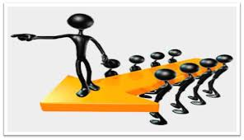
Starter Task
Notes:
The assessment objectives are the focuses of what the examiners are wanting you to do. So you need to be able to SHOW your skill in each of the areas.

Slide 4
Starter Task
Section | What’s in it | Why is it there?
Title | IV and DV | Allows the reader to very quickly identify the purpose of the report
Abstract | Details everything in around 250 words | Allows the reader to judge whether the article is relevant to them
Introduction | Background research | Introduces the topic area and prepares for peer review
Method | Enough detail about how the study was done to allow for replication | Allows people to replicate and verify the procedure
Results | Descriptive and inferential statistics | To show the results of the study
Discussion | Analysing the implications, applications and possible conclusions of the study | To stimulate discussion and give ideas for further research or applications
References | All of the reading which has been referred to | To acknowledge who was read and prevent plagiarism
Appendices | Any materials not found elsewhere, like the consent forms | To give any further information about the study.
Notes:
The assessment objectives are the focuses of what the examiners are wanting you to do. So you need to be able to SHOW your skill in each of the areas.

Slide 5
Wish List Wednesday
On your exit – 3 wishes that you have

Slide 6
Key Dates
Monday 20th May PM = Paper 1
Leavers Day is Friday 17th
Sunday 19th May Morning revision
Friday 7th June PM
Paper 2
Friday 14th June AM
Paper 3

Slide 7
Emic = universal
Etic = specific to individual cultures

Slide 8
Page 5

Slide 10
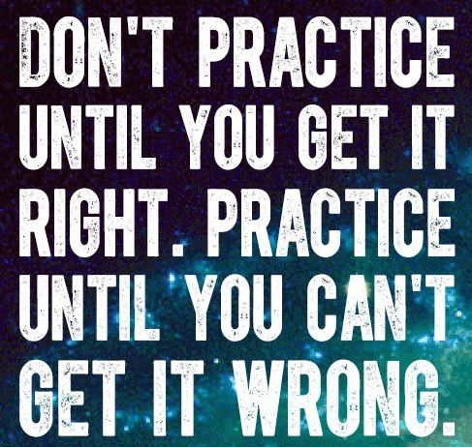
Practice Makes Perfect

Slide 11
Practice Makes Perfect
Do a practice paper
Get it marked
See where you did not get 100%
Complete it again with the comments and targets
Get 100%

Slide 12
Psychology A Level H567 Assessment Objectives
AO1: Demonstrate knowledge & understanding
AO2: Apply this knowledge
AO3: Analyse, interpret and evaluate
The assessment objectives are the focuses of what the examiners are wanting you to do.
Notes:
The assessment objectives are the focuses of what the examiners are wanting you to do.

Slide 13
AO1: Knowledge and Understanding
Identify
Explain
Outline
Describe
Which …
What …
When …
Who …
How …
Command words
Question words
Notes:
The assessment objectives are the focuses of what the examiners are wanting you to do. So you need to be able to SHOW your skill in each of the areas. Command and question words for AO1

Slide 14
AO1: Knowledge and Understanding
Identify - state it clearly
Explain - use the word ‘because’
Outline - don’t be brief
Describe - use key words
Which …
What …
When …
Who …
How …
Notes:
The assessment objectives are the focuses of what the examiners are wanting you to do. So you need to be able to SHOW your skill in each of the areas. Command and question words for AO1

Slide 15
Assessment Objectives: How the Marks are Awarded
AO1 - the amount of relevant material presented, where low marks are awarded for brief or inappropriate material and high marks for accurate and detailed material

Slide 16
AO1: Knowledge and Understanding
Describe one historical view of mental illness. [3]
Historically people viewed mental illness as evidence of demon possession. The behaviour was being controlled by the demon inside. Trepanning (drilling a hole into the skull) was used to release this demon and ‘cure’ the mental illness.
Notes:
The assessment objectives are the focuses of what the examiners are wanting you to do. So you need to be able to SHOW your skill in each of the areas. Command and question words for AO1

Slide 17
AO1: Knowledge and Understanding
Outline one definition of abnormality. [4]
The failure to function adequately definition indicates that a person is abnormal if they show a few of the 7 characteristics, such as suffering, observer discomfort. The characteristic of being showing irrational behaviour indicates that the person is abnormal because there is no logic to the behaviours they are showing, such as hearing voices.
Notes:
The assessment objectives are the focuses of what the examiners are wanting you to do. So you need to be able to SHOW your skill in each of the areas. Command and question words for AO1

Slide 18
Explain how mental illness is categorised and diagnosed. [8]
Mental illness is categorised into different types or groups of disorders – e.g. affective, anxiety, psychotic. Having categories for mental health is helpful, so that the diagnosis can be quickly undertaken and helps to indicate the type of treatment that they may receive. For example, affective disorders will need to be treated with interventions that focus on the person’s mood.
Notes:
The assessment objectives are the focuses of what the examiners are wanting you to do. So you need to be able to SHOW your skill in each of the areas. Command and question words for AO1

Slide 19
Explain how mental illness is categorised and diagnosed. [8]
Mental illness is diagnosed using the characteristics listed in the DSM-V and / or ICD 10. These are ‘diagnostic tools’ with lists of symptoms / characteristics a person will need to show to be diagnosed with the mental illness. For example, the DSM-V lists the characteristics of schizophrenia into positive and negative symptoms. Having the DSM-V and / or ICD 10 is helpful so that there is consistency in how psychologists diagnose people.
Notes:
The assessment objectives are the focuses of what the examiners are wanting you to do. So you need to be able to SHOW your skill in each of the areas. Command and question words for AO1

Slide 20
HOW Questions
There are a number of questions you can pre-prepare
and some questions you need to follow a set structure on HOW to answer them.

Slide 21
HOW Questions

Slide 22
Outline the biochemical explanation of mental illness. [6]
Unbalanced neurotransmitter levels cause mental illness. Having levels of these chemicals too high or low will cause areas of the brain to be under or over active. For example…
Adjusting & regulating neurotransmitter levels helps to alleviate mental illness. Medication adjusts these levels. For example, …
Notes:
The assessment objectives are the focuses of what the examiners are wanting you to do. So you need to be able to SHOW your skill in each of the areas. Command and question words for AO1

Slide 23
Outline the biochemical explanation of mental illness. [6]
Point: unbalanced neurotransmitter levels cause mental illness
Explain this: too high / too low
Example: low levels of GABA means that there is too much activity in the brain, causing greater levels of fear
Point: adjusting and regulating neurotransmitter levels helps to alleviate mental illness
Explain this: getting the levels right
Example: increasing levels of GABA using benzodiazepines helps lower the levels of anxiety in a person with specific phobias

Slide 24
Outline the genetic explanation of mental illness. [6]
Point: mental illness is caused by inherited genetic factors
Explain this: genes for some mental illness are passed down …
Example: Gottesman showed a genetic component in Sz and Bipolar depression
Point: People have evolved to have specific phobias
Explain this: it is ‘adaptive’
Example: Seligman suggests that if you did not evolve to fear heights, snakes, fire, you would have died out and your genes would die out with you.

Slide 25
Outline the genetic explanation of mental illness. [6]
Point: mental illness is caused by inherited genetic factors
Explain this: genes for some mental illness are passed down …
Example: Gottesman showed a genetic component in Sz and Bipolar depression
Point: People have evolved to have specific phobias
Explain this: it is ‘adaptive’
Example: Seligman suggests that if you did not evolve to fear heights, snakes, fire, you would have died out and your genes would die out with you.

Slide 26
Outline the brain abnormality explanation of mental illness. [6]
Point: mental illness is caused by under / over activity in specific brain areas (localisation of function)
Explain this: if the area of the brain is under / over active, then abnormal behaviour will follow
Example: PFC is underactive and amygdala is overactive in phobics
Point: Brain scans can be used to evidence that areas are under / over active
Explain this: scans which show activity (fMRI and PET) can be used to see where there is …
Example: Ahs - PET scans of snake or spider phobics

Slide 27
Outline the brain abnormality explanation of mental illness. [6]
Point: mental illness is caused by under / over activity in specific brain areas (localisation of function)
Explain this: if the area of the brain is under / over active, then abnormal behaviour will follow
Example: PFC is underactive and amygdala is overactive in phobics
Point: Brain scans can be used to evidence that areas are under / over active
Explain this: scans which show activity (fMRI and PET) can be used to see where there is …
Example: Ahs - PET scans of snake or spider phobics

Slide 28
Explain one Medical Model treatment for one specific mental health disorder.
Name the treatment
Name the disorder
Explain the cause of disorder it wants to address
Explain its ‘mode of action’ – how it works
Give example

Slide 29
Explain one Medical Model treatment for one specific mental health disorder.
Name the treatment - medication / chemotherapy
Name the disorder – specific phobias
Explain the cause of disorder it wants to address (specific phobias is too little GABA)
Explain its ‘mode of action’ – how it works
GABA is an inhibitory neurotransmitter
Benzodiazepines are prescribed for specific phobias,
Example - Valium (diazepam)
BZs are depressants – they help to reduce anxiety
by increasing the levels of GABA

Slide 30
Starter: Take up the challenge
Organise the 4 TOUGH Key studies

Slide 31
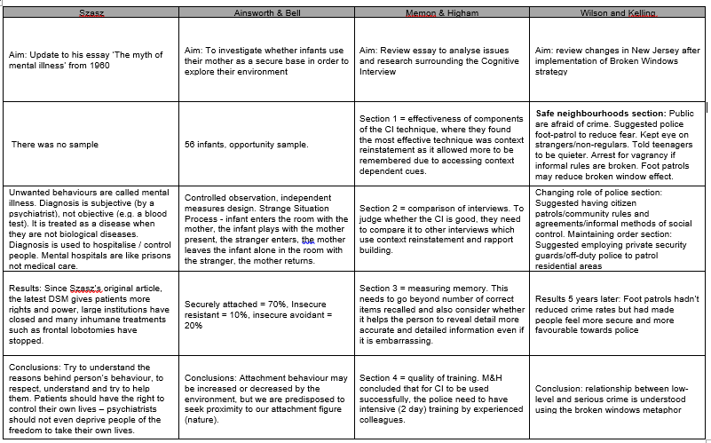
Answers: Take up the challenge

Slide 32
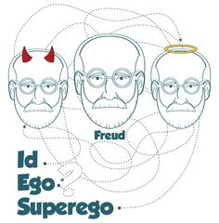
Psychodynamic
Tripartite personality – specific phobias = too much superego
5 Psychosexual stages – fixation at the phallic stage (Little Hans)
Overuse of the ego defence mechanisms (e.g. catastrophizing)

Slide 33
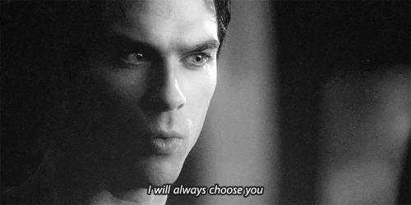
Learnt through classical conditioning, operant conditioning or SLT (D.A.R.R.M.)
Specific phobias are initiated by classical conditioning or SLT and then maintained through operant conditioning.
Empirical evidence: Watson & Rayner (1920) Little Albert to fear white furry objects through association with a loud noise.
Faulty / irrational thinking (cognitions) cause abnormal behaviour.
Attentional bias - selectively focus on the fear – hypervigilance
Negative appraisal bias - specific phobics exaggerate the risk of danger and under-estimate (appraise) their own ability to cope.
Empirical evidence: Pflugshaupt (2005) eye tracking people with specific phobias.
Tripartite personality – specific phobias = too much superego
5 Psychosexual stages – fixation at the phallic stage (Little Hans)
Overuse of the ego defence mechanisms (e.g. catastrophizing)
https://www.youtube.com/watch?v=k7ogbFvvCq0

Slide 34
Starter task: Pro-social / Anti – Social Stories
Here is Myles. Myles’s class had to stay inside at break time because of bad weather, so Myles decided to tidy up the classroom for his teacher.
Question 1: Is what Myles did good or naughty?

Slide 35
Starter task: Pro-social / Anti – Social Stories

Slide 36
Starter task: Pro-social / Anti – Social Stories
So Myles cleaned the classroom, and when the teacher returned after break, she said to her students, “Oh, I see that someone has cleaned the classroom for me.” The teacher then asked Myles, “Do you know who cleaned the classroom?” Myles said to his teacher, “I did not do it.”
Question 2: Is what Myles did good or naughty?

Slide 37
Starter task: Pro-social / Anti – Social Stories
Here is Urisha. When Urisha was out at breaktime, she saw that the top field was littered with rubbish. She picked up all the pieces she could find and threw them in the litter bin.
Question 1: Question 1: Is what Urisha did good or naughty?

Slide 38
Starter task: Pro-social / Anti – Social Stories

Slide 39
Starter task: Pro-social / Anti – Social Stories
So Urisha cleaned top fieldand at the end of break, the teacher said to her students, “I notice that top field is now nice and clean!” The teacher then asked Urisha, “Do you know who cleaned the yard?” Urisha said to her teacher, “I did it”.
Question 2: Is what Urisha said to her teacher good or naughty?

Slide 40
Starter task: Pro-social / Anti – Social Stories
Write a pro-social / anti-social, truth / lie telling story to share

Slide 41
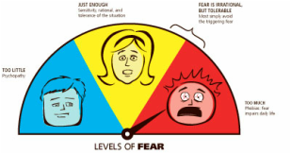
Name the treatment
Name the disorder
Explain the cause of disorder it wants to address
Explain its ‘mode of action’ – how it works
Give example

Slide 42
Name the treatment - flooding
Name the disorder – specific phobias
Explain the cause (learnt through classical conditioning and maintained through operant)
Explain its ‘mode of action’
To extinguish the unreasonable fear response.
No relaxation
Repeated & Intense exposure
Fear = <20 minutes
New association

Slide 43
Starter task: Identify the research methodology for all 20 Core Studies

Slide 44
Outline the behaviourist explanation of mental illness. [6]
Behaviourist suggest that mental illness is learned.
Learning through classical conditioning where 2 things are associated together, means that people will show behaviours that are ‘maladaptive’. For example, people may associate spiders with people screaming, so will become phobic and anxious around spiders.
Learning also occurs through operant conditioning. If a person is rewarded for a specific behaviour, this will continue. For example, attention is often given to a person in distress, so some may show distress often to gain this reinforcement.
Notes:
The assessment objectives are the focuses of what the examiners are wanting you to do. So you need to be able to SHOW your skill in each of the areas. Command and question words for AO1

Slide 45
Outline the cognitive explanation of mental illness. [6]
The over-use of cognitive biases cause mental illness. Using specific thinking patterns will produce behaviours which are maladaptive. For example, depression is lined to ‘all or nothing’ thinking.
The cognitive triad of depression is thinking negatively about the self, world and future. When a person automatically thinks negatively, they are likely to show depression. For example, a person may feel negatively about their A Level mocks, then doubt that they will get a ‘fair’ paper, then believe that no university will want them.
Notes:
The assessment objectives are the focuses of what the examiners are wanting you to do. So you need to be able to SHOW your skill in each of the areas. Command and question words for AO1

Slide 46
Outline the psychodynamic explanation of mental illness. [6]
Fixation at one of the 5 psychosexual stages cause mental illness. Not completing the stage adequately will show itself in adult behaviour. For example, being anally retentive as a child links to OCD in adulthood.
Overuse of ego defence mechanisms, such as repression, regression, denial causes mental illness. When the ID is too strong and is being controlled by an ego defence mechanism, an imbalance occurs in the personality (psyche) which leads to behaviours such as dissociative identity disorder (multiple personalities)
Notes:
The assessment objectives are the focuses of what the examiners are wanting you to do. So you need to be able to SHOW your skill in each of the areas. Command and question words for AO1

Slide 47
AO2: Apply Knowledge & Understanding
…in this study
… with reference to this study
…used in this study …
Use examples from appropriate core studies to support your answer.
Support your answer with evidence from the article.
Command words
Question words
Notes:
The assessment objectives are the focuses of what the examiners are wanting you to do. So you need to be able to SHOW your skill in each of the areas.

Slide 48
AO2: Apply Knowledge & Understanding
…in this study
… with reference to this study
…used in this study …
Use examples from appropriate core studies to support your answer.
Explain how you would investigate this topic
Support your answer with evidence from the article.
Link the point to the study / topic
Notes:
Ensure quotes are used and linked to the points being made

Slide 49
AO2: Apply Knowledge & Understanding
…in this study
… with reference to this study
…used in this study …
Use examples from appropriate core studies to support your answer.
Explain how you would investigate this topic
Support your answer with evidence from the article.
Quote something from the study described
Notes:
Ensure quotes are used and linked to the points being made

Slide 50
AO2: Applying the Debates
Applying a debate to the topic area
Know the 2 sides of the debate (free will v determinism has 3)
Know at least 1 strength and 1 weakness for each side of the debate
Link the evaluation points to the topic area
Notes:
Step 3 – apply the explained point to the study mentioned

Slide 51
Assessment Objectives: How the Marks are Awarded
the level and effectiveness of critical commentary
where low marks are awarded for superficial consideration of a restricted range of issues and
high marks for a good range of ideas and specialist terms, and effective use of material addressing a broad range of issues

Slide 52
AO2: Applying the Debates
Applying a debate to the topic area
Know the sides of the debate (free will v determinism, nature v nurture each have 3 sides!)
Know at least 1 strength and 1 weakness for each side of the debate
Link the evaluation points to the topic area
Notes:
Step 3 – apply the explained point to the study mentioned

Slide 53
AO2: Applying the Debates
Know the sides of the debates
Notes:
Step 3 – apply the explained point to the study mentioned

Slide 54
Know the sides of the debates
Side 1 | The Middle Way | Side 2
Nature | Interactionist | Nurture
Reductionist |  | Holistic
Free will | Environmental determinism | Deterministic
Individual explanation |  | Situational explanation
Research should aim to be useful |  | The value is doing the research itself, not how it is used
Ethical considerations must be upheld |  | The ends justify the means
Socially sensitive research should be done |  | Socially sensitive research should be avoided
Severe ethnocentrism |  | Softer ethnocentrism
Notes:
Step 3 – apply the explained point to the study mentioned

Slide 55
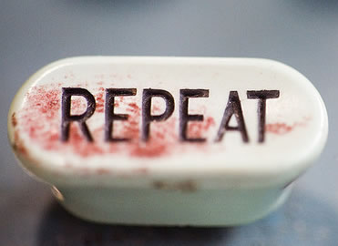
AO2: Applying the Debates
Point
Explanation
Evidence
Conclusion
Challenge (if you want A*-B)
Notes:
Step 3 – apply the explained point to the study mentioned

Slide 56
AO2: Applying the Debates
Being on the nature side of the debate, the Medical Model takes the nature view and states that physiology / biology causes the mental illness.
This is because it considers biochemistry, brain abnormality and/or genes are the cause of behaviour.
For example, Gottesman showed a strong concordance between Sz parents having children who also have this disorder.
Adopting this reductionist view is helpful because it offers useful applications, such as advising 2 Sz parents not to have children.
However you cannot change a person’s genes so the applications will not be useful individually.
Notes:
Step 3 – apply the explained point to the study mentioned

Slide 57
AO2: Applying the Debates
Being on the nurture side, the alternatives to the medical model suggest that behaviour is acquired through upbringing.
Mental illness is learnt through childhood and shown in the adult’s thinking.
For example, Szasz suggested that sometimes abnormal behaviours are just ways people are coping with a very difficult environment around them, such as depression and difficult life circumstances.
Adopting this reductionist view is helpful because it offers practical applications, such as advising parents on how to avoid stress in their children’s lives.
However this suggests that parents and the community are to blame for mental illness.
Notes:
Step 3 – apply the explained point to the study mentioned

Slide 58
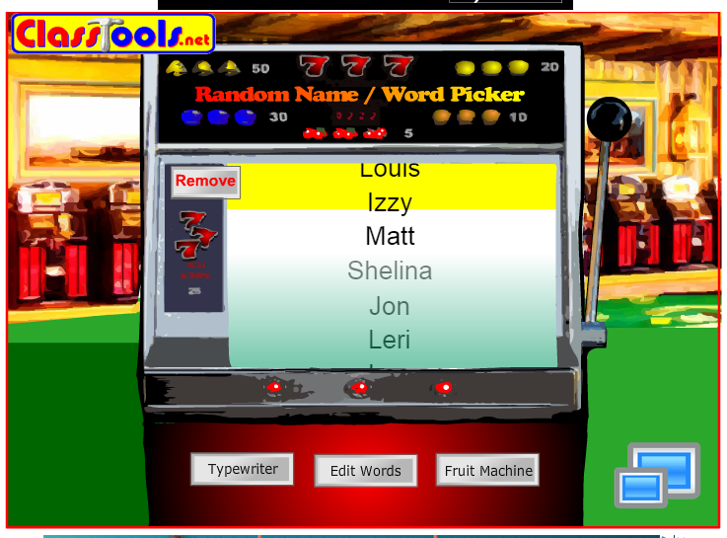
AO2: Applying the Debates
http://www.classtools.net/education-games-php/fruit_machine
Page 3: Historical Context
Page 7: Medical Model
Page 11: Alternatives to the Medical Model
Produce a model answer for your question.
2 x P-E-E-C-C
Do you need a conclusion?
Notes:
Step 3 – apply the explained point to the study mentioned

Slide 59
To what extent are the Medical model’s explanations of mental illness useful? [10]
To what extent are the explanations from alternatives to the Medical model reductionist? [10]
To what extent are alternatives to the medical model of explaining mental illness scientific? [10]

Slide 60
Starter Task: Designing your own study
Level 4 = 12-15 marks
All 4 required features are addressed
Accurate knowledge of each choice is demonstrated (Choice)
Application to this scenario is demonstrated in relation to each choice (Applied)
Appropriate justification of all or most techniques is demonstrated (Justified)
Response explicitly draws on the candidates own research (Research)
The answer has sufficient coherence and detail to allow for replication.

Slide 61
Starter Task: Designing your own study
Choice
Applied
Justified
Research
The answer has sufficient coherence and detail to allow for replication.
Quick bullet point draft of your chosen study

Slide 62
Starter Task: Kohlberg’s stages
There are 3 levels and 6 stages in Kohlberg’s theory of moral development
Identify the 3 levels
Identify the 6 stages
Explain each of these
Give an example of each

Slide 63
Starter Task: Kohlberg’s stages
Level | Stage
1. Pre-conventional | P&O
 | 2. IR
2. Conventional | 3. GBGG
 | 4. L&O
3. Post-conventional | 5. SC
 | 6. UP

Slide 64
Starter Task: Kohlberg’s stages
Level | Stage | Moral reasoning shown
1. Pre-conventional | 1. Punishment and obedience orientation | Rules are kept to avoid punishment
 | 2. Instrumental-relativist orientation | ‘Right’ behaviour is that which ultimately brings rewards to oneself
2. Conventional | 3. Good boy-good girl orientation | ‘Good’ behaviour is what pleases others – conformity to goodness
 | 4. Law and order orientation | Doing one’s duty, obeying laws is important
3. Post-conventional | 5. Social contract orientation | ‘Right’ is what is democratically agreed upon
 | 6. Universal principles orientation | Moral action is taken based upon self-chosen principles

Slide 65
AO2: Recap – Applying our knowledge
The Medical Model also takes an interactionist approach to mental illness.
This means following the diathesis stress model, genes may predispose the abnormal behaviour but something from their environment / upbringing is needed to trigger or precipitate it.
For example, the variant MAOA gene makes crime and aggression more likely, but Caspi showed that you would also need to have abuse during childhood for this behaviour to be shown.
Taking this interactionist approach is helpful so holistic treatments can be found for individuals.
However, holistic treatments will be person specific, rather than working generally for most people, like using SSRIs for depression.

Slide 66
Cognitive explanation of mental illness is neither nature or nurture
Because your way of thinking which causes your abnormality is your choice
E.g. being depressed is due to the cognitive triad, (negative view of self, world & future), rather than something you are born with / trained to be.
It is helpful to take neither side on the debate, so you can generate holistic therapies, like CBT which changes both thinking & behaviours which follow.
However, this does blame the person themselves (rather than their bodies / nature or their environment and upbringing / nurture), which can lead to the ‘What the hell effect’ causing people not to bother with their treatment.

Slide 67
Assessment Objective AO3: Analyse, Interpret, Evaluate
AO3 - the extent to which the answer demonstrates a thorough understanding of research methods
and uses analysis, interpretation, explanation
and evaluation of research methodologies and investigative activities.

Slide 68
AO3: Analyse, Interpret, Evaluate
To what extent
Compare
Strength
Weakness
Discuss
Analyse
Evaluate
Assess
Command words
Question words
Notes:
The assessment objectives are the focuses of what the examiners are wanting you to do. So you need to be able to SHOW your skill in each of the areas. Command and question words for AO1

Slide 69
AO3: Analyse, Interpret, Evaluate
To what extent – make a decision and justify it
Compare – similarities and differences
Strength – explain why this helps
Weakness – explain why this matters
Discuss – give strengths and weaknesses
Analyse – use key terms
Evaluate – give strengths and weaknesses
Assess – must come to a conclusion
Command words
Question words
Notes:
The assessment objectives are the focuses of what the examiners are wanting you to do. So you need to be able to SHOW your skill in each of the areas. Command and question words for AO1

Slide 70
AO3: Analyse, Interpret, Evaluate
‘To what extent’ questions:
Come to a judgement
A balanced judgement is really good – e.g. lesser / greater extent
Give at least one reason for your view.
Command words
Question words
Notes:
To what extent questions

Slide 71
AO3: Analyse, Interpret, Evaluate
Child and Crime B style questions (15 mark). This is focusing on the analysis of:
The topic in relation to a debate
OR The research in terms of methodological issues
Notes:
Analysis in Sport and Crime

Slide 72
AO3: Analyse, Interpret, Evaluate
Methodological issues include:
The research method (C.O.S.E)
The timing of the method (snapshot v longitudinal)
The experimental design (R.I.M.)
The sampling method (R.O.S.S.)
Reliability
Validity
Notes:
Methodological Issues

Slide 73
5 mark study summaries
Rosenhan = page 4
Gottesman = page 8
Szasz = page 12
http://www.classtools.net/education-games-php/fruit_machine
Notes:
Methodological Issues

Slide 74
Do you know the key details?
Milgram (1963) - Obedience
40 number of male participants
20-50 participants age in years
4.50 amount of $ participants paid to take part
300 the number of volts all participants shocked the learner up to
15 the number of volts the switches went up by with each increment
26 the number of participants who shocked up to 450v
Notes:
Methodological Issues

Slide 75
Do you know the key details?
Bocchiaro et al. (2012) – Disobedience and whistle-blowing
149 undergraduate students took part
7 number of euros participants paid to take part or they could have course credits
11 number of participants removed from the initial sample due to suspiciousness
8 number of pilot tests carried out to ensure the procedure was credible
3 the number of minutes the participants had to reflect on the action-based decisions they were about to make
7 the minutes before the experimenter returned to collect the participant after they had decided and acted in response to the request to write the supporting ethics letter
76.5 the percentage who actually obeyed the experimenter
3.6 the percentage in the comparison group who predicted they would obey
Notes:
Methodological Issues

Slide 76
Do you know the key details?
Loftus and Palmer (1974) – Eyewitness testimony
45 the number of participants in experiment 1
9 the number of participants in each group for experiment 1
50 the number of participants in each condition for experiment 2
4 the number of seconds the multiple car crash in the video was in experiment 2
40.5 the mean speed estimate in mph in the smashed condition for experiment 1
31.8 the mean speed estimate in mph in the contacted condition for experiment 1
16 the number of participants that reported seeing broken glass in the smashed condition in experiment 2
7 the number of participants who reported seeing broken glass in the hit condition in experiment 2
Notes:
Methodological Issues

Slide 77
Do you know the key details?
Grant et al. (1998) – Context-dependent memory
8 the number of students who were experimenters
17 the youngest age of a participant in the experiment (the oldest being 56 years)
16 the number of multiple choice questions to test memory of the two page article
2 the number of minutes between the end of the study phase and the beginning of the test phase
30 the approximate time in minutes that the procedure took
39 the number of participants results who were used
14.3 the mean score on the multiple choice test for the silent/silent condition (compared to only 12.7 in the silent/noisy condition)
Notes:
Methodological Issues

Slide 78
Do you know the key details?
Bandura et al. (1961) – Transmission of aggression
72 the number of children used in the sample
52 the mean age in months of the participants
3 the number of rooms children visited during the experiment
20 the number of minutes that children were in room 3 for, being observed
240 the number of observations recorded of children in the third room (every 5 seconds)
2 The number of minutes the model waited in the first room before behaving aggressively in the aggressive condition
10 The number of minutes the child was in the first room
Notes:
Methodological Issues

Slide 79
Do you know the key details?
Chaney et al. (2004) – Funhaler study
32 the number of children in the sample
2.2 the average duration of asthma
3 the number of parents out of 30 that reported ‘always’ being successful when using their existing device
38 the increase in % of parents that reported medicating their children the previous day when using the Funhaler
60 the increase in % of children that took the recommended four or more cycles per aerosol delivery
Notes:
Methodological Issues

Slide 80
Do you know the key details?
Sperry et al. (1968) – Split brain study
11 the number of patients who had undergone the commisurotomy
35 the millimetre transparencies that were used in the projector
1/10 of a second was the time images were shown to the participants
2 the number of hemispheres that were being tested
Notes:
Methodological Issues

Slide 81
Do you know the key details?
Casey et al. (2011) – Neural correlates of delay of gratification
4 the age of the participants in the original marshmallow study
562 the number of initial participants
27 the number of participants in experiment 1 who agreed to be part of experiment 2
59 the number of participants who agreed to participate in Casey’s experiment 1
500 the milliseconds the faces were presented for
98.2 the mean % of correct hits for the ‘go’ trials in terms of accuracy
Notes:
Methodological Issues

Slide 82
Do you know the key details?
Baron-Cohen et al. (1997) – Autism in adults
16 the number of participants that were used in the experimental condition ‘autism group’
6 the number of basic emotions in the control task the basic emotion recognition test
16.3 the mean score the Autistic group scored on the eyes test
20.4 the mean score the Tourettes group scored on the eyes test
18.8 the mean score males in the ‘normal’ group scored compared to a mean score of 21.8 for the females.
Notes:
Methodological Issues

Slide 83
Do you know the key details?
Baron-Cohen et al. (1997) – Autism in adults
16 the number of participants that were used in the experimental condition ‘autism group’
6 the number of basic emotions in the control task the basic emotion recognition test
16.3 the mean score the Autistic group scored on the eyes test
20.4 the mean score the Tourettes group scored on the eyes test
18.8 the mean score males in the ‘normal’ group scored compared to a mean score of 21.8 for the females.
Notes:
Methodological Issues

Slide 84
Key Studies and Applying these
On paper 3, the Key Studies are going to have a question each for 10 marks.
5 marks for the study
5 marks for the applying this to the question
Notes:
Methodological Issues

Slide 85
Key Studies and Applying these
Explain how the research by … can be applied to … [10]
Using the research by … explain …
The application area can be specific to the topic (diagnosis, attachment, intelligence, effects of imprisonment), or real life in general. This means you can pre-prepare answers for these.
Notes:
Methodological Issues

Slide 86
Key Studies and Applying these
Related to the topic
Or applied to real life
How it explains the topic
Relationships between X and Y
Notes:
Methodological Issues

Slide 87
Key Studies and Applying these
Related to the topic
Or applied to real life
How it explains the topic
Relationships between X and Y
Historical context of mental health
The medical model
Alternatives to the medical model
Rosenhan
Gottesman
Szasz
Notes:
Methodological Issues

Slide 88
Related to the topic
Or applied to real life
How it explains the topic
Relationships between X and Y
Using the research by Rosenhan, explain how the historical views of mental health differ from today
Using the research by Gottesman, discuss whether the medical model is useful
Using Szasz’s research discuss the usefulness of alternatives to the medical model
Notes:
Methodological Issues

Slide 89
Related to the topic
Or applied to real life
How it explains the topic
Relationships between X and Y
Using the research by Rosenhan, explain how the diagnosis of a psychotic disorder is undertaken nowadays.
Using the research by Gottesman, explain how the Medical Model can be applied to mental illness
Using Szasz’s research, explain one way mental illness is treated by the alternatives to the medical model
Notes:
Methodological Issues

Slide 90
Related to the topic
Or applied to real life
How it explains the topic
Relationships between X and Y
Using the research by Rosenhan, explain historical views of mental illness.
Using the research by Gottesman, explain one explanation / treatment of mental illness from the Medical Model
Using the research by Szasz, explain one explanation / treatment of mental illness from the alternatives to the medical model
Notes:
Methodological Issues

Slide 91
Related to the topic
Or applied to real life
How it explains the topic
Relationships between X and Y
Using the research by Rosenhan, explain the relationship between categorisation and diagnosis of mental illness.
Using the research by Gottesman, explain the relationship between one explanation of mental illness from the Medical Model and the one treatment from the Medical Model
Using the research by Szasz, explain the relationship between one explanation of mental illness from the Medical Model and the one treatment from the Medical Model
Notes:
Methodological Issues

Slide 92
In general, relationships can be:
In a line (linear)
Hierarchical (boss – junior)
Correlational (positive / negative / no correlation)
Sequential (one after another)
Notes:
Methodological Issues

Slide 93
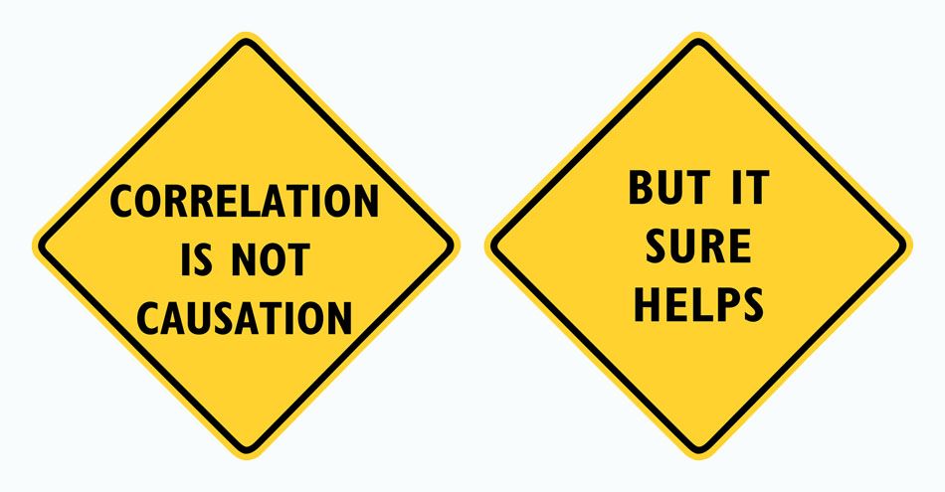
There is a strong positive correlational relationship between number of parents with a mental illness and the likelihood of their genetic child having a mental illness.
Notes:
Methodological Issues

Slide 94
There is a sequential (one after another) relationship between:
Rosenhan and improvements in categorisation & diagnosis of mental illness
Treatments lead to explanations from the medical model
Explanations lead to treatments from the alternatives to the medical model
Notes:
Methodological Issues

Slide 95
Treatments explanations from the medical model?
Explanations treatments from the alternative
Notes:
Methodological Issues

Slide 96
Alternatives to the Medical Model identify a cause of mental illness
To explain it, then come up with
a treatment to undo / reverse / correct the cause.
Notes:
Methodological Issues

Slide 97
The Medical Model trials a treatment
To come up with an explanation
Of the mental illness
Treatment aetiology fallacy: the mistaken belief that the effectiveness of a form of treatment indicates the cause of a disorder.
Notes:
Methodological Issues

Slide 98
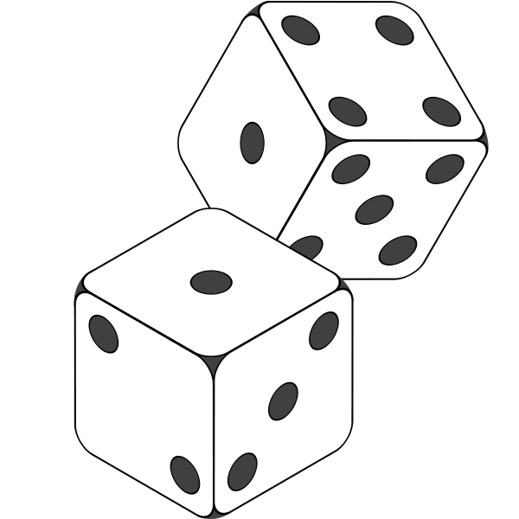
Page 14 = Questions 1, 4, 7, 10
Page 15 = Questions 2, 5, 8, 11
Page 16= Questions 3, 6, 8, 12
Notes:
Methodological Issues

Slide 99
Treatments for Mental Health
1 treatment from the medical model
1 from the alternatives to the medical model
Explain them and evaluate them
Notes:
Methodological Issues

Slide 100
SSRIs for Depression & OCD
Summary / Acronym / Key Words
Notes:
Methodological Issues

Slide 101
SSRIs for Depression & OCD
Chemotherapy
Imbalance neurotransmitters
Adjust this
For depression / OCD, increase serotonin
Help normalise worry circuit
By blocking reabsorption
SSRIs raise serotonin levels
Higher dose for OCD than depression
Notes:
Methodological Issues

Slide 102
CBT for any mental illness
Detail / Examples / Explain
https://create.kahoot.it/details/evaluation-of-szasz-and-the-cognitive-approach/50ed6c01-6fba-4cd3-b979-b9c7ab31b030
Notes:
Methodological Issues

Slide 103
AO3: Evaluating
Know the 8 evaluation points for each therapy
Notes:
Step 3 – apply the explained point to the study mentioned

Slide 104
1. Drug therapy has the advantage …
2. However, the length of …
3. Furthermore, all biological treatments …
4. This makes chemotherapy …
5. However, some patients may need drug …
6. So, a multi-dimensional …
7. Research suggests …
8. The psychological therapy …
Notes:
Step 3 – apply the explained point to the study mentioned

Slide 105
1. Wilhelm et al (2005) found ….
2. The OCD scores before and after ….
3. However, this research may have been affected by the “hello-goodbye effect” ….
4. Additionally, effectiveness …
5. However, (thinking) …
6. One of the advantages of CBT …
7. This means that the …
8. The ethical issues of harm …
Notes:
Step 3 – apply the explained point to the study mentioned

Slide 106
1. Wilhelm et al (2005) found ….
2. The OCD scores before and after ….
3. However, this research may have been affected by the “hello-goodbye effect” ….
4. Additionally, effectiveness …
5. However, (thinking) …
6. One of the advantages of CBT …
7. This means that the …
8. The ethical issues of harm …
Notes:
Step 3 – apply the explained point to the study mentioned

Slide 107
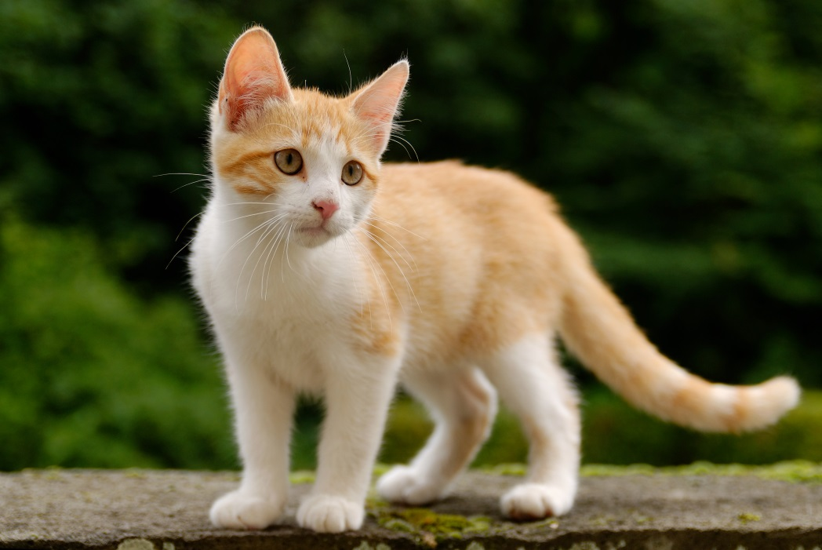
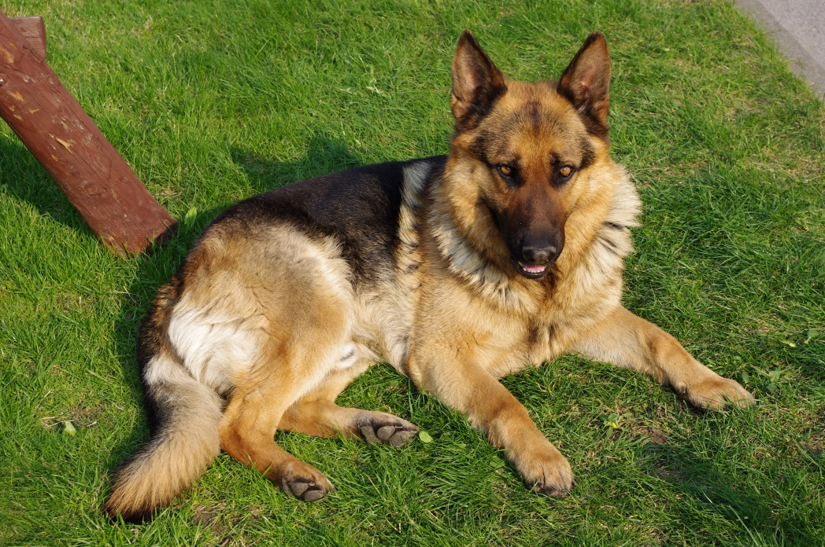
Comparison Questions: Similarities and Differences
Similarity / difference is identified
Discussed / elaborated
and supported by evidence from one side
and supported by evidence from the other side.

Slide 108
Compare 2 or more treatments for mental illness [8]
Similarity / difference is identified
Discussed / elaborated
and supported by evidence from one side
and supported by evidence from the other side.
x 2

Slide 109
Compare 2 or more treatments for mental illness [8]
A similarity between SSRIs and CBT is free will
Both treatments require the patient / client to have control over their own recovery
The GP will need the patient to be treatment compliant (keep taking the SSRI pills) even when it is tough because of side effects
Likewise the therapist will need the client to write their diary of thoughts and behaviours, despite its difficulty.

Slide 110
Compare 2 or more treatments for mental illness [8]
A similarity is they are both available on the NHS
Which suggests they are very effective
The GP will prescribe SSRI pills without needing a psychologist
Likewise the GP can refer people for CBT and 10 sessions are often freely available for young people.

Slide 111
Compare 2 or more treatments for mental illness [8]
A similarity between SSRIs and CBT is its timescale of its effects
Palliative treatments maintain the person at a functioning level and curative means the person can be cured of the mental illness
SSRIs work only for as long as the pills are taken (palliative)
Whereas CBT can be curative, if the client keeps analysing their thinking and behaviour.

Slide 112
Applying the debates

Slide 113
Applying the debates
To what extent are treatments for mental illness …. [10]
Useful
Scientific
Reductionist
Deterministic
Ethical
Individualistic

Slide 114
Applying the debates
To what extent are treatments for mental illness …. [10]
Point
Explanation
Example
Conclusion
Challenge
x 2

