Slide 1
The phenomenal power of the human mind
I cdnuolt blveiee taht I cluod aulaclty uesdnatnrd waht I was rdanieg
The phaonmneal pweor of the hmuan mnid! Aoccdrnig to a rscheearch at Cmabrigde Uinervtisy, it deosn't mttaer inwaht oredr the ltteers in a wrod are, the olny iprmoatnt tihng is taht the frist and lsat ltteer be in the rghit pclae. The rset can be a taotl mses and you can sitll raed it wouthit a porbelm. Tihs is bcuseae the huamn mnid deos not raed ervey lteter by istlef, but the wrod as a wlohe. Amzanig huh? Yaeh, and I awlyas thought slpeling was ipmorantt.

Slide 2

True or False?
If it is true, put it on the left
If it is false, put it on the right
Be prepared to explain why
Challenge: how would a psychologist investigate this?

Slide 3

1. There is a part of the brain that is much bigger in London Taxi drivers.
Maguire et al. (2000) found that taxi drivers have a significantly larger hippocampus (a part of the brain associated with memory) in comparison to non-taxi drivers.

Slide 4

2. Playing brain training games / apps increases the connections in the brain and improves memory and IQ.
An article by Novella (2013) provides evidence against the belief that brain training games increase intelligence.

Slide 5
3. If one identical twin is homosexual, there is approximately a 50% chance that the other twin will be homosexual also.
Bailey and Pillard (1991) found a concordance rate of 52% in identical twins for homosexuality, in comparison to a concordance rate of 22% in non-identical twins

Slide 6
4. If one identical twin has depression, there is approximately a 45% chance that the other twin will suffer from it.
McGuffin et al. (1996) found a concordance rate of 45% in identical twins for major depression, in comparison to a concordance rate of 20% for non twins.

Slide 7
5. Listening to Mozart improves concentration.
Steele et al. (1999) found that there is little to no evidence to support the intellectual programmes based on the existence of the Mozart effect.

Slide 8
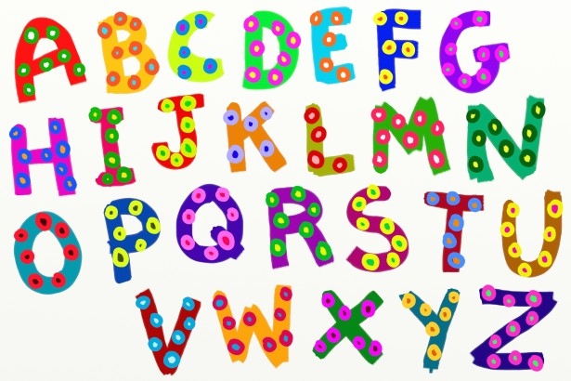
Now we are going to do a simple activity involving letters of the alphabet.
Based on your gut feelings, quickly write down:
Your six FAVOURITE letters
Your six LEAST FAVOURITE letters

Slide 9
Circle all of the letters that occur in your own first name. Count the number of circled letters in each list.
Which list included more of the letters from your own first name?
1/6 = 17%
2/6 = 33%
3/6 = 50%
4/6 = 67%
5/6 = 83%

Slide 10
The preference for the letters in one’s
own name is the name letter effect.
TO THINK ABOUT: Why would people be more likely to purchase a product if the product resembled his or her name?

Slide 11
6. We tend to like people more and rate them more highly when we know them well than when we are not familiar with them.
The mere exposure effect – being familiar with something helps people avoid anxiety and so they feel more positively about it.

Slide 12
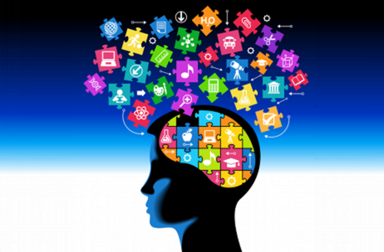
WELCOME TO PSYCHOLOGY
http://resourcd.com/@psychexchange/video/show/1265

Slide 13
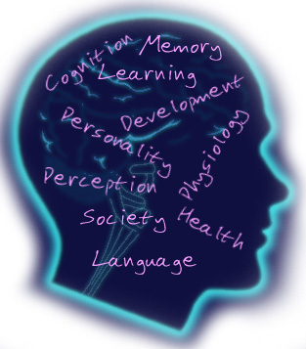
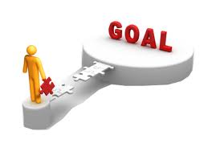
Lesson Objectives
What: To look at the course in psychology
How: looking at different ways of explaining human behaviour
Why: To get a feel or what you would do in this course.
Prep for Friday 14th Sept
Summer prep research questions

Slide 14
Psychology is the scientific study of the brain and behaviour

Slide 15
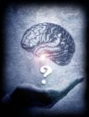
What is the Scientific Process in Psychology?
You know that scientists use scientific methods to investigate things. They do experiments and other studies, to try to find out what causes things to happen.
Same happens in Psychology, experiments are carried out to find out the cause of human behaviour.
During a typical Psychology class, you will be given a theory, examine the evidence for or against it, and then evaluate both the theory and the evidence to come to a conclusion.

Slide 16
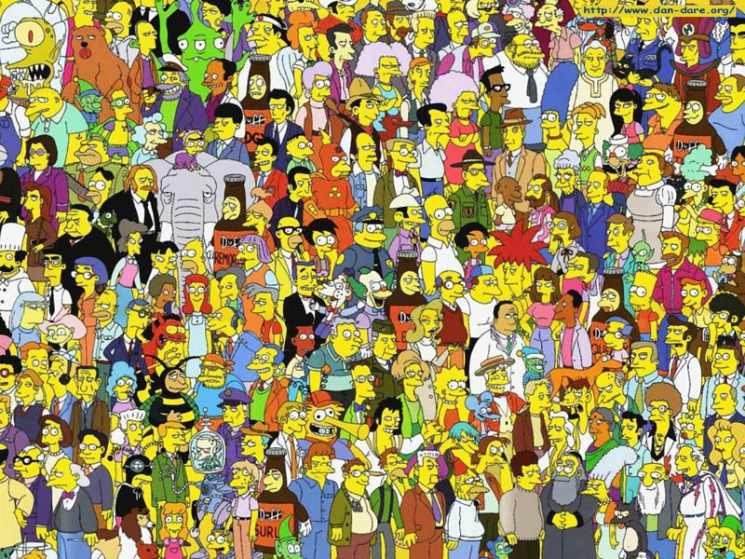
How Do Psychologists Study Behaviour?

Slide 17

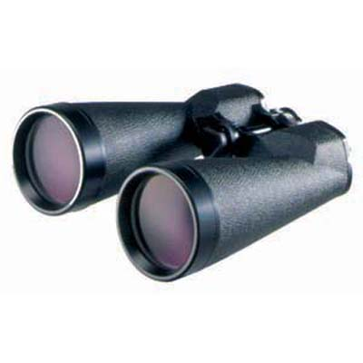
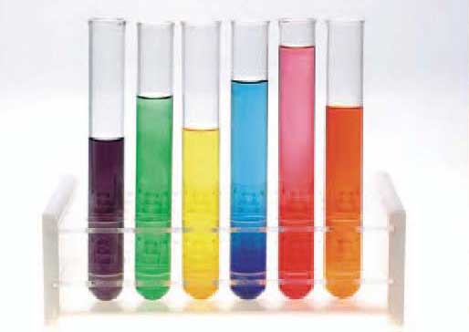
There are 4 ways in which psychologists do research:
By asking people questions – but they could lie
By watching people – but they might know they are being watched
By meddling with them – but is it ethical?
By looking at the links between things – do links always show that caused something?
We call these:
1. Self - reports
2. Observations
3. Experiments
4. Correlations

Slide 18
The 4 Main Research Methods are:
Experiments
Self-reports
Observations
Correlations

Slide 19
For each of the items,
Say whether they are true / false
Think of how a psychologist would scientifically investigate whether this topic

Slide 20
True / False and How
1. Psychology is an easy subject.
FALSE
How would a psychologist investigate this?
Self-reports – ask the Year 13s
Correlations – look at which is easiest to pass based on the results

Slide 21
True / False and How
2. Some people dream at night, other don’t.
FALSE
How would a psychologist investigate this?
Experiments – use an EEG / sleep app

Slide 22
True / False and How
3. Psychologists go around analysing people all the time.
FALSE
How would a psychologist investigate this?
Self-reports – ask them Year 13s
Observations – watching them

Slide 23
True / False and How
4. Psychologists are interested in this
TRUE
How would a psychologist investigate this?
Experiments
Self-reports
Observations
Correlations

Slide 24
True / False and How
5. Psychologists can read people’s minds
Let us see
How would a psychologist investigate this?
Experiments
Observations

Slide 25
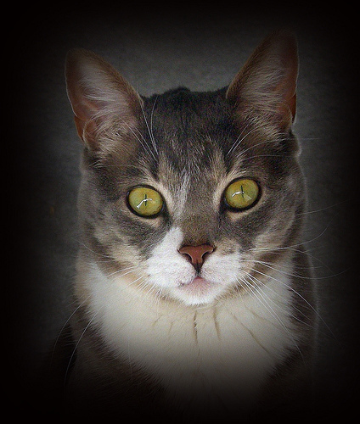

You can see 6 cards.
Think of one of them.
Just think.

Slide 26
Look into my eyes. Just think about your card.

Slide 27
After a moment you find out how well I can read your mind

Slide 28

Look,
I took
your card !!!

Slide 29
I knew the choice you would be making!

Slide 30
True / False and How
5. Psychologists can read people’s minds
FALSE
Just analyse the behaviours shown

Slide 31
True / False and How
6. The Government, Exam Boards and UCAS classify as a science.
True
How would a psychologist investigate this?
Don’t need to

Slide 32
True / False and How
7. Psychologists are interested in this
TRUE
How would a psychologist investigate this?
Experiments
Self-reports
Observations
Correlations

Slide 33
True / False and How
8. Psychology doesn’t involve any maths – so doesn’t matter if I don’t like maths.
FALSE
10% minimum

Slide 34
True / False and How
9. A Levels require you to study just in lessons and for prep
FALSE
How would a psychologist investigate this?
Correlations – look at the results and the general amount of time spent in independent research
http://www.aldenhampsychology.com/independent-learning.html

Slide 35
True / False and How
10. Psychologists are interested in this
TRUE
How would a psychologist investigate this?
Experiments
Self-reports
Observations
Correlations

Slide 36
True / False and How
11. Psychologists all have the same views about behaviour
FALSE
How would a psychologist investigate this?
Self-reports – ask them
Observations – watch them

Slide 37
Your Psychology teachers have different views about behaviour
The A Level course at Aldenham is taught by 3 teachers:
Mrs Evagora (Head of Psychology)
Mr Dunstan (Debates in Psychology / Social)
Mr Kirsten (Areas in Psychology / Child Psychology and Sports Psychology)
http://www.aldenhampsychology.com/teachers.html

Slide 38
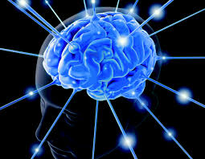
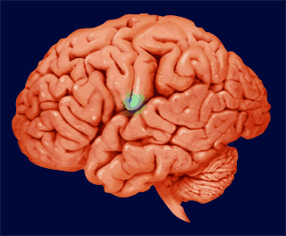
Cognitive Psychology
The Nature of Human Memory
How might psychologists do an experiment to see how many pieces of info you can fit into your short term memory?

Slide 39











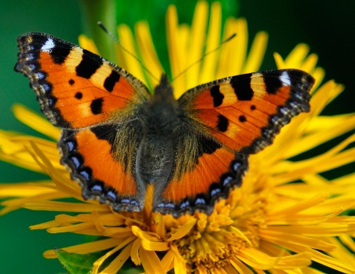
Kim’s Game

Slide 40
How many objects can you remember?
There were 15

Slide 41
Kim’s Game
One is missing? Which one?

Slide 42
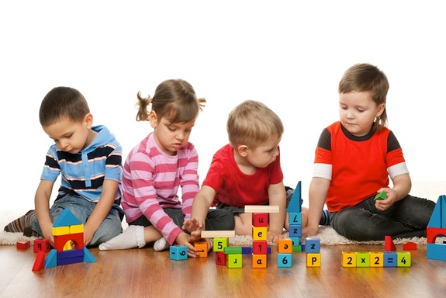
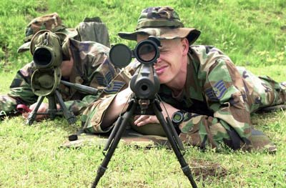
Kim’s Game is played with children as it promotes the development of memory and observation skills. It and can be used for learning new groups of objects, such as shapes or fruits.
Kim’s Game is also used in training the military such as US Marines.

Slide 43
Say the colour of the words in the next slides.

Slide 44
Red

Slide 45
Blue

Slide 46
Green

Slide 47
Purple

Slide 48
Orange

Slide 49
Yellow

Slide 50
Brown

Slide 51
Grey

Slide 52
Pink

Slide 53
Stop

Slide 54
Say the colour of the ink the word is written in
Start

Slide 55
Dog

Slide 56
Cat

Slide 57
Pig

Slide 58
Horse

Slide 59
Bird

Slide 60
Cow

Slide 61
Fish

Slide 62
Rabbit

Slide 63
Chicken

Slide 64
Fox

Slide 65
Say the colour of the ink the word is written in
Start

Slide 66
Red

Slide 67
Blue

Slide 68
Green

Slide 69
Purple

Slide 70
Orange

Slide 71
Yellow

Slide 72
Brown

Slide 73
Grey

Slide 74
Pink

Slide 75
Black

Slide 76
Stop

Slide 77
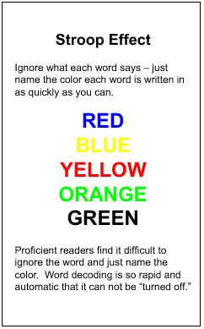
Why do you think children under 7 are quicker than you at doing this?
The Stroop Effect is a reaction time test. It illustrates automatic processing versus conscious visual control
When we look at the words in the test, we process the colour of each word as well as the meaning of each word.
Experience tells us to attach more significance to the meaning of words rather than the colours they are written in.
So, when we are told to say the colour of the word, our brains help us to adjust our responses, which means our reaction times become much slower.

Slide 78
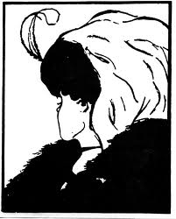
Areas and Perspectives in Psychology
An area / perspective is a point of view in Psychology. The areas think different things influence our behaviour:
Biological – brain, chemicals, genes
Cognitive – thought processes
Developmental – upbringing and maturity
Individual differences – different things for different people
Social approach – people and places around you cause your behaviour
Behaviourist – your behaviour is caused by what you have learnt
Psychodynamic – your unconscious drives, personality and upbringing cause your behaviour

Slide 79
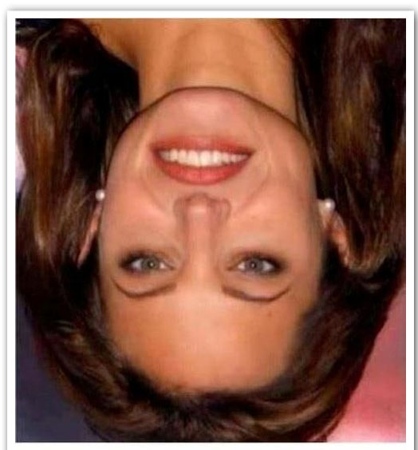
Areas and Perspectives in Psychology
Is she beautiful?

Slide 80
Areas and Perspectives in Psychology
Young woman or old woman?

Slide 81
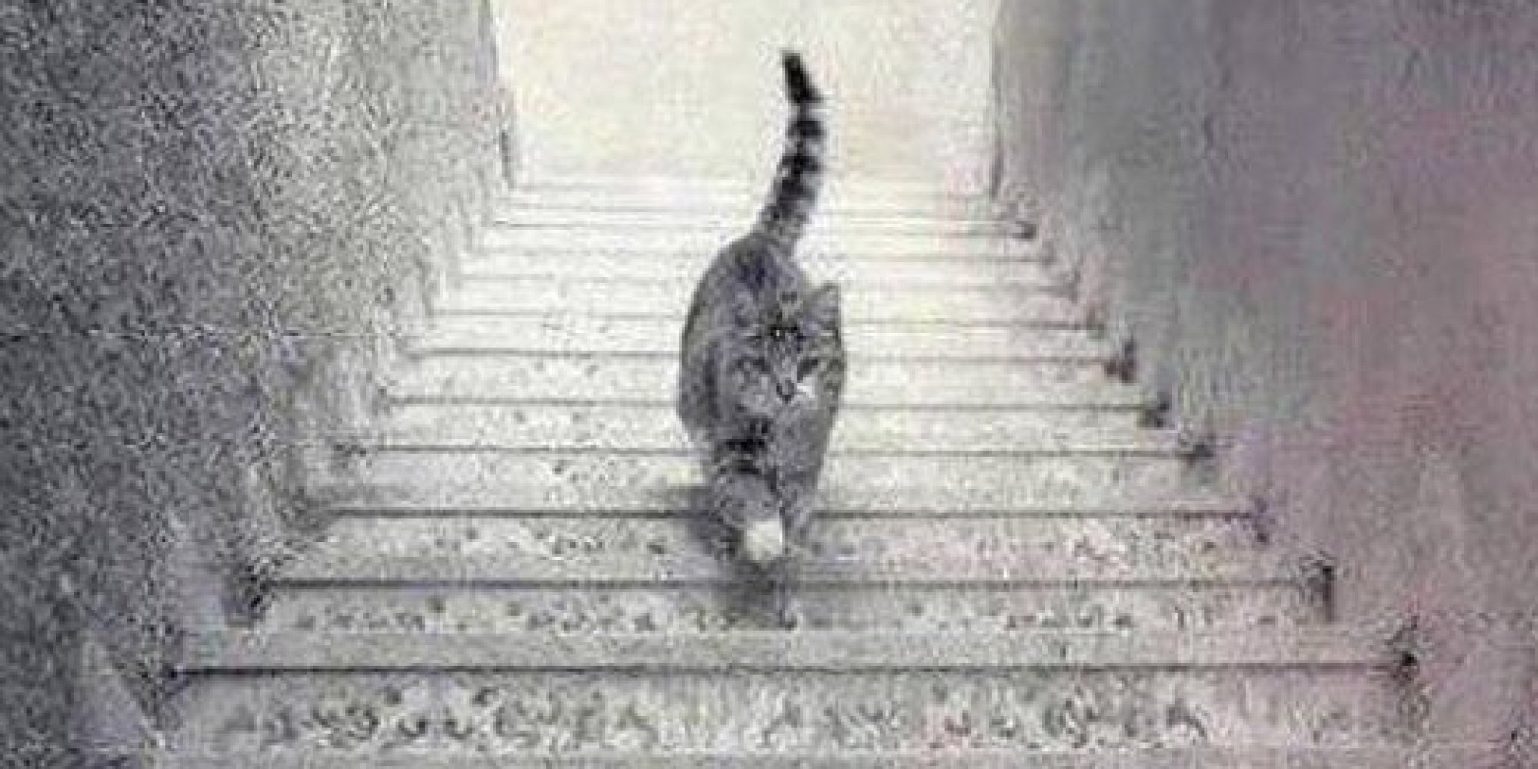
Areas and Perspectives in Psychology
Going UP or DOWN?

Slide 82
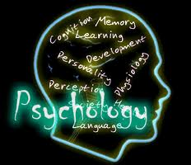
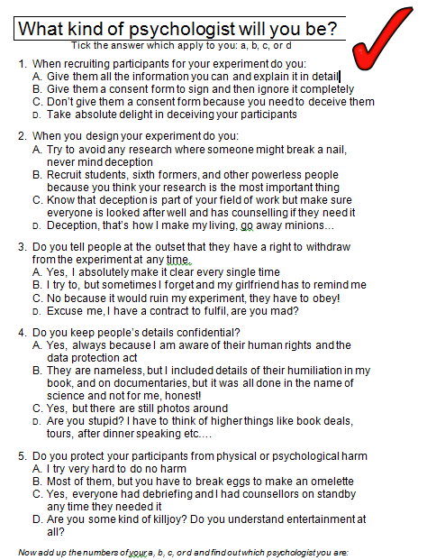
So what type of Psychologists would you be???
It is worth finding out what type of psychologist you would be.

Slide 83
True / False and How
12. Most psychologists work as therapists or counsellors
FALSE
How would a psychologist investigate this?
Self-reports – ask them
Correlations – look at which areas they work in

Slide 84
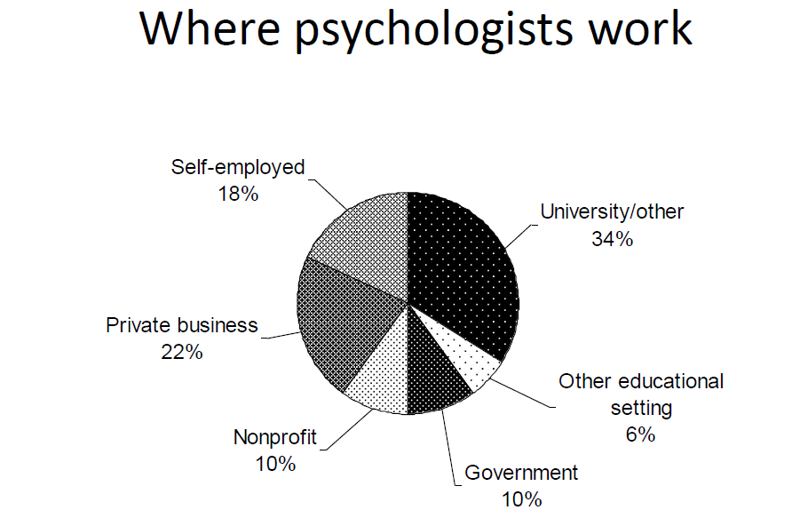
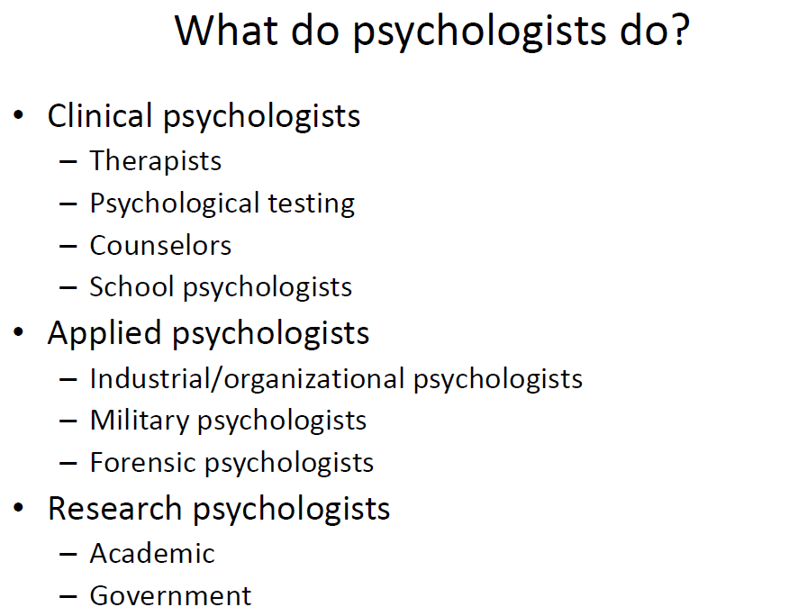
Psychology – True or False?
Notes:
84

Slide 85
True / False and How
13. To succeed in Psychology you need to have an open mind
???
How could you measure being open minded or not?

Slide 86
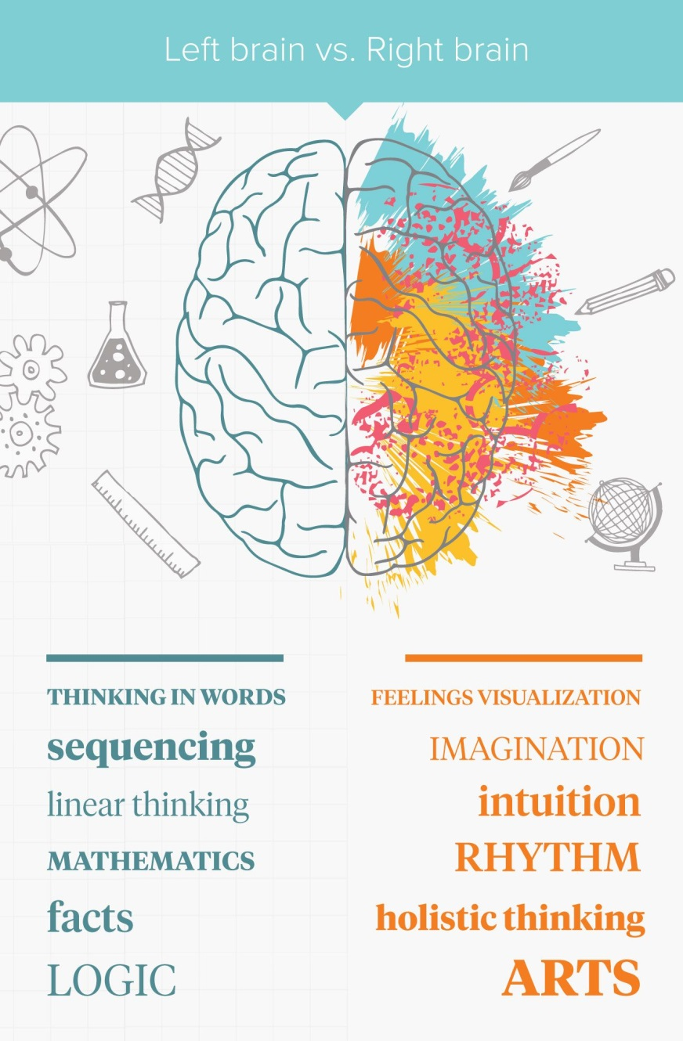
Psychology – True or False?
https://www.youtube.com/watch?v=wE85GV6pLYc
Notes:
86

Slide 87
True / False and How
14. Some people are left-brained (logical), others are right-brained (artistic).
Somewhat True
How would a psychologist investigate this?
Experiments
Self-reports
Observations
Correlations

Slide 88
True / False and How
15. Psychologists are interested in this
TRUE
How would a psychologist investigate this?
Experiments
Observations
Correlations

Slide 89
True / False and How
16. Psychology requires lots of long essay writing.
FALSE
How would a psychologist investigate this?
Don’t need to
http://www.aldenhampsychology.com/past-papers.html

Slide 90
True / False and How
17. Psychologists are interested in this
TRUE
How would a psychologist investigate this?
Experiments
Self-reports
Observations
Correlations

Slide 91
True / False and How
18. By studying Psychology A Level, I will learn how to lie effectively and how to pull women/men
Somewhat
How would a psychologist investigate this?
Experiments
Self-reports
Observations
Correlations

Slide 92
True / False and How
19. Psychology involves getting evidence to support your ideas
TRUE
How would a psychologist investigate this?
Experiments
Self-reports
Observations
Correlations

Slide 93
True / False and How
20. Psychologists are interested in this
TRUE
How would a psychologist investigate this?
Experiments
Observations
Correlations
Self-reports

Slide 94
A Level Psychology Course
Paper 1: Research Methods | Paper 2: Core Studies | Paper 3: Applied Psychology
How to conduct and analyse psychological research. 2 hour exam in Year 13, including multiple choice and data interpretation questions. | 10 pairs of Psychology studies - a classic & a contemporary study. 2 hour exam in Year 13, including short essays and data analysis questions. | Issues in mental health and 2 options from: Child Criminal, Environmental Sport Psychology. 2 hour exam in Year 13, including short essays and data analysis.

