Slide 1
Where am I assessed on Freud, the Individual Differences Area and the Psychodynamic Perspective?
Identify the psychological content/ issue/ problem in this song
https://www.youtube.com/watch?v=bMD9VsIn218

Slide 2
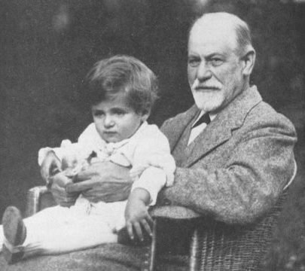
Why is Freud in both the Individual Differences Area and the Psychodynamic Perspective?
Learning Objectives
To distinguish the principles of the Individual Differences area and Psychodynamic perspective
To understand Little Hans’ dreams, fantasies and phobia
To apply knowledge to Paper 2 Sections A, B and C
Prep
Exam Practice Questions

Slide 3
What is the Individual Differences Area all about?
Some people think that all humans behave in the same way and react to situations and experiences in a universal way.

Slide 4
What is the Individual Differences Area all about?
In reality, the human experience is so complex that it is an interaction of lots of variables within a person’s life that influence their behaviour and cause them to differ from the next person.

Slide 5
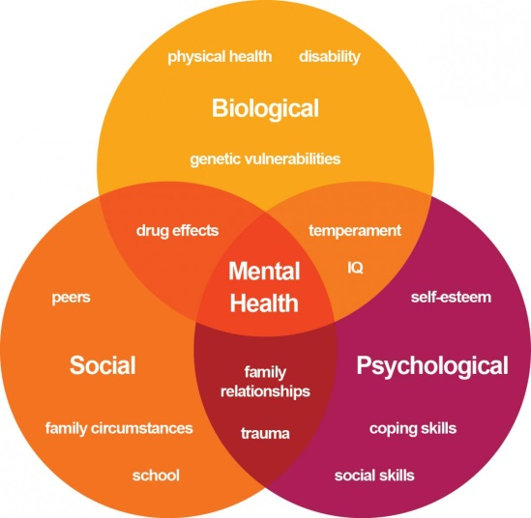
What is the Individual Differences Area all about?
Individual differences researchers aim to establish what the differences are among people and why they have developed these differences.
Models of behaviour are used to understand the differences that occur in a particular behaviour, such as schizophrenia or autism.

Slide 6
What is the Individual Differences Area all about?

Slide 7
What are the Principles of Individual Differences Area?
Individuals differ in their behaviour and personal qualities so not everyone can be considered ‘the average person’.

Slide 8
What are the Principles of Individual Differences Area?
Every individual is genetically unique and this uniqueness is displayed through their behaviour. So everyone behaves differently.

Slide 9
What are the Principles of Individual Differences Area?
All human characteristics can be measured from one person and quantified. The measures gained from one person are different to those gained from another.

Slide 10
What are the Principles of Individual Differences Area?
All psychological characteristics are inherited and as everyone inherits different characteristics, everyone is different and unique.

Slide 11
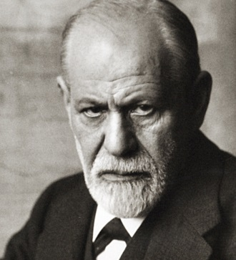
Why is Freud Placed in the Individual Differences Area?
because of its focus on trying to explain a way in which people may differ
– by having phobias. It does this through the case study of a single boy.

Slide 12
Why is Freud Placed in the Individual Differences Area?

Slide 13
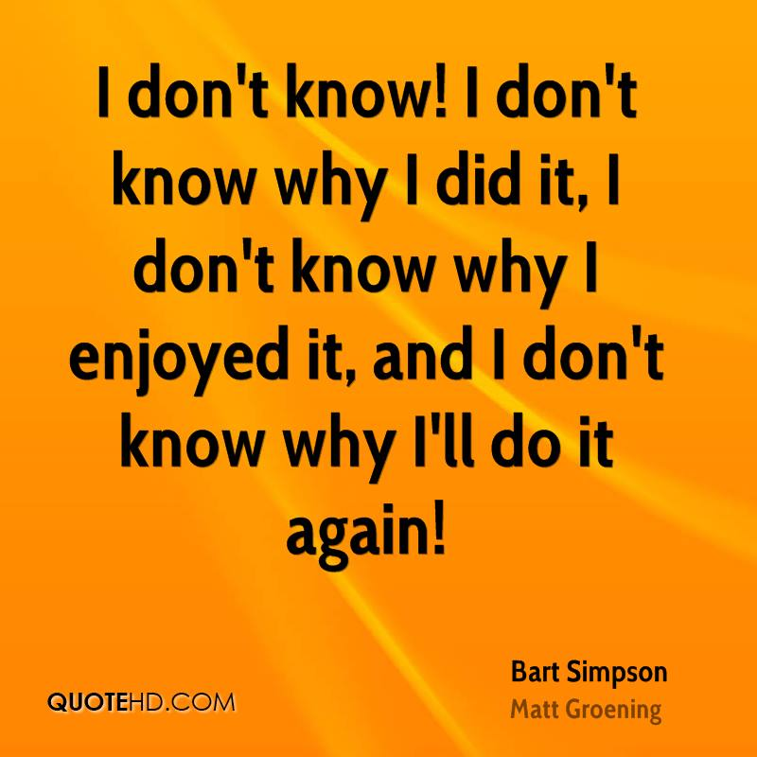
What are the Principles of the Psychodynamic Perspective?
Many important influences on behaviour come from a part of the mind individuals have no direct awareness of, the unconscious.

Slide 14
What are the Principles of the Psychodynamic Perspective?
Personality is shaped by relationships, experience and conflict over time, particularly during childhood.

Slide 15
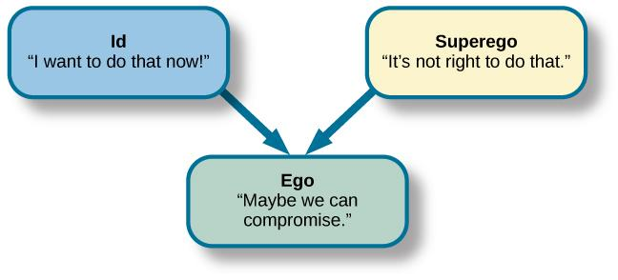
What are the Principles of the Psychodynamic Perspective?
Different parts of the mind are in constant dynamic struggle with each other (often unconsciously) and the consequences of this struggle are often shown through behaviour.

Slide 16
What are the Principles of the Psychodynamic Perspective?
The mind is like an iceberg. We have conscious, subconscious and unconscious thought, all of which can influence our behaviour.

Slide 17
What are the Principles of the Psychodynamic Perspective?

Slide 18
Why is Freud Placed in the Psychodynamic Perspective?
because of the way in which Freud’s theory of psychosexual development (especially the Oedipus complex)
is drawn upon to explain little Hans’ phobias and fantasies.

Slide 19
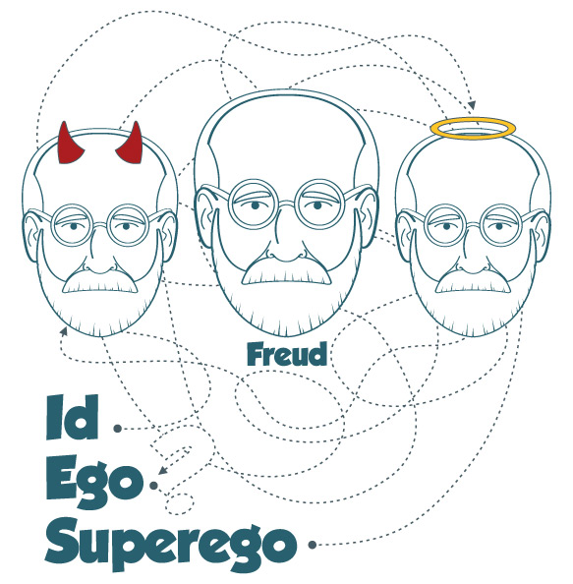
Why is Freud Placed in the Psychodynamic Perspective?

Slide 20
Why COULD Freud be placed in the Developmental Area?

Slide 21
Using the text the clip, summarise Freud’s case study for 5 marks:

Slide 22
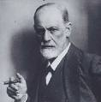
Core Study: Sigmund Freud (1909) The analysis of a phobia of a five year old boy The Case Study of Little Hans
Learning Objectives
To evaluate case studies as a research method
To understand how phobias represent intra-psychic conflict
To understand Freud’s interpretation of Hans’ phobias
To describe and evaluate key aspects of this case study
https://www.youtube.com/watch?v=XA_DA8s803s
https://www.youtube.com/watch?v=twZet50f9SQ

Slide 23
Core Study: Sigmund Freud (1909) The analysis of a phobia of a five year old boy The Case Study of Little Hans
https://www.youtube.com/watch?v=twZet50f9SQ

Slide 24
The analysis of a phobia of a five year old boy The Case Study of Little Hans
1. His mother threatened to call a doctor to ‘cut-it off’ because he had been playing with it.
2. Hans saw a horse collapse in the street, and was very distressed by this.
3. Hans liked to climb into his parent’s bed each morning and cuddle his mother- his father objected to this, and stopped Hans from doing it.

Slide 25
The analysis of a phobia of a five year old boy The Case Study of Little Hans
4. The horse that Hans was scared of was white, with blinkers and a nose strap- this was though to symbolise his father’s pale skin, glasses and moustache.
5. Little Hans dreamed that two giraffes were in his room one night, a tall one and a crumpled one. Hans took the crumpled giraffe away from the large one, which cried out.
6. Hans had a fantasy that a plumber came and removed his bottom and penis, and replaced them with larger ones.

Slide 26
What was Freud’s Methodology?
Freud gathered qualitative data but he gathered it in his own ways. He did not use questionnaires as these would not have accessed the unconscious mind.
Freud used case studies both to build a body of knowledge and as a research method.
At the same time he used them to help cure his patients
The people in Freud’s case studies are patients / clients rather than participants.

Slide 27
What was Freud’s Methodology?
Freud used free association, dream analysis and symbol analysis as well as slips of the tongue (Freudian slips - parapraxes) rather than conventional research methods. All these things make up psychoanalysis.
Similarities include the gathering of rich detailed data which is qualitative.

Slide 28
Evaluation of Freud’s case study research methods
The data come directly from the individual so they are real and valid
The data is rich and varied – an individuals differences can be studied and focused upon.
It can be used as a therapy as well as a research method

Slide 29
Evaluation of Freud’s case study research methods
Freud himself recognised the failings of free association. It is hard to allow a stream of conscious thoughts out, as the unconscious will always try to block it.
The therapist subjectively interprets the data.
The unconscious is not measurable in a scientific way.

Slide 30
Little Hans: Freud’s Only Child Case Study
This is the ONLY case study of a child undertaken by Freud
Freud’s ideas about infant sexuality were based on his work with adult women (and his own self analysis)
The longitudinal CASE STUDY through psychoanalytic therapy
was carried out by correspondence and interviews with Hans’ father
First reports when Hans was three

Slide 31
Little Hans: Freud’s Only Child Case Study
Hans was very interested in his ‘widdler’
His mother told him
“not to play with your widdler .. or else she would call the doctor to come and cut it off”
Hans’ mother threatened to leave him

Slide 32
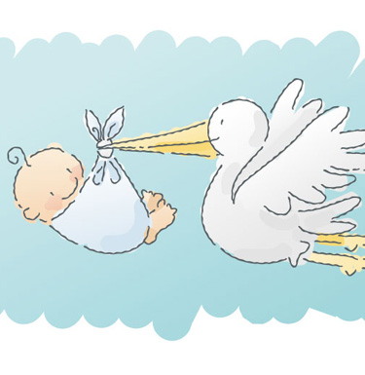
Little Hans: Sister is born
Hans’ baby sister was born
He was told the stork had brought the baby
Early jealousy of sister
Continued interest in his widdler, according to father his dreams and fantasies were of widdlers and of ‘widdling’

Slide 33
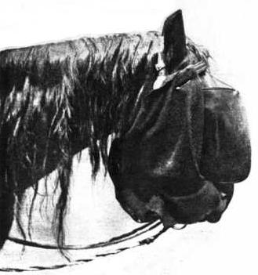
Little Hans – Father writes to Freud
When Hans was five - father wrote to Freud
“Hans is afraid of horses, afraid a horse will bite him in the street, this fear seems to be connected to his being frightened by a large penis”

Slide 34
Little Hans – Father writes to Freud
Freud & father try to make sense of what Hans was experiencing and to resolve his phobia of horses
Freud noted that Hans’ fear of horses developed after the child had anxiety dreams of losing his mother AND after he has been warned not to play with his widdler

Slide 35
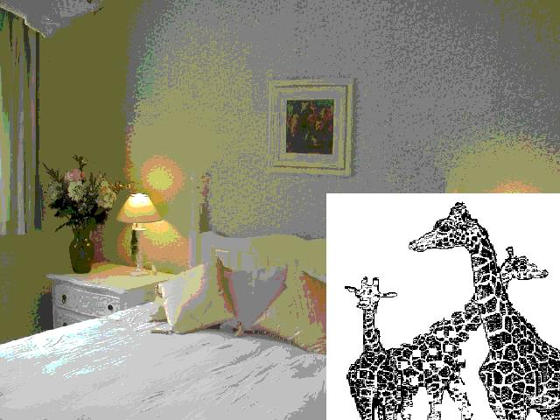
Little Hans: Dreams and fantasies
Hans dream of three giraffes
The scene in marital bed in the morning
The big giraffe = daddy?
The crumpled giraffe = mummy?
The little giraffe = Hans?

Slide 36
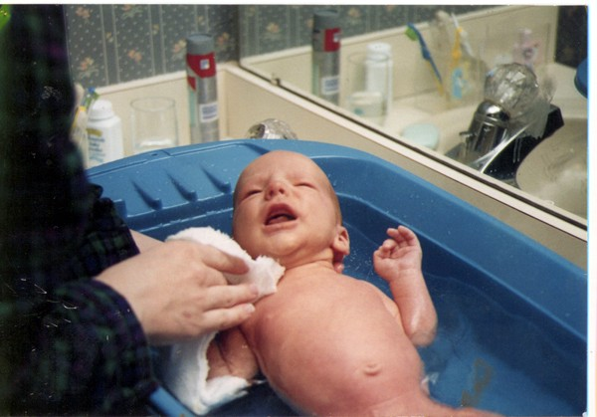
Little Hans: Dreams and fantasies
Hans fear of being drowned in the bath
Hans began to fear having a bath
He was afraid his mother would drown him
Freud suggested this was a projection of his unconscious wish that his mother drown his baby sister

Slide 37
Little Hans: Dreams and fantasies
Hans dreams about a giraffe were explained as ‘fear of big penis’
(long neck = big penis)
Freud theorised that Hans’ fear of horses was really fear of father
Horse = symbolic for father

Slide 38
Little Hans: Dreams and fantasies
Hans dreamed that a plumber came and gave him a bigger bottom

Slide 39
Little Hans: Dreams and fantasies
Freud’s conclusion
Little Hans phobia of horses was really fear of father
(castration fear) during resolution of the Oedipus Conflict
Fear resolved when Oedipus conflict resolved

Slide 40
Little Hans: Criticisms
Hans is analysed by the father who is emotionally involved
Father is biased as he already admires the work of Freud and may have believed that the boy was in the Oedipal (phallic stage)
Father ‘put words into Hans’ mouth’

Slide 41
Little Hans: Criticisms
The case study seems to be both scientific evidence and treatment
These should be separated because
If we ‘treat’ what we are investigating how can it remain unchanged to be investigated?
But … Freud did deal with real people & their problems
Not neat & tidy but has “ecological validity”

Slide 42
Little Hans
https://play.kahoot.it/#/?quizId=16fdf8e0-48da-4504-a483-960e14bf73ac

Slide 43
Little Hans
Freud felt that the case study of Hans provided support for his idea of the Oedipus complex. Hans had a wish to be close to his mother. This set Hans up as a rival to his father and he wished him gone (dead). But he could not express this directly. Instead he projected it onto a fear of horses. Successful resolution of the Oedipus conflict came when Hans was able to express his feelings about his father and finally able to transfer his identification from his mother to his father.

Slide 44
On your whiteboard, write 3 strengths and 3 weaknesses of the Little Hans case study
Evaluation of Little Hans Study
https://www.youtube.com/watch?v=XA_DA8s803s

Slide 45
What are the Strengths and Weaknesses of the Little Hans Case Study?
To understand the methods of evaluating Core Studies
To practice using the methods of evaluation
To generate PEEs from the evaluative points

Slide 46
Which of the following statements is a directional (one-tailed) hypothesis? A There will be no difference in aggression towards an inflatable toy between boys and girls. B Men and women will have different scores on a crossword. C There will be a difference in tidiness of the bedroom depending on gender. D Men are better at map reading than women.
MCQ

Slide 47
Which of the following statements is a directional (one-tailed) hypothesis? A There will be no difference in aggression towards an inflatable toy between boys and girls. B Men and women will have different scores on a crossword. C There will be a difference in tidiness of the bedroom depending on gender. D Men are better at map reading than women.
MCQ

Slide 48
According to Freud’s theory of psychosexual development the superego develops in the A oral stage B anal stage C phallic stage D latency stage
MCQ

Slide 49
According to Freud’s theory of psychosexual development the superego develops in the A oral stage B anal stage C phallic stage D latency stage
MCQ

Slide 50
Barry bullied his little brother when they were both children but now, as an adult, has no memory of this behaviour. This is an example of A repression B Oedipus complex C the superego D the conscious
Starter: MCQ

Slide 51
Barry bullied his little brother when they were both children but now, as an adult, has no memory of this behaviour. This is an example of A repression B Oedipus complex C the superego D the conscious
Starter: MCQ

Slide 52
Task

Slide 53
1. D 2. D 3. A 4. C 5. D 6. C 7. C 8. C 9. D 10. D
Task

Slide 54
Point – Explanation – Example – Link
Undeveloped:
The study lacked reliability as there were few controls, so it cannot be easily replicated.
Developed:
The study lacked reliability as there was not a set of standard questions to ask Little Hans, therefore it cannot be repeated easily, which is a problem as Psychology studies should have replicability, as the subject is scientific.

Slide 55
Point – Explanation – Example – Link
Undeveloped:
Freud had to interpret the information so increasing subjectivity
Developed:
Freud had to interpret the information so increasing subjectivity as other analysts may come to different conclusions from the same data, which is a problem of reliability. There needs to be consistency between psychologists, so any treatment offered will be effective.

Slide 56
Point – Explanation – Example – Link
As it was a case study on one boy the results may not apply to everyone/be generalised
The data may be biased as it was collected by Hans’ father who may only have included details that fit with Freud’s theory
The study was done in Little Hans’s natural environment so there was ecological validity
Freud ignored other reasons for Hans’ phobia, such as he saw a horse collapse in the street
It was considered ethical as he was under 16 so his parents gave consent for him to participate in the study.

Slide 57
In your pairs, analyse the Little Hans case study in reference to the key idea. Present for all students.
Paired Work

Slide 58
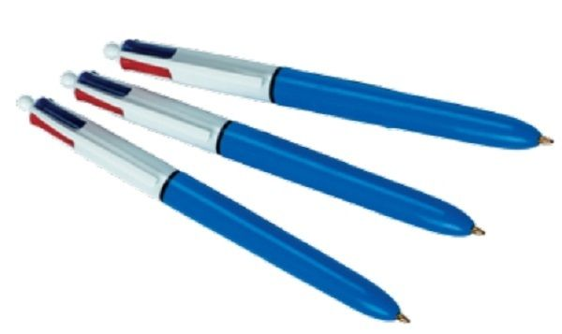
Evaluate the Little Hans case study. * Point – Explanation – Evidence – Link * 2 different colours IF there are positive and negative points to be made
Paired Work

Slide 59
When developing our points, we need examples from the studies. Work out which piece of evidence supports each point.
Examples
Point/ Theme | Explain (How/ why is it a strength/ weakness? Use key terminology) | Example (Give a specific example from the study…)
The research method (case study | A strength of a case study is that we can collect lots of rich detailed information on the Ps, which develops understanding of development
 | A disadvantage of a case study is that it is non-experimental, so we cannot infer cause and effect due to the lack of control over other variables that could have caused the behaviour.

Slide 60
Examples
Point/ Theme | Explain (How/ why is it a strength/ weakness? Use key terminology) | Example (Give a specific example from the study…)
The research method (case study | A strength of a case study is that we can collect lots of rich detailed information on the Ps, which develops understanding of development | For example, we are able to study Little Hans in lots of detail in order to understand how his phobia developed and was resolved.
 | A disadvantage of a case study is that it is non-experimental, so we cannot infer cause and effect due to the lack of control over other variables that could have caused the behaviour. | For example, we cannot conclude that the phobia was caused by the Oedipus complex, and we do not have enough control over other things such as his experience with the horse in the street.
Sampling Bias | A case study also relies on a very small sample, and therefore we cannot generalise beyond the sample- there is a lack of external validity. | Little Hans, was one boy from Vienna, therefore we cannot generalise beyond this- he does not represent all other children.

Slide 61
Examples
Point/ Theme | Explain (How/ why is it a strength/ weakness? Use key terminology) | Example (Give a specific example from the study…)
Qualitative data | Rich in detail- allowing insightful interpretations of development | For example, we are able to study Little Hans in lots of detail in order to understand how his phobia developed and was resolved.
 | However, qualitative data is subjective and therefore can be prone to bias which reduces the internal validity of the data. | For example, Freud could have interpreted the evidence in line with his theory- researcher bias.

Slide 62
Examples
Point/ Theme | Explain (How/ why is it a strength/ weakness? Use key terminology) | Example (Give a specific example from the study…)
Ethics | As the research was conducted on a child, informed consent is required from a parent. | For example, Hans’ father provided informed consented and gave Freud lots of information on his son.
 | Due to the nature of the study, there may have been an invasion of privacy and psychological harm. | For example, Han’s father gathered lots of data from his son through intense questioning over personal matters.

Slide 63
Examples
Point/ Theme | Explain (How/ why is it a strength/ weakness? Use key terminology) | Example (Give a specific example from the study…)
Validity | Lack of external validity | The sample of consisted of a single individual, with a specific phobia. Therefore, we cannot generalise the findings to other disorders and to a wider population.
 | Lack of internal validity caused by demand characteristics, and also researcher bias. | Little Hans may have been affected by leading questions from his father, so answered in a way that would please him. This reduces internal validity, as his answers may not be his true thoughts.

Slide 64
Evaluation of Little Hans Study

Slide 65
Evaluation of Little Hans Study

Slide 66
Evaluation of Little Hans Study

Slide 67
Evaluation of Little Hans Study

Slide 68
Where am I assessed on Freud, the Individual Differences Area and the Psychodynamic Perspective?
The 20 Core Studies are assessed mainly in paper 2.
There are 3 papers
Each has 3 sections
Each lasts 2 hours long

Slide 69
Where am I assessed on Freud, the Individual Differences Area and the Psychodynamic Perspective?
Paper 2 Section A
Short answer questions on the Core Studies. For example:
a. Describe one of Hans’ phobias. [2]
b. Describe Freud’s interpretation of one of Hans’ phobias. [2]

Slide 70
Where am I assessed on Freud, the Individual Differences Area and the Psychodynamic Perspective?
Paper 2 Section A
Strategies:
Check the question command words
Check the number of marks available
Watch out for limiting words like ‘one’
Know the fine detail of the studies

Slide 71
Where am I assessed on Freud, the Individual Differences Area and the Psychodynamic Perspective?
Paper 2 Section B
Longer answer questions on the areas, perspectives and debates. For example:
a. Describe two principles or concepts of the psychodynamic perspective [4]
b. Outline how Freud’s study links to the psychodynamic perspective. Support your answer with evidence from this study. [4]
https://www.youtube.com/watch?v=bMD9VsIn218

Slide 72
Where am I assessed on Freud, the Individual Differences Area and the Psychodynamic Perspective?
Paper 2 Section B
Strategies:
Check the question command words: explain needs the word ‘because’
Check the number of marks available
Watch out for limiting words like ‘one’
Learn the principles of the areas carefully – refer to ‘behaviour’

Slide 73
Where am I assessed on Freud, the Individual Differences Area and the Psychodynamic Perspective?
Paper 2 Section C
Relating your knowledge of the Core Studies to a specific story.
a. Identify the psychological content/issue/problem [3]
b. Outline psychological research and how it relates to this issue [5]
c. Show application to real life by explaining how the situation could be managed [10]
d. Evaluate your suggestion [10]
https://www.youtube.com/watch?v=bMD9VsIn218

Slide 74
Where am I assessed on Freud, the Individual Differences Area and the Psychodynamic Perspective?
Paper 2 Section C
Strategies:
Learn the # for each area / perspective
Highlight the key words and phrases that could be evidence of an area or perspective.
Explain what the area / perspective believes CAUSES behaviour
Link this to the article
Use quotes.

