Slide 1




Emotions
What emotions do you think these cartoons are showing?
3. Now draw faces for the following emotions:
  amazed
  confused
  fearful
2. What are the key features of the face that we use to show emotion?
Notes:
Give this PowerPoint (or handout format) to students to complete as they come in, as a settling in task, or while registration is taken, depending on your needs. It is aimed at getting students to see how eyes help to convey emotion.

Slide 2
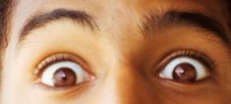
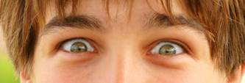

Surprised or indifferent?
Angry or pleased?
Calm or fearful?
Notes:
Answers: surprised, angry, fearful

Slide 3
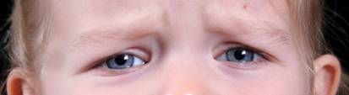
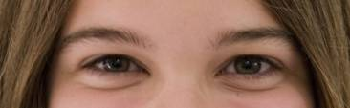

Cheerful or sad?
Happy or sad?
Disgusted or delighted?
Notes:
Answers: sad, happy, disgusted

Slide 4

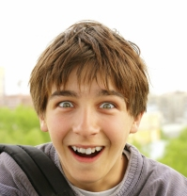


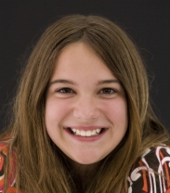

Surprised
Angry
Fearful
Sad
Happy
Disgusted

Slide 5
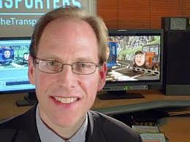
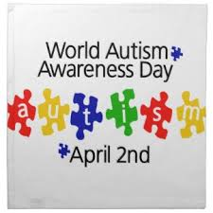
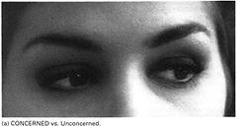
Baron Cohen et al (1997) – Another Advanced Test of Theory of Mind
How could you test for Theory of Mind (TOM) in adults with autism & Asperger syndrome & what might be the issues?

Slide 6
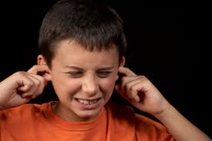
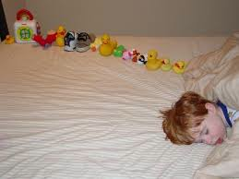
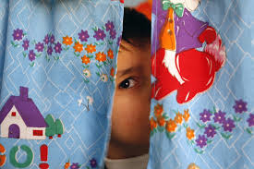
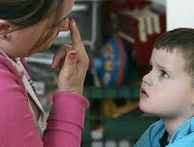
Baron Cohen et al (1997) – Another Advanced Test of Theory of Mind
What do you know about
autism?
THINK-PAIR-SHARE (in your group, 1 - 3)
https://www.youtube.com/watch?feature=player_embedded&v=ejpWWP1HNGQ
http://socialintelligence.labinthewild.org/mite/#

Slide 7

Baron Cohen et al (1997)
Reading Minds: The eye task
Which word best describes what this person is thinking or feeling
Concerned or Unconcerned

Slide 8
Learning Objectives
To understand the 3 characteristics of autism
To analyse and evaluate Baron Cohen’s research
To justify why Baron Cohen’s study links with Freud’s in ‘Understanding Disorders’
Prep
Complete the Baron Cohen short answer questions. Make sure you are detailed, precise and concise.

Slide 9
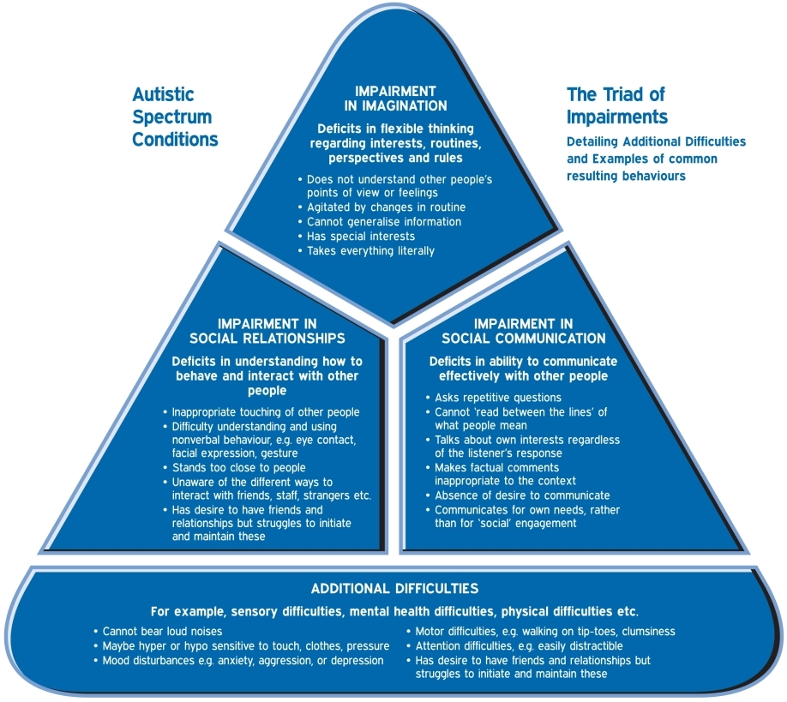
Understanding Disorders – what is Autism?
Notes:
The first part of the session is all about how to perfect the technique of referencing. We will cover how to “cite” other peoples work and will explain how to create a reference list or bibliography.
We will also cover the topic of plagiarism and how correct referencing will help you avoid this in your EPQ and in all other pieces of work you have to do.

Slide 10


Definitions of autism
Autism is a lifelong developmental disability that affects how a person communicates with, and relates to, other people. It also affects how they make sense of the world around them.
Autism spectrum disorder (ASD) is a condition that affects social interaction, communication, interests and behaviour. It includes Asperger syndrome and autism.

Slide 11
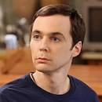


What we now understand by the term autism
Autism affects how a person communicates with, and relates to other people, and how people make sense of the world around them
No one knows exactly what causes autism , but the core idea is that the brain of someone with autism functions differently, receiving and processing information in a different way (Forrester-Jones, 2014)
Autism is a spectrum condition which means there are lots of different ways that autism can affect individuals.

Slide 12

What we now understand by the term autism
Autism manifests in many different ways. Everyone is unique with their own abilities, talents, challenges and symptoms.

Slide 13

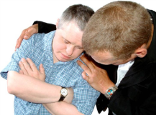
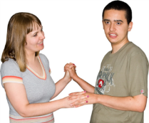
What we now understand by the term autism
In the general population, many people have co-morbidities (i.e. more than one health condition at any one time)
People with autism are the same, and can have other conditions too, such as a learning disability, mental health challenges, OCD, ADHD and Dyspraxia.

Slide 14


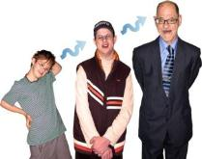
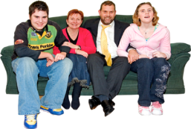
What we now understand by the term autism
The amount of support therefore, that
individual’s may require can vary from
constant to occasional
Autism is a lifelong, developmental condition that affects the brain and it’s functions
Autism not only affects the person but the people around them like their family, friends and carers.
Support Lifelong Condition Family/Friends/Carers

Slide 15

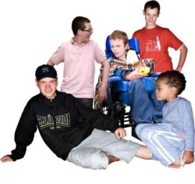
What we know about autism: Facts and Figures
Autism affects about 700,000 people in the United Kingdom, which equates to 1:100 of the population (National Autistic Society, 2014).
The number of children known to have autism has increased dramatically since the 1980’s due to changes in diagnostic practice, yet many people still remain undiagnosed and without support
It is estimated that at least 4 times more males
than females are diagnosed with autism,
and around a third of people with a
learning disability may also have autism.
Notes:
Image of UK map.

Slide 16
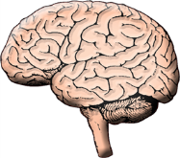
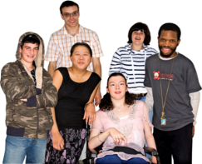


What we know about autism: Facts and figures
Autism affects communication. The brain
sees things differently, and it works differently
The cause of autism is not known and there
is no cure
Autism can affect anyone, anywhere in the world. All people with autism share a difficulty making sense of the world
Autism affects all and does not discriminate across sex, ethnic origin, country or class.

Slide 17
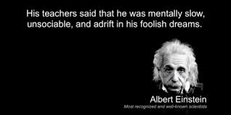
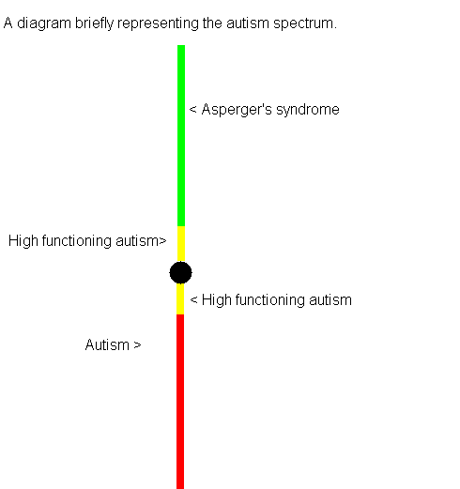


Slide 18
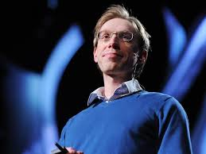
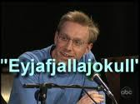

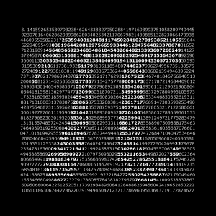
Daniel Tammet
https://www.youtube.com/watch?v=vZniLc6HuNQ

Slide 19
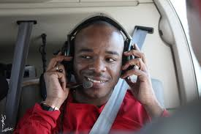
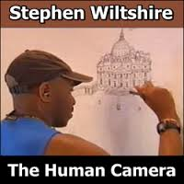
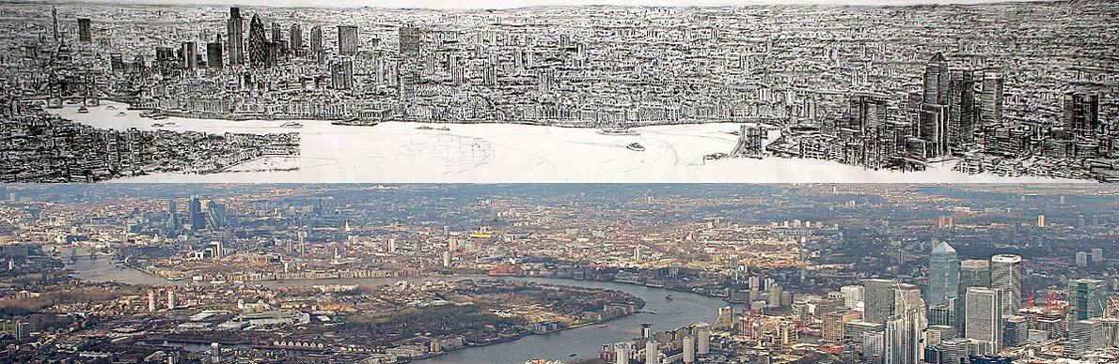
https://www.youtube.com/watch?v=bsJbApZ5GF0

Slide 20
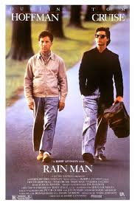
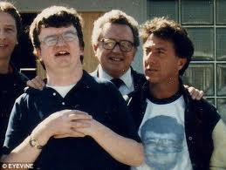
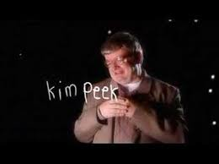
Memorised 12,000 books.
Could read two pages at a time using one eye for each page.
Could recall 98% of everything that he ever experienced in perfect detail.

Slide 21
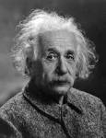
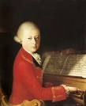

People from the past with suspected autism:
Albert Einstein – He had an obsession with physics (his interest). Albert Einstein also had a lack of social empathy and a lack of tact
Mozart – Repeated facial expressions and constant movement of his hands. Mozart also had very sensitive hearing
Isaac Newton – Not good at making or keeping friends. Isaac relied constantly on routines, also he used to forget to eat. He was also not interested in people.

Slide 22
People with suspected autism:
Fictional television character from ‘The Big Bang Theory’
Theoretical Physicist:
Dr Sheldon Lee Cooper B.S., M.S., M.A., Ph.D., Sc.D.
Capacity to remember complex information and solve mathematical problems
Photographic memory
Doesn’t like hugs or physical contact

Slide 23

People with suspected autism:
Fiercely guarding his spot on the couch or
Strict routines about what he eats on each day and having particular pajamas for each night of the week
Doesn’t like change and struggles to adapt
Sheldon struggles to pick up sarcasm in conversation and most non-verbal cues.

Slide 24

Characteristics of autism
People with autism generally experience three main areas of difficulty:
Social Communication,
Social Interaction and,
Social Imagination.

Slide 25



1. Social Communication
Social communication is where people with autism have difficulties understanding:
Facial expressions
Tone of voice
Common gestures
Eye contact
Body language and,
Giving and receiving verbal and
non-verbal communication.

Slide 26



2. Social Interaction
Social interaction is where people with autism struggle with:
Understanding their own and other people’s feelings and emotions
Forming relationships and making friends.
People can appear aloof, indifferent and withdrawn.

Slide 27

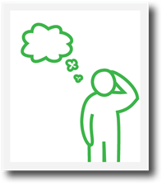

3. Social Imagination
Social imagination is where people with autism have difficulties comprehending:
Abstract concepts and ideas
People’s actions, emotions,
behaviours and consequences
Solutions to life outside of their routines.

Slide 28
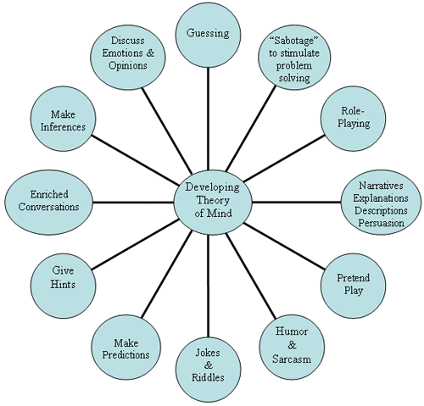
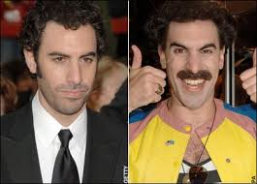
What is a Theory of Mind?
“Developing a theory of mind allows the child to begin to understand other people & to predict what other people are likely to do & believe”.
Baron-Cohen, 1997
Professor of Developmental Psychopathology at the University of Cambridge

Slide 29
What is a Theory of Mind?
ToM = other people have thoughts and feelings

Slide 30

Baron Cohen Reading Minds
The eye task
Advanced test for theory of mind in adults with Autism
Discussion:
Why ‘minds’ can only ever be a theory!
Are these two people happy or sad?

Slide 31
Baron Cohen Reading Minds
The eye task
Research Question: Why do adults with autistic spectrum disorders have problems with social relationships
The hypothesis:
Adults with high functioning autism can’t interpret states of mind from ‘reading eyes’

Slide 32
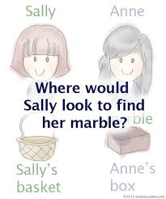
Baron-Cohen, Leslie and Frith (1985)
The Sally-Anne Test - The child with autism's inability to employ a theory of mind.
How does this test work & what is it exactly testing?
https://www.youtube.com/watch?v=QjkTQtggLH4&feature=player_embedded

Slide 33
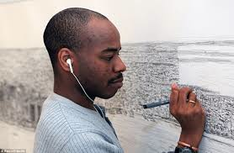
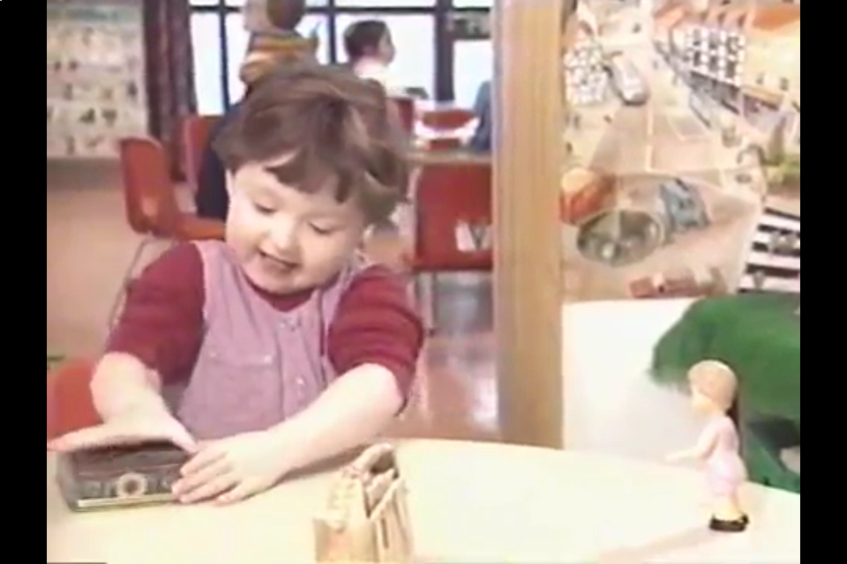
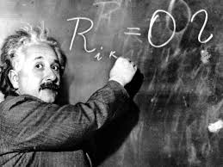
The Sally-Anne Test
The Sally-Anne was for children (up to a mental age of 6). But what about high functioning adults with autism?

Slide 34
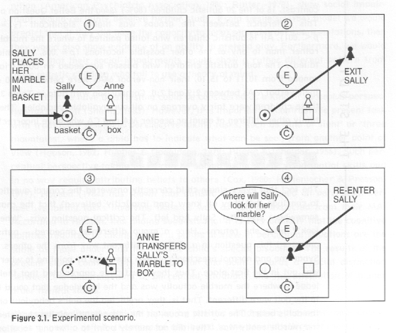
The Sally-Anne Test

Slide 35
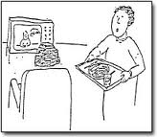
Task 2 - Strange Stories Task (Happe, 1994)
Read the following:
Ann's mother has spent a long time cooking Ann's favourite meal: fish and chips. But when she brings it in, Ann is watching TV, and she doesn't even look up or say thank you. Ann's mother is cross and says ‘Well that's very nice, isn't it! That's what I call politeness!’
Question 1 - Is it true what Ann's mother says?
Question 2 - Why does Ann's mother say this?
Question 3 – Is any irony experienced?

Slide 36
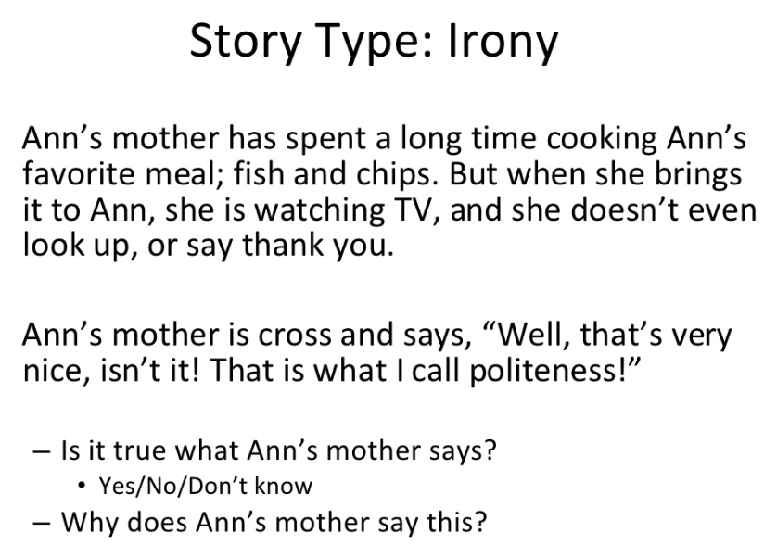
Happe’s Strange Stories

Slide 37
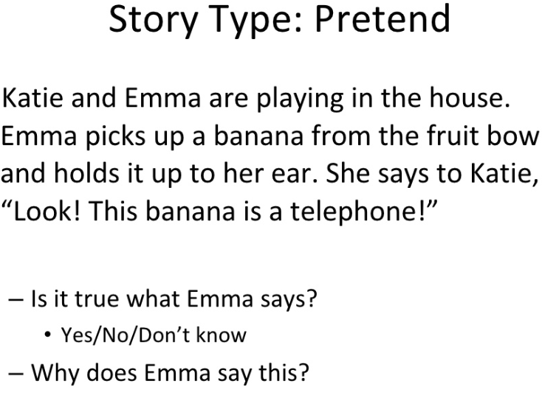
Happe’s Strange Stories

Slide 38
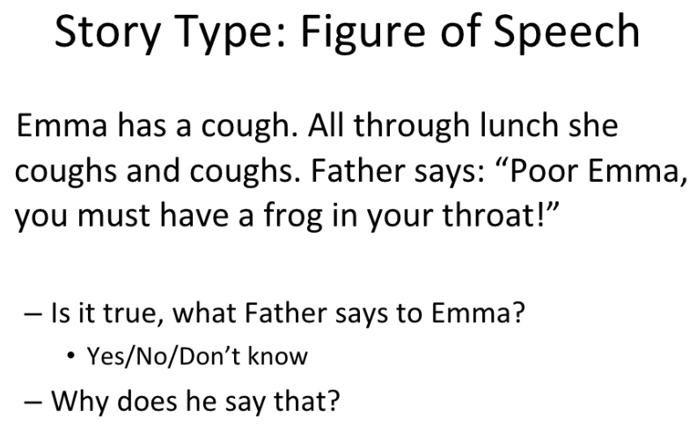
Happe’s Strange Stories

Slide 39
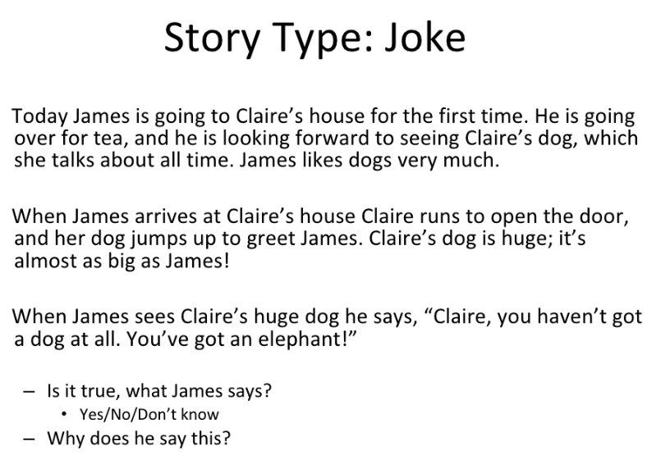
Happe’s Strange Stories

Slide 40
Happe’s Strange Stories

Slide 41
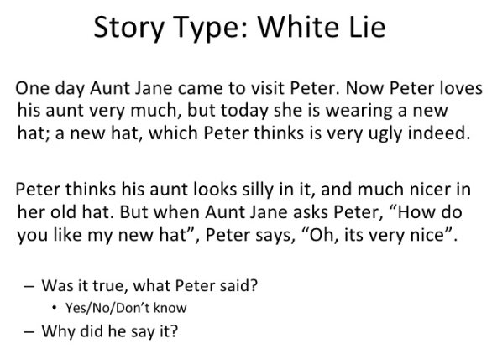
Happe’s Strange Stories

Slide 42
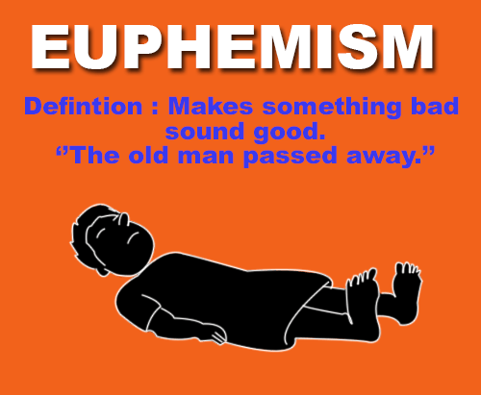

How do these assess a theory of mind?

Slide 43


How do these assess a theory of mind?

Slide 44



How do these assess a theory of mind?

Slide 45


Tests for Theory of Mind
Write a new ‘strange story’ which could be used with children. [4]
OR
Write the method of a new Sally Anne text which could be used with children. [4]
https://www.youtube.com/watch?v=8hLubgpY2_w

Slide 46
Tests for Theory of Mind
Electra was in a bar on her own and she was upset. Sebastian asked her, ‘Why are you so blue?’
Is it true what Sebastian asks about Electra? Y/N/Don’t know
Why does he say this?
Saj and Sasha
https://www.youtube.com/watch?v=8hLubgpY2_w

Slide 47
Tests for Theory of Mind
Anna’s Granny goes to the bathroom and tells her she is going to ‘spend a penny’.
Is it true what Anna’s Granny says? Y/N/Don’t know
Why does she say this?
Georgie, Tara, Myles?
https://www.youtube.com/watch?v=8hLubgpY2_w

Slide 48
Tests for Theory of Mind
Liam has a satchel with a packet of crisps in it, Prithvi has a shopping bag. Liam left the room. Prithvi took the crisps out of Liam’s satchel and put them in his shopping bag.
When Liam returns, where will be look for the packet of crisps?
Emmanuel

Slide 49
Tests for Theory of Mind
Fred wants to have a slice of toast, so he puts a slice of bread into the toaster and turns the toaster on. He then leaves the room.
Naughty Bob takes the slice of bread out of the toaster and hides it under his plate.
Fred returns. Where will he think the slice of bread is?
Tanishq

Slide 50
Tests for Theory of Mind
Molly was in a Maths lesson, revising for her GCSE. She looks depressed. Her friend walks past and says: ‘You look happy!’
1. Is it true, what Molly’s friend says? Yes/ No/ Don’t know
2. Why does she say that?
Vici and Emma

Slide 51
Tests for Theory of Mind
Sophie and her family are planning to go on a picnic. However just as they are about to leave the weather gets worse and it starts to rain. Sophie’s dad says, “We can’t go, it’s raining cats and dogs!”
1. Is it true, what Sophie’s dad says?
Yes/ No/ Don’t know
2. Why does he say that?
Hannah

Slide 52

Devise your own study
Design an ethical study to show how people with autism will generally experience difficulty in one of the three main areas: Social Communication, Social Interaction and Social Imagination. [15]

Slide 53
Devise your own study
For each bullet point:
Name the Feature (from each of the bullet points)
Explain it (how you would be doing this – enough for replication)
in context (using the unique words of the story)
Justified (why it is right to do here)
referring to Own research (to show a similarity)

Slide 54
Devise your own study
My study will be a lab experiment, because this allows control over EV and can show cause and effect. With my own research doing ‘Kim’s Game’, doing an experiment helped to show that memory is improved by repetition and story-telling.
Feature #1
Justified #1
Own Research #1

Slide 55
Devise your own study
My study will be a natural experiment, using the Smarties tube and pencils to show that people with autism lack understanding of other people’s view, because this allows control over EV and can show cause and effect. With my own research doing ‘Kim’s Game’, doing an experiment helped to show that memory is improved by repetition and story-telling.
Feature #1
Explained #1
Context #1
Justified #1
Own Research #1

Slide 56

Aim: Why a new test?
Sally-Anne test identifies autism in CHILDREN
Adults with Autism can pass it
(they apply logic and experience, rather than trying to “get into Sally’s head”)
CEILING EFFECT → test stops being useful when participants reach a certain level of ability
Need a new test for adults
A ceiling effect is when a task is so easy that all or most of the respondents achieve maximum marks.

Slide 57
Procedure
Method: Natural / Quasi experiment
3 groups of participants
IV = Normal, Autism, Tourette’s syndrome
DV = performance on eye task (maximum score = 25)

Slide 58
Past Paper and Exam Style Questions: January 2013 (section A)
Explain the term quasi experiment in relation to this study. [4]
Experiment in any location
IV occurs naturally
Baron Cohen’s is a quasi experiment because the IV occurred naturally
Whether people were normal, had Tourette's or had autism
Page 11

Slide 59
Past Paper and Exam Style Questions: Paper 1 section 2
Write a directional hypothesis for this study. [3]
ONE DIRECTION – BETTER / WORSE
Why are there 3 marks?

Slide 60
Past Paper and Exam Style Questions: Paper 1 section 2
1 mark for providing the correct type of hypothesis
1 mark for the IV correctly operationalised
1 mark for the DV correctly operationalised
H₁ = higher / lower; H₂ = different; H₀ = no difference / effect)
People with autism will have a ….performance than people with Tourettes / normal people
performance on the Eyes task (score out of 25)

Slide 61
Mark this answer
People with autism will have a lower performance on the Eyes task
IV not fully operationalised
Correct type of hypothesis
DV not fully operationalised

Slide 62
Past Paper and Exam Style Questions: Paper 1 section 2
People with autism will have a lower performance than people with Tourettes / normal people on the Eyes task (score out of 25)
Correct type of hypothesis
IV fully operationalised
DV fully operationalised

Slide 63

What were the 4 tasks used in Baron Cohen’s Procedure?
The Eyes Task
Strange Stories Task
(control tasks)
3) Gender Recognition Task
4) Basic Emotion Recognition Task
Consider these whilst reading the full study
https://www.youtube.com/watch?v=7s6kQdyyxOE&feature=youtu.be

Slide 64

Control tasks
Basic emotion recognition task
= looking at whole faces and judging emotions
Gender recognition task
= looking at two sets of eyes and identifying gender
On the two control tasks, there were no differences between the groups.
Notes:
(a) Gender Recognition Task: this involved looking at the same sets of eyes in the experimental task, but this time identifying the gender of person in each photograph.
This is a social judgment without involving mind reading, and allowed us to check if any deficits on the Eyes task could be attributed to general deficits in face perception, perceptual discrimination, or social perception.
This naturally had a maximum score of 25.
(b) Basic Emotion Recognition Task: (Emotion Task): this involved judging
photographs of whole faces displaying the basic emotions. This was to check whether any deficits on the Eyes task could be attributed to a deficit in basic emotion expression recognition.
Six faces were used, testing the following basic emotions: happy, sad, angry, afraid, disgust, and surprise. The basic emotion recognition task gives information from the whole face, whereas the Eyes task only had information from the eyes alone.
The fact that there are no difference between the groups shows that there are no deficits in emotion perception.

Slide 66



Slide 67
Baron Cohen et al (1997)
Reading Minds
The eye task
Participants
16 with autism 13 male 3 female
50 normal, 25 male, 25 female
10 Tourette’s patients, 8 male, 2 female
matched on age & normal intelligence
Note: The 2 clinical groups had passed
1st order ToM tests at 6 year old level

Slide 68
Why did Baron-Cohen use participants with Tourette’s Syndrome?
Tourettes participants were used as Tourette’s Syndrome and autism are similar and using both would control some of the extraneous variables.
Both Tourette’s Syndrome and autism participants:
  had normal intelligence
  suffered with disorder from childhood
  had disorders that disrupted schooling and peer relations
  had disorders supposed to originate in frontal lobe abnormalities.
Participants in both clinical groups had passed Theory of Mind tests based on 6-year-old Theory of mind skills.
https://www.youtube.com/watch?v=XqdTS9hOi_8
Notes:
The two conditions are very similar in onset, effect, and so on.
There was some Theory of Mind in both groups, but tested using a basic child’s test.

Slide 69
Was the sample representative of all people with Autism? How does this affect the conclusions that can be drawn?
Group 1
16 participants with high functioning autism or Asperger syndrome
13M & 3F
Age range 18-49 years
All of normal intelligence
Recruited using an advert in the National Autistic Society magazine as well as through clinics
Group 2
50 normal (age-matched) adults
25M & 25F
Age range 18-48 years
Selected from general population of Cambridge (no students)
No history of any psychiatric condition & assumed to have normal IQ
Group 3
10 participants (age-matched) with Tourette's syndrome
8M & 2F (mirroring the sex ratio of group 1)
Age range 18-47 years
Recruited from a referral centre in London
Normal IQ

Slide 70
Past Paper and Exam Style Questions: Paper 2 section A (May 2012
Outline two of the ways the participants were tested. [4]
Page 11

Slide 71
Procedure
The ‘eyes task’ procedure:
25 photos of eyes
each 15 x 10cm black and white
each photo shown for 3 seconds
forced choice question
tested individually in quiet room

Slide 72
Procedure
Forced choice ‘eye task’ questions
Examples
Target Foil
attraction worried
friendly hostile
calm anxious
The target is the correct answer presented randomised both left and right

Slide 73
Procedure
How was the ‘eye task’ created
Magazine photos selected
4 judges generated the target words
Target Foil
calm anxious
The target is the correct answer the FOIL is the opposite

Slide 74
Procedure
Control in generating targets & foils (increases its internal validity)
Eye photos shown to panel of 8 adults who did not know there was a ‘right or wrong’ answer there was 100% agreement with target (inter-rater reliability)

Slide 75
Creating the Eyes Task: Paired work
Hunt for a picture of a person’s face showing the 1 of the 6 universal emotions: disgust, sadness, happiness, fear, anger, surprise.
Crop this to just the eyes, removing hair, nose, etc. Stick this down on the page.
As a pair agree on which emotion the eyes are showing (the target word).
Add in a ‘foil’ word – usually the opposite of the emotion you have identified

Slide 76
Eyes task and strange stories task:
All groups completed the eyes task
Only groups 1 and 3 the strange stories
Why do you think this would be?

Slide 77
Eyes task and strange stories task:
All groups completed the eyes task
Only groups 1 and 3 the strange stories
Why do you think this would be?
It demonstrates validity of the eyes task as a test for TOM.
If a valid test then the performance of the eyes task should correlate with the performance of the strange stories task (concurrent validity)

Slide 78
Eyes task and strange stories task:
Give another example of some things that show concurrent validity
https://www.questionwritertracker.com/quiz/61/Z4MK3TKB.html
http://socialintelligence.labinthewild.org/mite/

Slide 79
Eyes task:
Imagine you had to explain to a friend what Theory of Mind is. As a pair write a definition for this term.

Slide 80
Results
Findings:

Slide 81
Results
Are females better at reading minds from eyes than males ?

Slide 82
Results
Were these differences significant (above the level of chance)?
At a significance level of p =< 0.0001 Normal and Tourette’s better than Autistic
At a significance level of p =< 0.0001 Normal females better than males

Slide 83

Results

Slide 84
Conclusion
Conclusion:
Evidence for subtle ‘mindreading’ deficits in intelligent adults on the Autistic spectrum
The eye task is a ‘pure theory of mind test’ because there is no context

Slide 85


Multiple Choice Test

Slide 86
D
F
C
C
A
A
A
C
D
A
A
D
C
D
A
C
A
B
Multiple Choice Test
D
F
C
C
A
A
B/D
C
D
A
A
D
C
D
A
C
A
B

Slide 87

Baron Cohen et al (1997)
Reading Minds: The eye task

Slide 88
Identify the IV and the DV in the Eyes task. [2]
Outline one conclusion from the Eyes task. [2]
Describe two of the groups used in Baron Cohen’s study. [4]
Outline the procedure of the Eyes task. [4]
Identify one difference between the performance of the autism group and the Tourette group. [1]

Slide 89
Identify the IV and the DV in the Eyes task. [2]
Outline one conclusion from the Eyes task. [2]
Describe two of the groups used in Baron Cohen’s study. [4]
Outline the procedure of the Eyes task. [4]
Identify one difference between the performance of the autism group and the Tourette group. [1]
Explain why is meant by the ‘ceiling effect’. [2]
Did Baron Cohen’s Eyes task have a ceiling effect? Explain your answer. [3]
Outline one conclusion which can be drawn from Baron Cohen’s study. [4]
Explain two reasons why the Eyes task lacks validity. [4]
Identify one difference between the performance of the autism group and the Tourette group. [1]
Identify one target and one foil word used in the Eyes task. [2]

Slide 90
Identify the IV and the DV in the Eyes task. [2]
Outline one conclusion from the Eyes task. [2]
Describe two of the groups used in Baron Cohen’s study. [4]
Outline the procedure of the Eyes task. [4]
Identify one difference between the performance of the autism group and the Tourette group. [1]
Explain why is meant by the ‘ceiling effect’. [2]
Did Baron Cohen’s Eyes task have a ceiling effect? Explain your answer. [3]
Outline one conclusion which can be drawn from Baron Cohen’s study. [4]
Explain two reasons why the Eyes task lacks validity. [4]
Identify one difference between the performance of the autism group and the Tourette group. [1]
Identify one target and one foil word used in the Eyes task. [2]
Explain how the Eyes task was standardised to ensure reliability. [2]
Describe one of the control tasks used in Baron Cohen’s study. [2]
Identify the two control groups used in Baron Cohen’s study. [2]
Explain why the two control groups used in Baron Cohen’s study. [3]
Explain how Theory of Mind was operationalised in Baron Cohen’s study. [2]

Slide 91
Eyes task Evaluation:
In your groups evaluate the task
Some points to consider:
Does it actually test TOM?
What type of data is being collected? What are the strengths and weaknesses of this?
Is the task ecologically valid? If not what are the strengths and weaknesses of investigating in a way that is not representative of everyday situations?
How would you change this task? How might this affect the outcome and conclusions of study?

Slide 92
Evaluation:
Is the way the experiment measures
the DV (Theory of Mind)
and the experimental setting
and the sample of participants
realistic in a real life setting? Would the same Ps behave in the same way in real life?
Discuss: why or why not?

Slide 93
Eyes task Evaluation:
Quantitative = matters of fact objective, scientific & replicable
Useful for analysis & comparison
or:
Qualitative = matters of opinion
Subjective, rich in detail, can be hard to analyse, may be misinterpreted

Slide 94
Eyes task Evaluation:
Was the method appropriate for the aim?
Are the experimental conditions realistic (mundane realism = real world realism)
How was the DV operationalised and was this a valid measure of the behaviour being studied?

Slide 95
Eyes task Evaluation:
How were the participants allocated to the conditions and were controls used to remove ‘extraneous variables’?
Were there any cues that might have generated demand characteristics ?
Reliability: Could the study be replicated to find the same results? Why or why not?

Slide 96
Eyes task Evaluation:
Who were the participants
Was the sample biased in any way?
Was the sample large enough to mask the effect of individual differences?
To which population can we safely generalise the findings?

Slide 97

Final thoughts…
Ask the Expert
If you could ask Baron-Cohen one question about his work what would it be?
Do you think this study is useful?
What one thing do you want to know about autism?
Why is this in the Individual Differences area?
What could be the cause of autism and should we try and cure it?

Slide 98
Comparing Freud and Baron-Cohen
Learning Objectives
To evaluate Baron Cohen’s study
To identify the differences and similarities between Freud and Baron Cohen’s studies in terms of Validity, psychology as a science, usefulness, socially sensitive research, ethics.
To justify the strengths of the Individual Differences Approach

Slide 99


Evaluating Baron-Cohen
Page 23
https://www.classtools.net/random-name-picker/84_dXGjSh

Slide 100



Evaluating Baron-Cohen
https://www.classtools.net/random-name-picker/84_dXGjSh
Create an acrostic of key words for Baron-Cohen and Autism

Slide 101

Matching Pairs
Page 26
The 20 Core Studies are placed into pairs with a key theme (#).
One is a classic study (like Freud) and the other is a contemporary study (like Baron Cohen).

Slide 102

Questions you can pre - prepare
How are you preparing for your mocks?

Slide 103

Classic + Contemporary = key theme
Key theme = Intelligent
Classic (Teacher)
Contemporary (Student)

Slide 104
Classic + Contemporary = key theme
Key theme = Kind
Classic (Teacher)
Contemporary (Student)

Slide 105
Classic + Contemporary = key theme
Key theme = Sporty
Classic (Teacher)
Contemporary (Student)

Slide 106
Classic + Contemporary = key theme
Key theme = well read
Classic (Teacher)
Contemporary (Student)

Slide 107
Classic + Contemporary = key theme
Key theme = creative
Classic (Teacher)
Contemporary (Student)

Slide 108
Classic + Contemporary = key theme
Key theme = leader
Classic (Teacher)
Contemporary (Student)

Slide 109
Classic + Contemporary = key theme
Key theme = leader
Classic (Teacher)
Contemporary (Student)

Slide 110

Placing Baron-Cohen in the Individual Differences Area

Slide 111

Relating the Core Study to the Theme
Understanding disorders
Helps us know that people without a ToM will have difficulty in reading emotions from the eyes
Investigated the theory of mind in high-functioning adults with autism.

Slide 112
Relating Baron-Cohen to the Theme: Understanding Disorders
The theme for Freud and Baron-Cohen’s studies are ‘understanding disorders’.
Both studies help us to understand a specific disorder and how people with a specific disorder will behave and how they may be treated.

Slide 113

Classwork practice
Page 26

Slide 114

Linking / Relating a study to an area
2 bits of knowledge to show:
The Area / perspective
The Core Study

Slide 115
Linking / Relating a study to an area
Why is Ms Gratton HSM of Paulls?
Why is Mr Kirsten AHSM of Kennedy’s?
Why is Mrs Evagora tutor for Griffin?

Slide 116
Linking / Relating a study to an area
Clarity on the Principles
Brain
Stages
Thinking
Personality
Computer analogy

Slide 117
Linking / Relating a study to an area
Clarity on the study
Aims
Findings
Conclusions

Slide 118
Loftus
& Palmer
Simons
& Chabris
Grant
Moray
Levine
Bandura
Piliavin
SPIN!
Chaney
Bocchiaro
Kohlberg
Milgram
Lee
Hancock
Sperry
Gould
Casey
Freud
Maguire
Baron
Cohen
Blakemore
&
Cooper

Slide 119
Classwork practice
Page 26

Slide 120
Classwork practice
Page 26
Individual differences because it explains why people differ and are unique, such as having Autism due to differences in people's Theory of Mind.

Slide 121

Comparing Freud and Baron-Cohen

Slide 122
Comparing Freud and Baron-Cohen
Control – 3 groups
Independent measures
Inter-rater reliability – Eyes task and the other tests
Natural experiment
Opportunity sample – ‘normal’ group only
Ordinal / Interval data
Primary Data
Quantitative Data
Replicable
Right to withdraw
Scientific
Snapshot
Useful for intervention
Confidentiality
Debrief
Informed consent
Self-selecting sample:
Freud = through parents
Baron Cohen = Autism and Tourettes
Case study
Ecological Validity
Longitudinal
Nominal data
Qualitative Data
Secondary Data
Unscientific
Useful for therapy

Slide 123

Comparison Questions: Similarities and Differences
You can be asked to compare
Research methodologies
Pairs of study
Areas and perspectives
Debates
Explanations and treatments of mental health

Slide 124



Comparison Questions: Similarities and Differences
Similarity / difference is identified
Discussed / elaborated
and supported by evidence from one side
and supported by evidence from the other side.

Slide 125
Comparison Questions: Similarities and Differences
Dog
Barks
Needs a lot of looking after
Don’t clean themselves
Cats
Meow
Needs less looking after
Clean themselves
Mammals
Pets
4 legs
Fur
Tails

Slide 126
Comparison Questions: Similarities and Differences
Dog
Barks
Cats
Meow
Explain one difference between cats and dogs. [4]
Dogs bark whereas cat meow. (only achieved 2 marks)

Slide 127
Explain one difference between cats and dogs. [4]
Needs a lot of looking after
Needs less looking after
Point of comparison
A difference between cats and dogs is their voice [1] and how they communicate [1] Dogs bark to each other and to humans[1] whereas cats meow, but this is only dirrectioned to humans[1]
Elaboration
Evidence #1
Evidence #2

Slide 128
Explain one difference between cats and dogs. [4]
Needs a lot of looking after
Needs less looking after
A difference between cats and dogs is their level of dependency [1] on their owners to care for them [1] Dogs need a lot of looking after [1] whereas cats are more independent [1]
Point of comparison
Elaboration
Evidence #1
Evidence #2

Slide 129
Individual Differences – comparing Freud and Baron Cohen
Explain HOW Freud and Baron Cohen are similar / different [8]:
Validity
Psychology as a science
Reliability
Free will vs determinism
longitudinal vs snapshot.

Slide 130

Freud and Baron Cohen are different in terms of validity. [1]
Freud’s work is lacks population validity because he worked only with 1 person in the 1900s, [2]
Whereas Baron Cohen’s work has better temporal validity because he was working in the 1990’s with a number of people with autism [3]

Slide 131

Freud and Baron Cohen are similar in terms of usefulness. [1]
Freud’s work is useful because it generates a way to treat people with phobias through psychoanalysis [2]
And Baron Cohen’s work helps to train people with autism in knowing HOW to read emotions from the eyes [3]

Slide 132
Classwork practice
Page 26

Slide 133

How does the study change our understanding?
Change our understanding

Slide 134

How does the study change our understanding?
Change our understanding
Of the Key theme
Of diversity

Slide 135
How does the study change our understanding?
To what extent does the contemporary study changes our understanding of the key theme. [3]
A comparative judgement
Lesser extent
Greater extent
More
Less

Slide 136
Comparing the 2 studies
To what extent does the contemporary study changes our understanding of the key theme. [3]
The 2nd / newer (right hand side) of the pair – e.g. Casey

Slide 137

Comparing the 2 studies
To what extent does the contemporary study changes our understanding of the key theme. [3]
Classic = Sperry
Contemporary is….

Slide 138
Comparing the 2 studies
To what extent does the contemporary study changes our understanding of the key theme. [3]
Classic = Bandura
Contemporary is….

Slide 139
Comparing the 2 studies
To what extent does the contemporary study changes our understanding of the key theme. [3]
Classic = Milgram
Contemporary is….

Slide 140
Comparing the 2 studies
To what extent does the contemporary study changes our understanding of the key theme. [3]
Classic = Freud
Contemporary is….

Slide 141
Comparing the 2 studies
To what extent does the contemporary study changes our understanding of the key theme. [3]
Classic = Loftus
Contemporary is….

Slide 142
Comparing the 2 studies
To what extent does the contemporary study changes our understanding of the key theme. [3]
From the 1st / older (left hand side) study of the pair – e.g. Sperry

Slide 143
Comparing the 2 studies
To what extent does the contemporary study changes our understanding of the key theme. [3]
Who comes before Casey?

Slide 144
Comparing the 2 studies
To what extent does the contemporary study changes our understanding of the key theme. [3]
Who comes before Maguire?

Slide 145
Comparing the 2 studies
To what extent does the contemporary study changes our understanding of the key theme. [3]
Who comes before Levine?

Slide 146
Comparing the 2 studies
To what extent does the contemporary study changes our understanding of the key theme. [3]
Who comes before Lee?

Slide 147
Comparing the 2 studies
To what extent does the contemporary study changes our understanding of the key theme. [3]
The phrase between the pair of studies.

Slide 148
Comparing the 2 studies
To what extent does the contemporary study changes our understanding of the key theme. [3]
Key theme for Sperry

Slide 149
Comparing the 2 studies
To what extent does the contemporary study changes our understanding of the key theme. [3]
Key theme for Freud

Slide 150
Comparing the 2 studies
To what extent does the contemporary study changes our understanding of the key theme. [3]
Key theme for Loftus

Slide 151
Comparing the 2 studies
To what extent does the contemporary study changes our understanding of the key theme. [3]
Key theme for Milgram

Slide 152

How does the study change our understanding?
How does the study change our understanding of diversity?

Slide 153
How does the study change our understanding?
How does the study change our understanding of diversity?

Slide 154
How does the study change our understanding?
What is individual diversity?

Slide 155
How does the study change our understanding?
What is social diversity?

Slide 156
How does the study change our understanding?
What is cultural diversity?

Slide 157
How does the study change our understanding of diversity?
Both studies develop an understanding of why behaviour may differ among people. Baron-Cohen - lack of ToM leads to changes in behaviour over a lifetime; Freud - why some experience phobias for a shorter period of time

Slide 158
How does the study change our understanding of diversity?
Baron Cohen’s study was carried out in the UK and suggests that autism can be explained in the same way (lack of ToM) across other cultures however, like Freud, this research only focused on one culture (Austria).

Slide 159
Classwork practice
Page 26

Slide 160

Individual Differences Area
Page 28
Case studies OR experiments
Primary OR secondary data
Debrief OR Protection from psychological harm
Opportunity OR Self-selected / snowball
Large OR Small
Inter-rater OR split half
Has OR Lacks ecological validity

Slide 161
Individual Differences Area
Case studies
Primary
Protection from psychological harm
Self-selected / snowball
Small – idiographic
Inter-rater
May lack ecological validity

Slide 162
Individual Differences Area
Case studies = Unique behaviour cannot be studied in lots of people at the same time.
Primary data = information about their unique behaviour usually comes straight from the person themselves
Protection from psychological harm = knowing that they have abnormality
Self-selected / snowball = it is rare to find people with abnormalities all in the same place at the same time
Small = idiographic because the behaviour studied is unique
Inter-rater = checking the diagnosis between different psychologists
May lack ecological validity = the tasks may not have mundane realism

Slide 163

Exit Question: What is your strategy to answer Paper 2 Section C Apply your knowledge questions?

Slide 164
Starter Task: Similarities and Differences
Difficulties with social communication
Autism
Tourettes
Difficulties with social imagination
Difficulties with social interaction
Tics
Frontal lobe of the brain
Anxiety disorder
Learning disability

Slide 165
How can Baron Cohen’s research be applied to real life?
Learning Objectives
AO1: Knowledge and understanding
to know the 5 key features of Baron Cohen’s study
AO2: Application of knowledge
Apply knowledge of BC’s study to individual scenario
AO3: Analysis and evaluation
Critique BC’s study, strengths and weaknesses of the interventions for autism.

Slide 166
How can Baron Cohen’s research be applied to real life?
When Stacey went over to her new friend Chelsea’s house, she met Chelsea’s four year-old brother, Shawn.
“Hi,” said Stacey, smiling. Shawn looked at her but didn’t say anything. Then he turned back to a toy he was holding.
Later, in Chelsea’s room, Stacey said, “I don’t think your brother likes me.”
“It’ not your fault,” said Chelsea. “It’s not that he doesn’t like you — Shawn has autism and it’s hard for him to talk sometimes. But I can show you how to play with him, if you want.”

Slide 167
How can Baron Cohen’s research be applied to real life?
Identify one psychological issue raised by the above source. Support your answer with evidence from the source. [3]
Outline psychological research and how it relates to the issue you have identified [6]
Explain how the situation could be managed by Chelsea and Shawn. [6]
Evaluate your suggestions in Q3. [10]

Slide 168

Identify one psychological issue raised by the above source. Support your answer with evidence from the source. [3]
WHAT is the issue?
Explain WHY it is an issue
Give a quote
Quotes from the source
Shawn has autism and it’s hard for him to talk sometimes
Shawn looked at her but didn’t say anything

Slide 169
How can Baron Cohen’s research be applied to real life?
Outline psychological research and how it relates to the issue you have identified [6]
Aim
Sample
Procedure
Results
Conclusion
Explain that a lack of ToM means it is difficult for individuals with autism to understand social situations and how to interact

Slide 170

Aim = to test whether adults with autism could mind read from the Eyes.
Sample = 16 with Autism, 50 normal, 10 Tourette’s.
The Eyes task test had 25 photos of eyes, asked which word (from a choice of 2) best describes what the person is thinking or feeling
Mean score for autism was the lowest (16.3 out of 25), Tourette’s was the highest score (20.4)
Conclusion = adults with autism have difficulties in their mind reading ability.
A lack of ToM means it is difficult for individuals with autism to understand social situations and how to interact, just like Shawn in this article.

Slide 171

How can Baron Cohen’s research be applied to real life?
Explain how the situation could be managed by Chelsea and Shawn. [6]
WHAT is the strategy
helping Shawn with his difficulties with social interaction and communication
Explain which TYPE of strategy it is
An intervention which could be used to help Shawn with his difficulties with social interaction and communication is for his sister to teach him emotions from the eyes and body language
Detail what will be done with this strategy

Slide 172


How can Baron Cohen’s research be applied to real life?
Chelsea could teach Shawn how to recognise emotions from a person’s face
E.g. Anger causes the eyebrows to drop
She could give him chance to practice his new knowledge on play-dates.
Then teach him how to emotions from basic body language
E.g. People mirror the body language of another when they feel a bond with them
Then show his understanding on another playdate.

Slide 173

How can Baron Cohen’s research be applied to real life?
Evaluate your suggestions in Q3. [10]
Mention at least 4 evaluation points
Such as: Practicality, cost, time, ethics
Explain each point
Referred to a debate, such as reductionism / holism.

Slide 174
How can Baron Cohen’s research be applied to real life?
My strategy is very practical as it just needs Chelsea to be doing the training with Shawn. This also makes it fairly cheap compared to 1-2-1 sessions with a psychologist. If it is cheaper, the intervention is more likely to occur

Slide 175

How can Baron Cohen’s research be applied to real life?
However, it is a reductionist strategy, reducing all aspects of his autism to being able to read emotions and body language, which is an issue because he may have difficulties with social imagination, which cannot just be treated with pictures. This will mean that whilst it will be a helpful strategy overall, Shawn’s autism will still cause problems for him socially.

Slide 176


How can Baron Cohen’s research be applied to real life?
Extra time = 29 minutes

Slide 177
Exit Question: What is your strategy to answer Paper 2 Section C Apply your knowledge questions?

Slide 178
Placing Baron-Cohen in the Individual Differences Area
Assumptions of the Individual Differences Approach
Individuals differ in their behaviour and personal qualities so not everyone can be considered ‘the average person’.
Every individual is genetically unique and this uniqueness is displayed through their behaviour. So everyone behaves differently.
All human characteristics can be measured from one person and quantified. The measures gained from one person are different to those gained from another.
All psychological characteristics are inherited and as everyone inherits different characteristics, everyone is different and unique.

Slide 179

Placing Baron-Cohen in the Individual Differences Area
On your whiteboard, summarise the assumptions of the Individual Differences approach

Slide 180
Placing Baron-Cohen in the Individual Differences Area
No-one is ‘average’
Everyone behaves differently
All characteristics can be measured
All psychological characteristics are inherited

Slide 181
Placing Baron-Cohen in the Individual Differences Area
On your whiteboard, show what you know about autism (Baron Cohen)

Slide 182
Placing Baron-Cohen in the Individual Differences Area
On your whiteboard, show what you know about phobias (Freud)

Slide 183
Individual Differences – comparing Freud and Baron Cohen
Explain HOW Sperry and Casey are similar / different [6]:
Freud and Baron Cohen are different in terms of Psychology being a science. [1]
Freud’s work is not scientific because …
Whereas Baron Cohen’s work is very scientific because …

Slide 184
Freud and Baron Cohen are different in terms of validity. [1]
Freud’s work is lacks population validity because he worked only with 1 person in the 1900s, [2] meaning it is not representative of all people with phobias. [3]
Whereas Baron Cohen’s work has better temporal validity because he was working in the 1990’s with a number of people with autism, [4] meaning it is more representative of people with autism nowadays [5] even though his sample size was very small. [6]

Slide 185
Comparison Questions: Similarities and Differences
Research methodologies
Explain one difference between random and volunteer sampling

Slide 186
Comparison Questions: Similarities and Differences
Pairs of studies
To what extent does Simons and Chabris’ study change our understanding of attention?
Explain one similarity between Moray’s study and Simons and Chabris’ study.

Slide 187
Comparison Questions: Similarities and Differences
Areas and Perspectives
Explain one similarity and one difference between the Developmental area and the Behaviourist perspective

Slide 188
Comparison Questions: Similarities and Differences
Debates
Explain how the determinism/freewill debate is similar and different to nature/nurture debate

Slide 189
Comparison Questions: Similarities and Differences
Explanations / Treatments for mental health
Explain one difference between one Medical Model treatment of mental illness and one alternative [4]
Explain one difference between the genetic and biochemical explanations of mental illness [4]

Slide 190
Explain one difference between time and event sampling. [4]
The difference between time and event sampling is length of time the observer observes for [1].
If it's the whole time or at intervals [1].
Event sampling looks for specific behaviour over the whole event being observed (this is seen in Ainsworth's study) then a note is made
whereas time sampling is where behaviour is observed at predetermined intervals such as every 10 minutes (this is seen in Bandura's study) [1].

